Slide 1
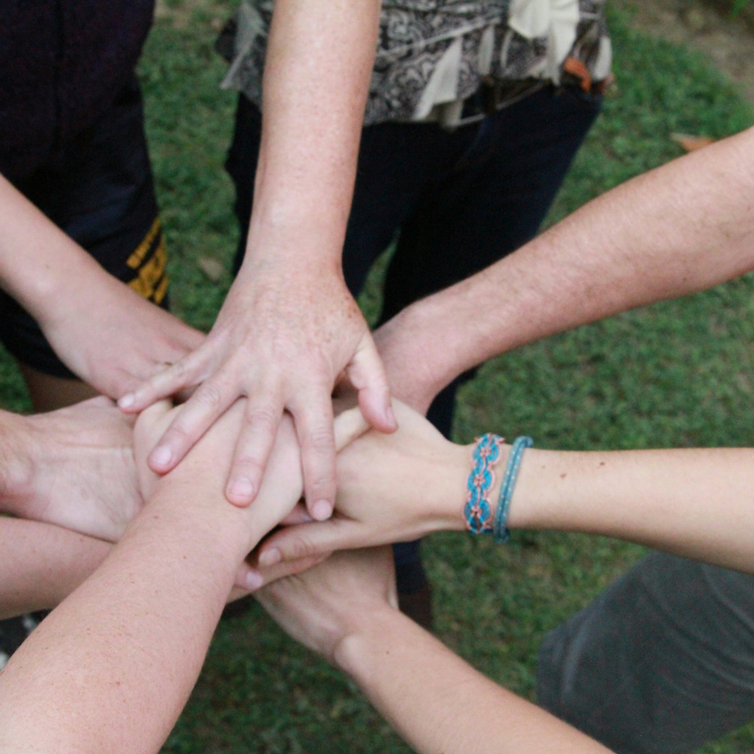
SMART Recovery USA National Conference 2026
When SMART
Meets Peer
Creating Synergy for Recovery and Growth
Evidence-based structure + authentic lived experience
Presenter: Rosette Felebrico-Singson
Notes:
Open with a brief self-introduction and orient the room to the purpose of the session. Frame the session around a practical question: what happens when structured SMART Recovery tools and authentic peer support are intentionally brought together?
Set the tone for a practical, implementation-focused conversation rather than a debate between models.
[Sources]
- User-provided conference presentation notes.
- Slide photo: Unsplash / Outward Bound Costa Rica, “a group of people putting their hands together” (Jan. 4, 2024), free under the Unsplash License.

Slide 2
Session focus:
What happens when SMART Recovery’s evidence-based structure and the relational strength of authentic peer support are intentionally combined?
SMART Recovery
Structure, language, and tools for intentional change.
Peer support
Trust, hope, and connection grounded in lived experience.
Not a choice between models
Synergy
Better engagement, deeper community connection, and stronger support for sustainable recovery growth.
A partnership that improves engagement
A path to empowerment, collaboration, and growth
The goal is synergy: each approach strengthens the other.
Notes:
This session is not about choosing one approach over the other. It is about understanding how both can operate in partnership to strengthen recovery outcomes, improve engagement, and deepen community connection.
Emphasize that structure and lived experience are complementary assets when they are used intentionally.

Slide 3
Learning outcomes:
Outcome 1
Identify where the SMART 4-Point Program and Family & Friends model can be integrated with authentic peer-based supports.
Outcome 2
Apply practical strategies that strengthen collaboration among facilitators, peers, and support networks in diverse settings.
Outcome 3
Describe how evidence-based tools plus lived experience can foster empowerment, connection, and long-term growth.
The session is designed to leave participants with strategies they can actually use.
Notes:
Walk participants through the session flow, then anchor the room in the three learning outcomes. Stress that the session is intentionally practical.
This is the operating framework for the conversation and for the activity later in the session.

Slide 4
Recovery is most effective when it is both structured and human.
Structured tools help people…
• build and maintain motivation
• cope with urges
• respond to thoughts and emotions
• move from reaction to intentional action
Human connection helps people…
• feel understood through lived experience
• find belonging and community
• believe change is possible
• reduce shame and isolation
Synergy, not duplication
SMART contributes practical skill-building; peer support contributes relational depth and hope.
Notes:
Many people benefit from practical tools that help them manage urges, respond to thoughts, regulate emotions, and build motivation. SMART Recovery provides that structure.
At the same time, people often need connection: someone who understands, a sense of belonging, and hope that change is possible. That is where peer support becomes powerful.
When these are combined well, each strengthens the other.

Slide 5
What SMART Recovery brings:
A structured, evidence-informed framework for self-management
1
2
3
4
Build and maintain motivation
Strengthen commitment to change over time.
Cope with urges
Use practical tools in moments of pressure.
Manage thoughts, feelings, and behaviors
Apply cognitive and behavioral strategies to real situations.
Live a balanced life
Support routine, purpose, wellbeing, and stability.
People need tools they can use in real situations.
SMART provides language, structure, and strategies that build self-management capacity.
Notes:
Highlight the four points of the SMART Recovery program at a high level. This is where the structured side of the model becomes very concrete.
The emphasis here is practical skill use, self-management, and intentional action.

Slide 6
What authentic peer support brings:
Credibility
Why it matters
Peers often help participants feel seen in a way that formal structure alone may not accomplish.
Key distinction
Peer support does not replace evidence-based tools. It increases engagement with them.
Relational
trust
Practical
hope
Lived
experience
Shared
understanding
Reduced
stigma
Peers help people move from “I am being told” to “I can relate.”
Notes:
Peer support contributes authentic lived experience, credibility, relational trust, practical hope, and a shared understanding of what recovery can feel like.
This does not replace evidence-based tools. It increases engagement with them by reducing distance and stigma.

Slide 7
Shared values create the foundation.
Empowerment
Self-direction
Respect
SMART Recovery
Peer support
Nonjudgment
Hope
Practical growth
Why integration works
These approaches are not in conflict. In many settings, they are naturally aligned around agency, forward movement, and collaborative change.
Notes:
SMART Recovery and peer support can look different on the surface, but they share important values: empowerment, self-direction, respect, nonjudgment, hope, and practical growth.
Both approaches reject the idea that people are passive recipients of help. Both support agency and forward movement.

Slide 8
What synergy looks like in practice:
The combined impact is greater than either approach on its own
SMART Recovery helps answer…
• What can I do differently?
• What skills can I use?
• How do I manage this challenge?
Peer support helps answer…
• Am I alone in this?
• Can recovery really happen?
• Can someone understand my experience without judgment?
Clarity + belonging
When these are integrated well, participants often experience both stability and engagement.
Notes:
Define synergy in practical terms: the combined impact is greater than either approach on its own.
SMART provides structure. Peer support provides connection. When those are intentionally paired, participants often experience both clarity and belonging — a highly stabilizing combination.

Slide 9
Integrating the SMART 4-Point Program with peer support:
SMART focus
Peer contribution
1. Motivation
Build and maintain commitment to change.
Model how motivation grows through ambivalence, setbacks, and recommitment.
2. Urges
Use strategies to respond effectively in moments of pressure.
Normalize the struggle and show how coping tools can work in real life.
Translate those tools into everyday, relatable situations.
3. Thoughts, feelings, behaviors
Apply structured cognitive and behavioral tools.
4. Balanced life
Examine routines, priorities, and lifestyle change.
Connect recovery to relationships, work, purpose, routine, and identity.
Peer support does not compete with the 4-Point Program; it makes it more accessible and believable.
Notes:
Walk through each point of the SMART 4-Point Program through a peer-support lens.
The emphasis is translation: peers help participants connect the structured tool to lived reality. That increases accessibility, relevance, and credibility.

Slide 10
Extending the model to Family & Friends:
Recovery affects whole systems, not only individuals.
Concern
Confusion, fatigue, worry, helplessness
SMART tools
Perspective, communication tools, healthier boundaries
Peer-informed support
Empathy, realism, validation, reduced over-functioning
Grounded response
Consistent, skill-based support instead of crisis reactivity
Family and support networks often benefit when empathy is paired with clearer boundaries and more grounded expectations.
Notes:
Recovery rarely affects only one person. Families, partners, and support networks are often carrying confusion, fatigue, worry, and sometimes helplessness.
SMART’s Family & Friends approach provides tools and perspective. Peer-informed support strengthens that by adding empathy, realism, encouragement toward healthy support, and validation for what families are carrying.

Slide 11
What authentic peer support looks like:
It is…
• grounded and purposeful
• recovery-oriented
• lived experience used in service of hope
• connection and mutual respect
• knowing when, how, and why to share
It is not…
• simply telling one’s story
• over-disclosure
• taking over the space
• positioning lived experience as superior to all other knowledge
Authentic peer support strengthens the room rather than shifting the room.
Notes:
Emphasize the word authentic. Authentic peer support is not simply storytelling, over-disclosure, or taking over the space.
It is grounded, purposeful, and recovery-oriented. It uses lived experience in service of hope, connection, and practical encouragement.

Slide 12
Practical strategies for collaboration:
01
Clarify roles
Facilitators, peer supporters, and support networks each need role clarity.
04
Protect authenticity
Do not over-script peer support; allow genuine connection with boundaries.
02
Use shared language
Reinforce empowerment, self-management, respect, and recovery growth.
05
Normalize multiple pathways
Some people connect first to structure, others first to relationship, many to both.
03
Pair tools with story
Introduce the tool, then connect it to a peer-informed example.
06
Build support beyond meetings
Strengthen community, support networks, and follow-through between sessions.
Operational goal: move integration from theory into daily practice.
Notes:
Use this slide to operationalize the model. These are concrete implementation moves that help collaboration work across settings.
The core message is that intentional integration requires role clarity, consistent language, and room for genuine peer connection.

Slide 13
Adapt across diverse recovery settings:
Correctional
settings
Outpatient
services
Community
recovery groups
Family support
spaces
Principles stay stable
Peer-led
environments
Hybrid recovery
communities
structure
respect
role clarity
inclusion
empowerment
practical application
Notes:
This model can be adapted across community recovery groups, correctional settings, outpatient services, family support spaces, peer-led environments, and hybrid recovery communities.
The implementation can vary by context, but the principles stay stable: structure, respect, role clarity, inclusion, empowerment, and practical application.

Slide 14
Participants do not only need information. They need translation.
Tool or concept
Relatable example
Reachable action
Without translation…
A worksheet alone may not create movement.
Without structure…
A story alone may not create skill.
With both together…
The pathway to change often becomes more reachable.
“Here is a tool” + “I have used something like this, and it can help.”
Notes:
In real practice, participants do not only need information. They often need translation — help turning concepts into action.
A worksheet alone may not create movement. A story alone may not create skill. But together, they bridge knowledge and lived reality.

Slide 15

Interactive discussion:
Where, in your own setting, is there the greatest opportunity to strengthen collaboration between SMART-based structure and peer-based support?
1. What currently works well?
2. Where is the gap between structure and connection?
3. What is one practical step that could strengthen collaboration?
Notes:
Open the room for discussion here. The prompt is where participants see the greatest opportunity in their own setting to strengthen collaboration between SMART-based structure and peer-based support.
Give the room about 7 to 8 minutes, then bring back a few examples and reinforce themes such as role clarity, lived experience, use of tools, family support, and sustainability.
[Sources]
- User-provided conference presentation notes.
- Slide photo: Unsplash / Vitaly Gariev, “Diverse group of people in a modern office meeting” (Sept. 24, 2025), free under the Unsplash License.

Slide 16
Key takeaways and closing reflection:
1. SMART Recovery provides strong tools
Practical, evidence-based support for self-management and recovery growth.
People do not have to choose between structure and human connection.
2. Authentic peer support deepens engagement
Lived credibility, trust, hope, and relational connection strengthen uptake.
When SMART meets peer in a thoughtful and authentic way, people gain both practical tools for change and relational confidence that change is possible. That combination can strengthen individual recovery and the recovery culture of the communities we serve.
3. Intentional integration builds sustainable support
The result can be stronger empowerment, better collaboration, and more durable recovery culture.
Thank you • Questions or reflections?
Notes:
Close with three core takeaways: SMART offers structured, evidence-based tools; authentic peer support brings lived credibility and connection; and intentional integration creates stronger, more sustainable recovery support.
End with a reflection that people do not need to choose between structure and human connection. Invite questions or a final round of reflections.

