Slide 1
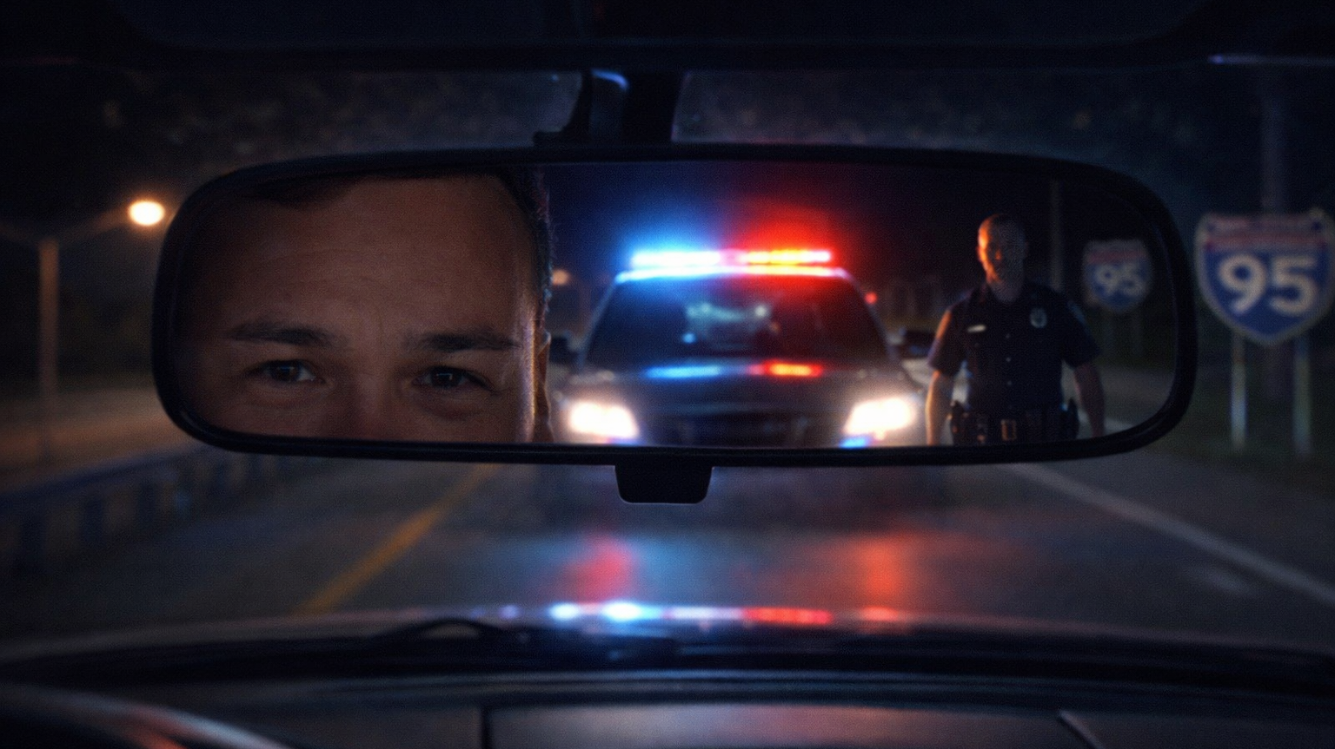

Slide 2
Recovery Without Conditions: Safety, Autonomy, and Overdose Prevention
Developed and Presented by:
Stephen Murray, MPH, NRP
Director, SafeSpot Overdose Hotline
Adjunct Clinical Assistant Professor, Boston University School of Public Health
Lieutenant, Northern Berkshire EMS (Retired)
Licensed Paramedic, Massachusetts

Slide 3
Disclaimer
The views expressed in this talk are my own, developed over years of lived experience with substance use and professional experience as a first responder and overdose program implementer. They do not necessarily represent the views of the organizations I am affiliated with (including Boston Medical Center and Boston University).

Slide 4
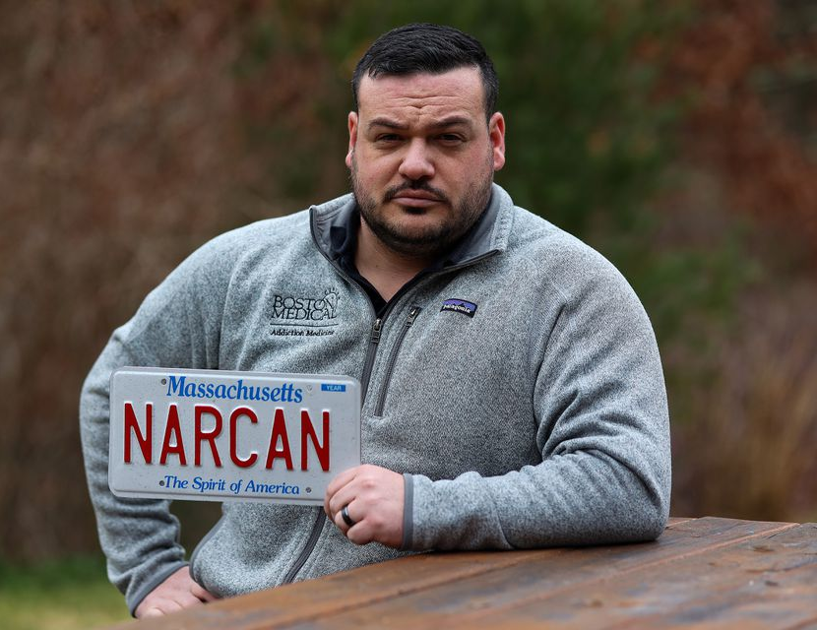
Disclosures
I have no financial disclosures or relationships with any ineligible companies
I do, however, have a vanity plate that I pay the fees for and do not receive any compensation from the manufacturer

Slide 5
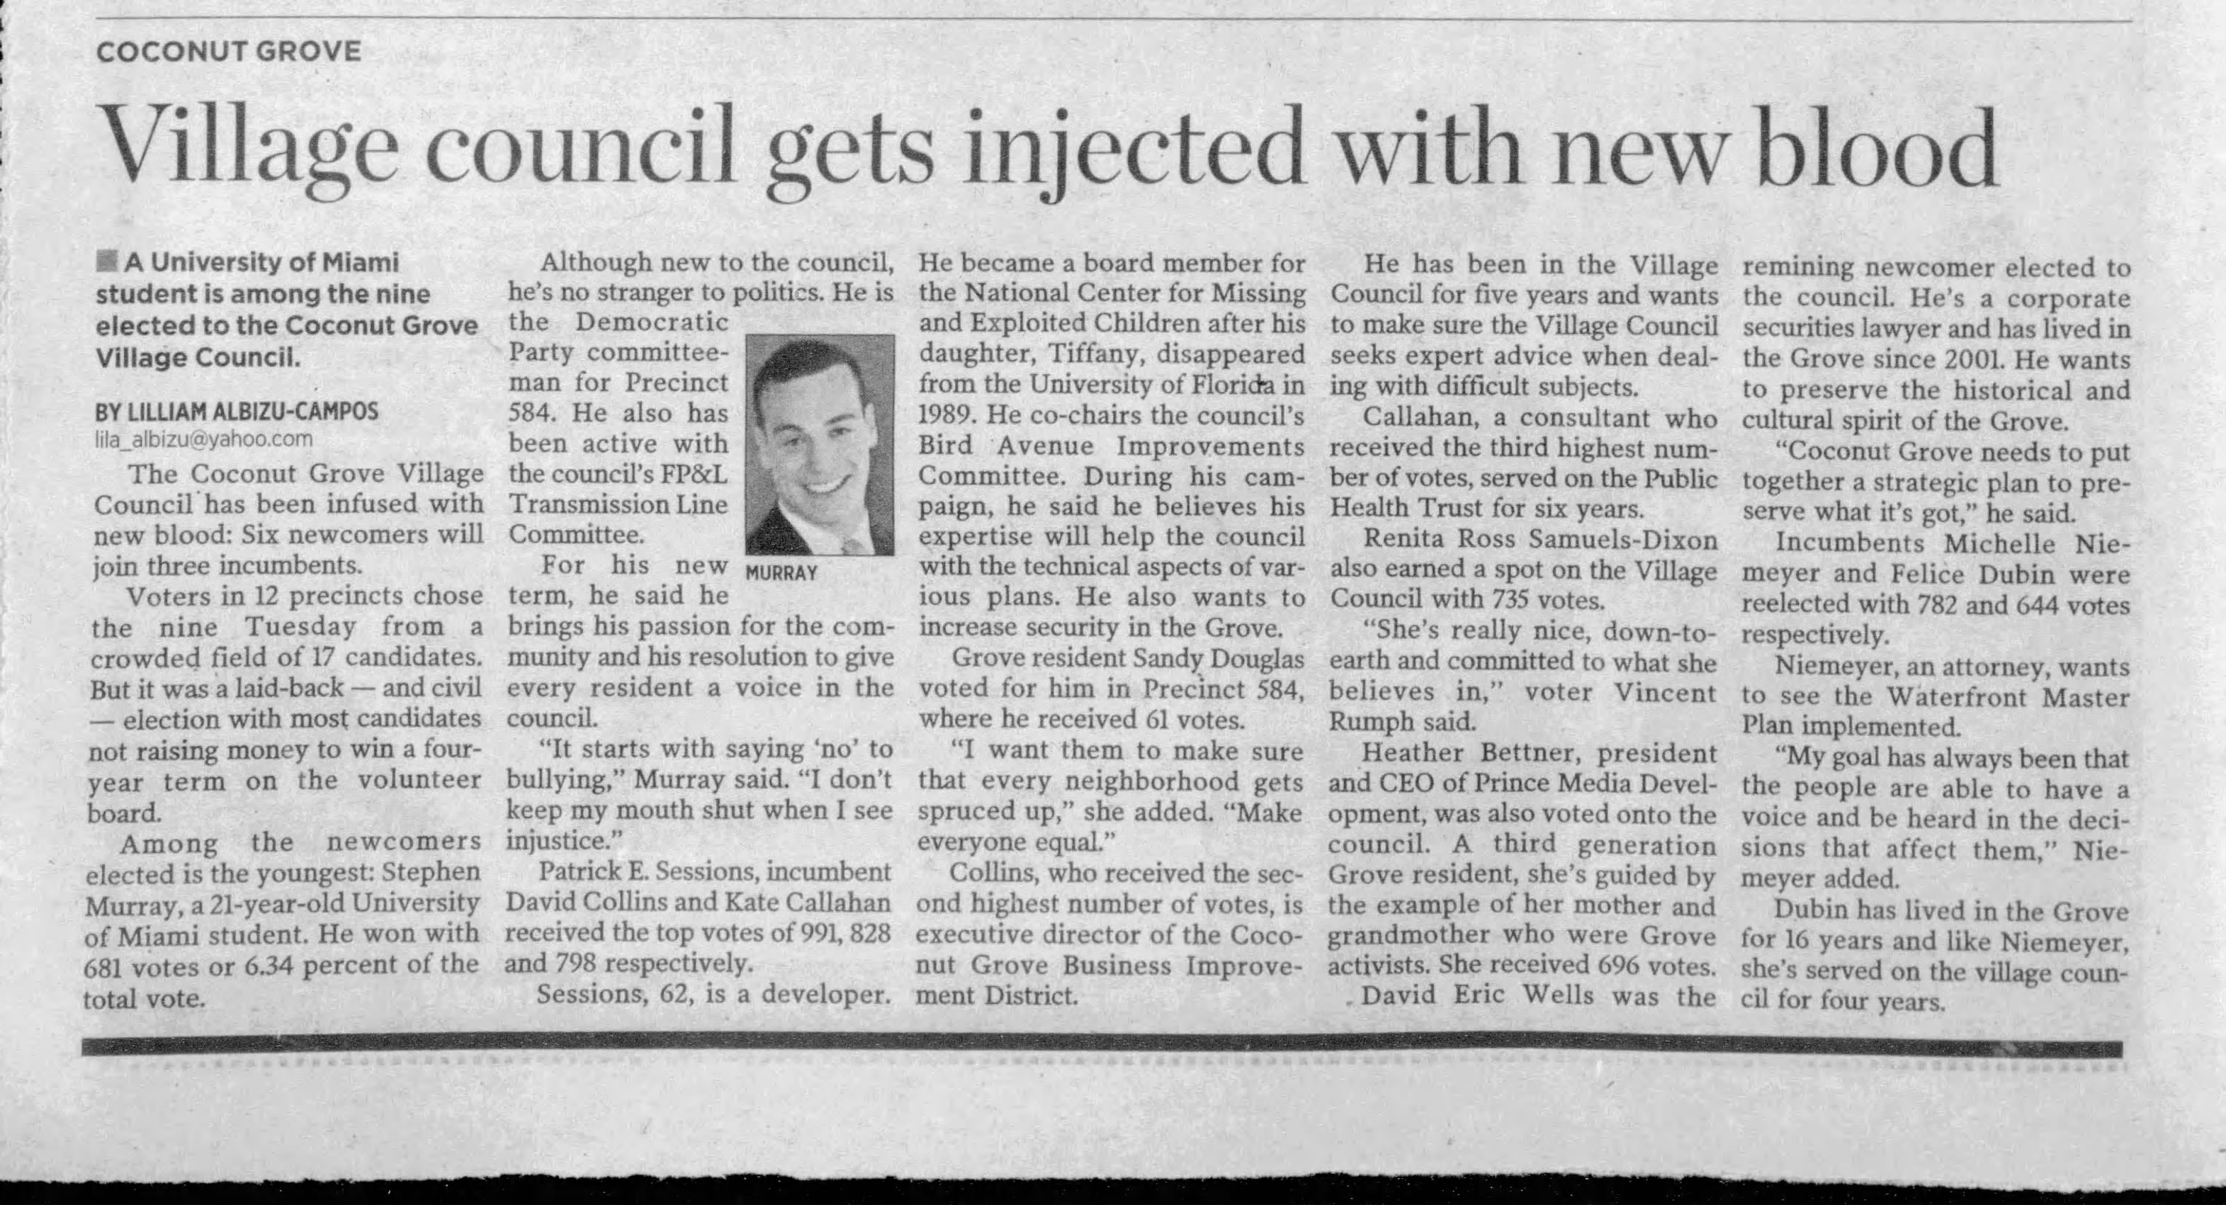
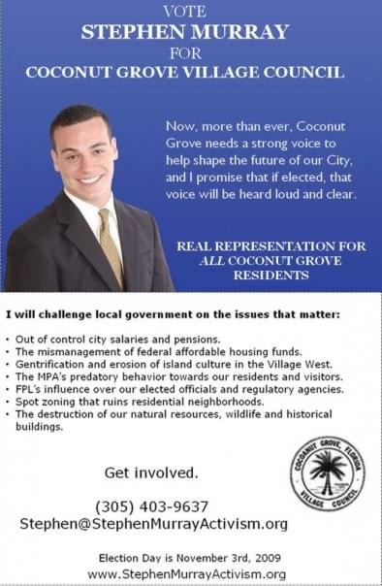
This is my brain on drugs…

Slide 6
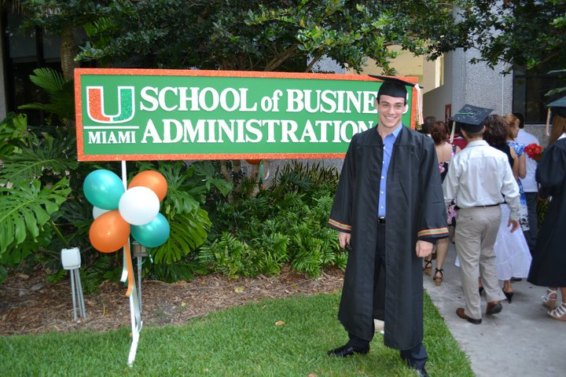
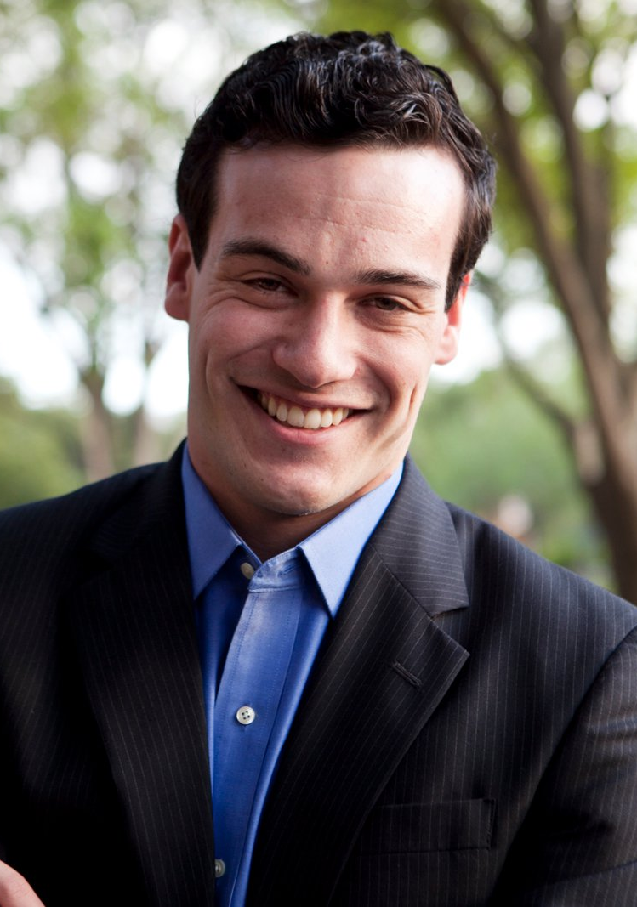
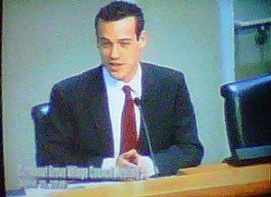
I’m a multiple overdose survivor of both opioids and stimulants

Slide 7
I struggled with treatment – it contradicted many of my values and family’s culture
Told I was an “addict”—this became my identity
Addiction defined as a chronic, relapsing brain disorder
Told “addicts” were morally flawed
No medication for addiction
Mental health issues (depression, anxiety) could be medicated until they took us to an off campus NA meeting…
The solution was meetings
Required to “surrender to a Higher Power”

Slide 8

My recovery pathway
I went to 28 day rehab
I took Suboxone for about 6 weeks after inpatient release
I participated in months of intensive outpatient
I attended six months of AA
I was in individual therapy for five years
I identified as a person in recovery for over a decade

Slide 9
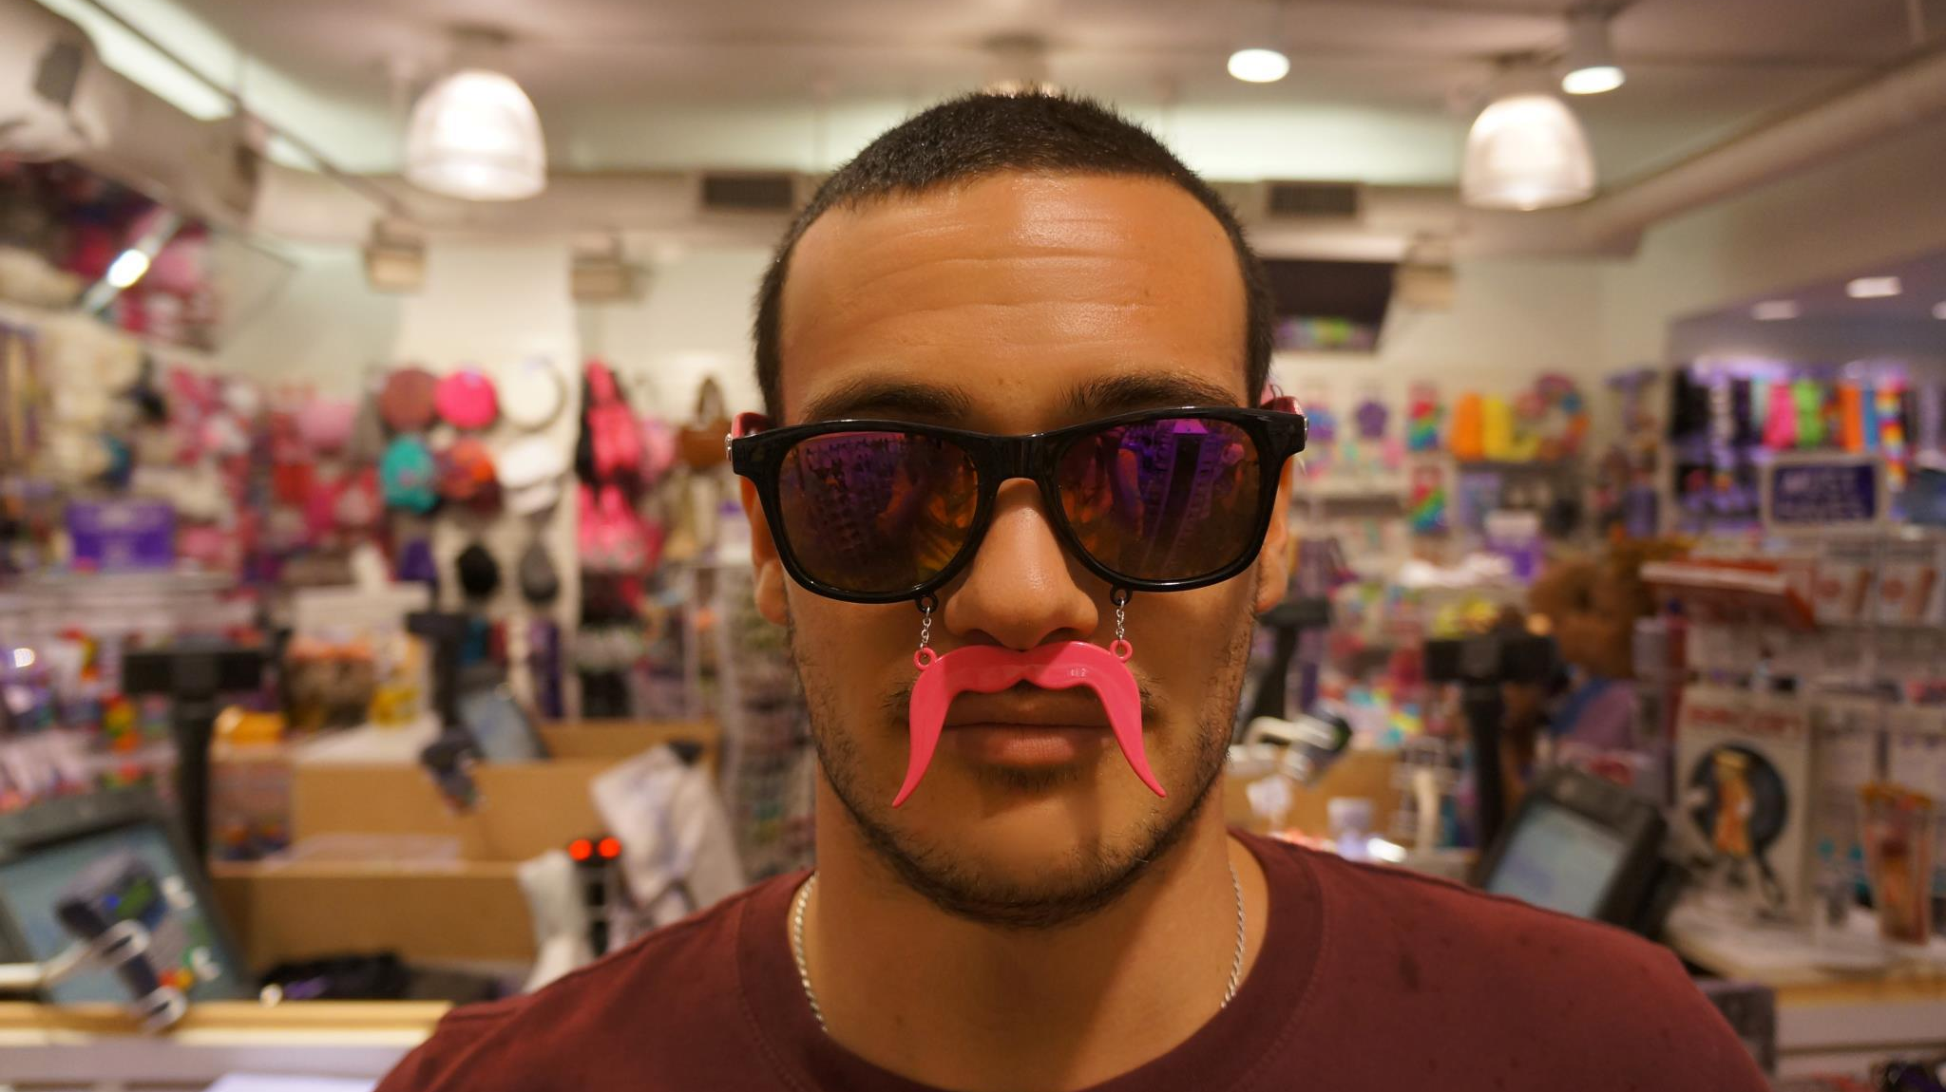
After doing the “treatment” routine for about 8 months, I went rogue
I was ready to move on
Continued therapy
Got a job
Got a girlfriend
Moved into an apartment
Stayed abstinent

Slide 10

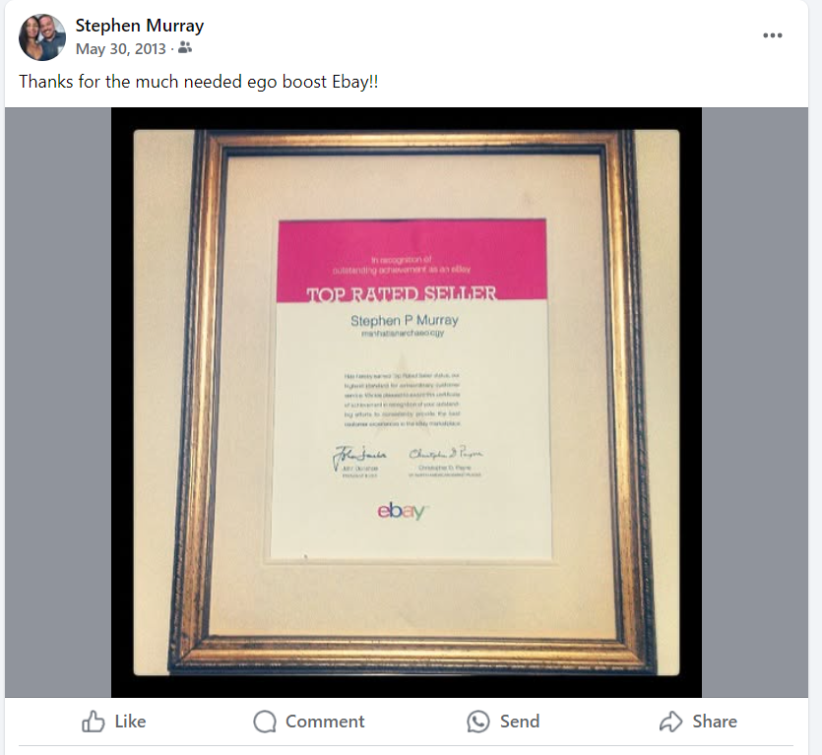
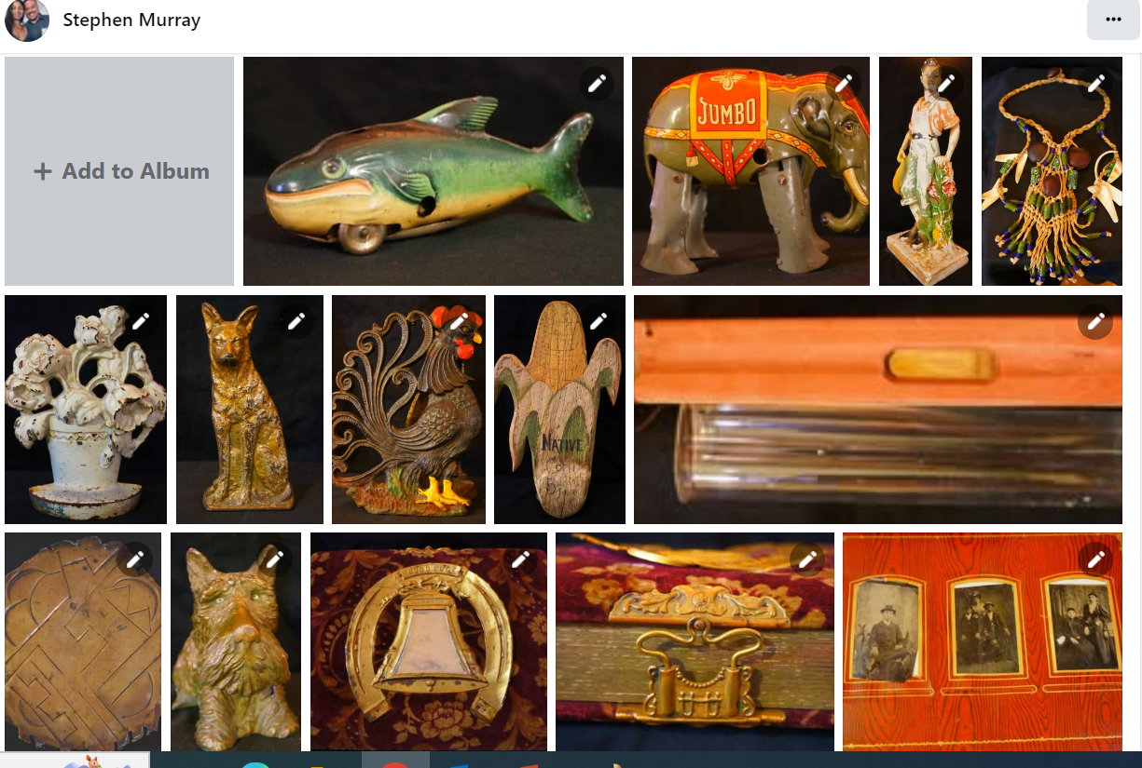

Slide 11
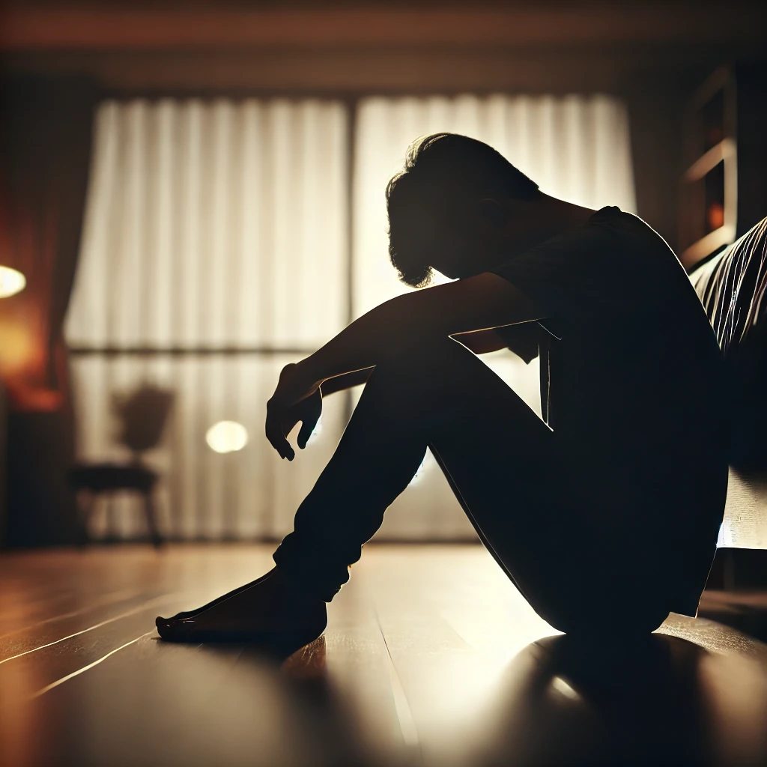
643

Slide 12
What my return to use taught me
Less than 48 Hours of Use, Then I Stopped
Not because I ran out or got caught
Simply didn’t feel like using anymore – threw away what was left
Rehab & AA had taught that relapse meant losing control and spiraling back to where I was
Supposed to be powerless—except I wasn’t
What it did teach me was that I didn’t have to spiral, but I had to keep it a secret because any return to use would have meant return to treatment and I didn’t want that disruption

Slide 13
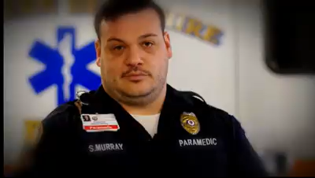
No one in my life knew about that…they did think I returned to use other times when I didn’t
Even 8 years into being mostly abstinent I would draw accusations from family about return to use
Any time I looked tired/sick, or had financial trouble it raised questions
This video taken 3 weeks into COVID pandemic – I had worked 72 hours that week covering shifts and we filmed in the morning after a 24 hour shift

Slide 14

The stigmatization of use impacts our ability to safely share what we are going through
People who use casually or recreationally are unable to talk about it and ask for help with their safety
People in recovery can’t easily share when they have returned to use

Slide 15
Why does this matter?
Take a moment and think about how many people you know who have been in “long term recovery” who died unexpectedly from overdose
Long-term recovery is a RISK FACTOR for fatal overdose that we often overlook

Slide 16
Drug use is logical…
People experiencing homelessness may use stimulants at night to stay awake for safety, in fear they might be assaulted or robbed if they fall asleep
People use drugs to self-medicate their untreated chronic physical pain
People use drugs to cope with emotional and physical trauma
People use drugs socially for the same reasons you may drink alcohol
People use drugs to increase their productivity or enhance studying
People use drugs for pleasure and to rest

Slide 17
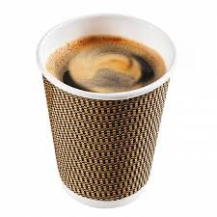

Slide 18
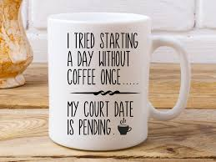
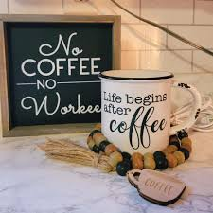
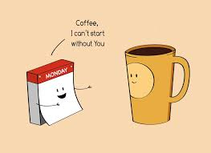
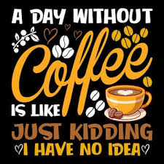
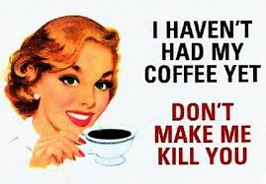
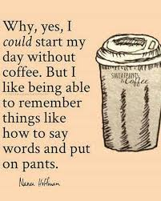

Slide 19
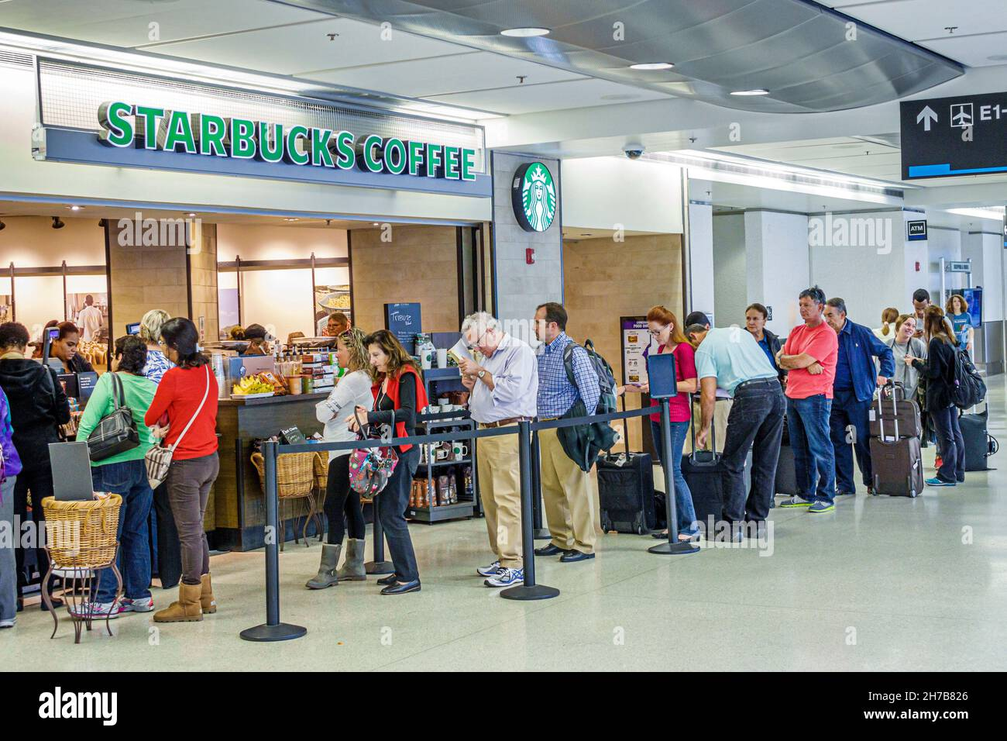

Slide 20
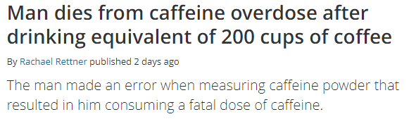
Even caffeine can be lethal if not safely sourced
Personal trainer Tom Mansfield died in January 2021 after taking caffeine powder in Wales
Dad-of-two Mr. Mansfield tried to weigh a dose of the powder within a range of 60 milligrams to 300 milligrams using a scale that had a weighing range of 2g-5,000g, meaning he ended up consuming several grams
A coroner report found Mansfield had caffeine levels of 392 milligrams per liter of blood in his system - one cup of coffee generates an average of 2 to 4 milligrams of caffeine per liter of blood.
Source: https://www.livescience.com/caffeine-overdose-200-cups-of-coffee

Slide 21
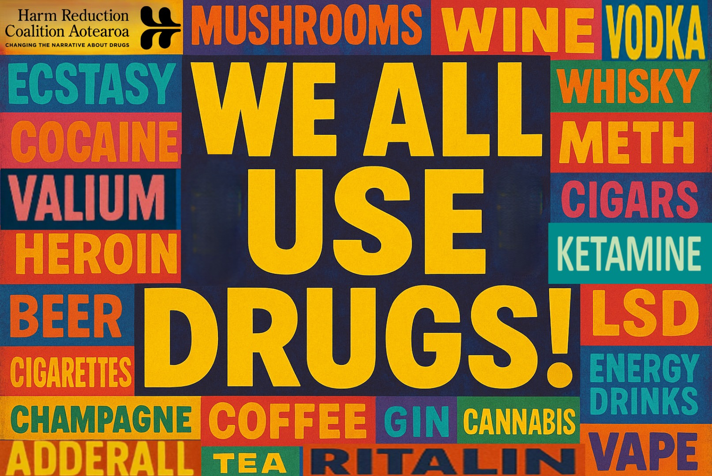
Even in recovery, we are all drug users – some of us just have the privilege of safety with the drugs we are using

Slide 23
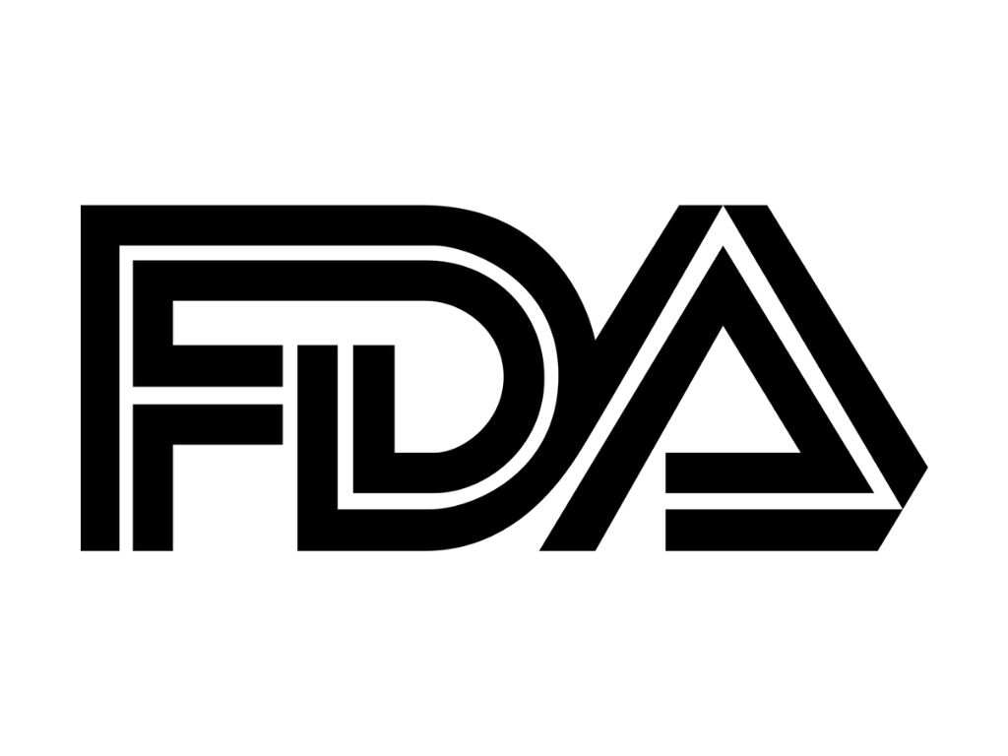
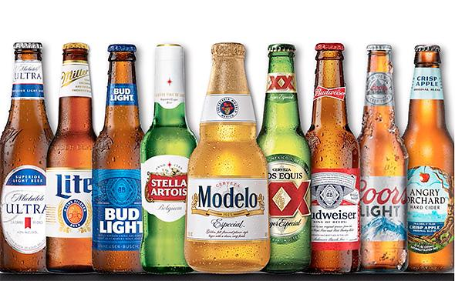
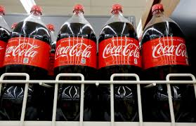
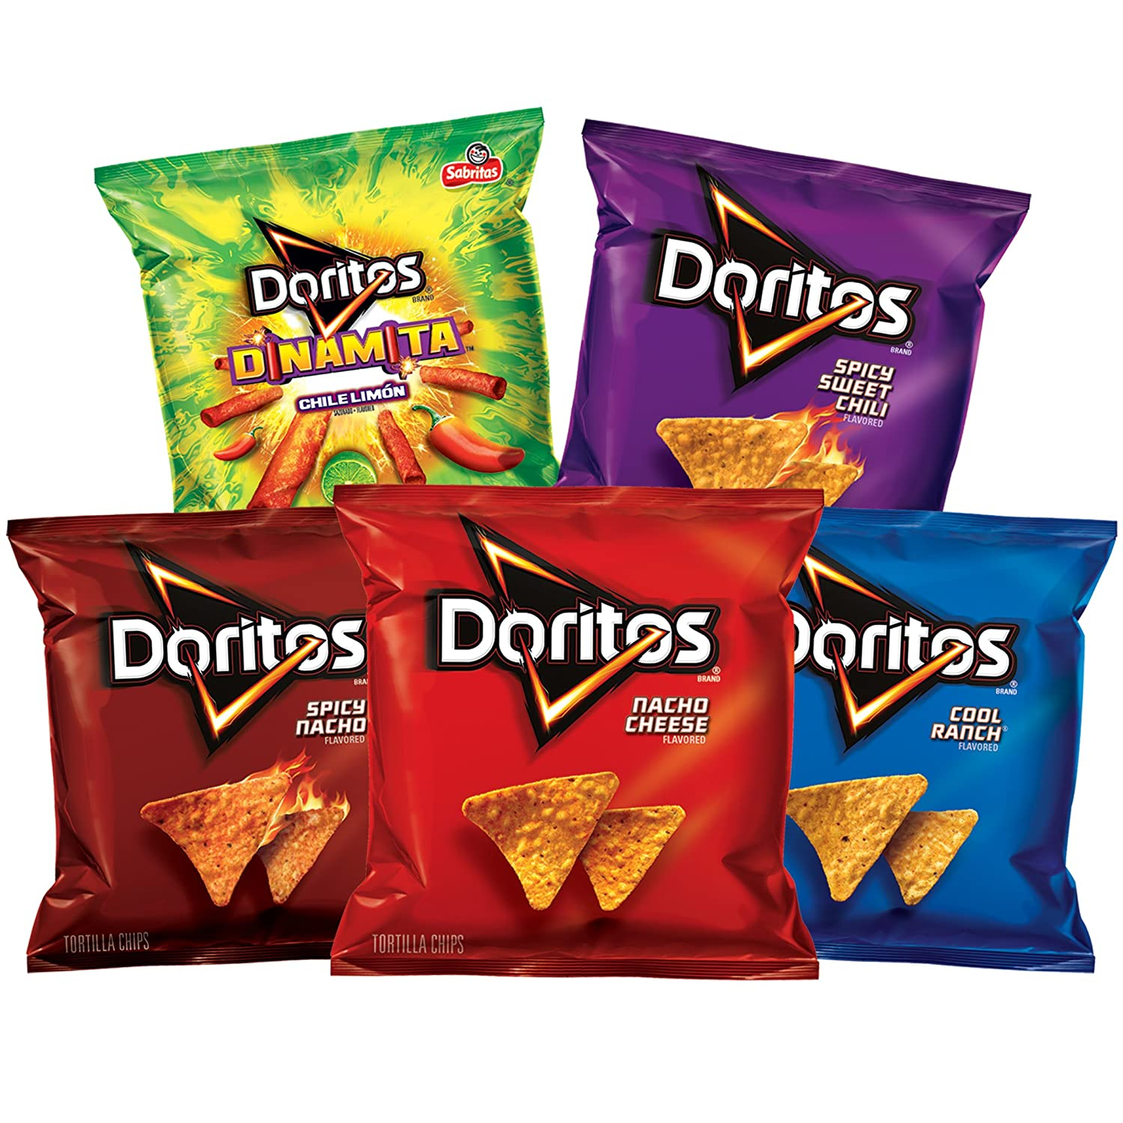
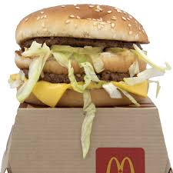
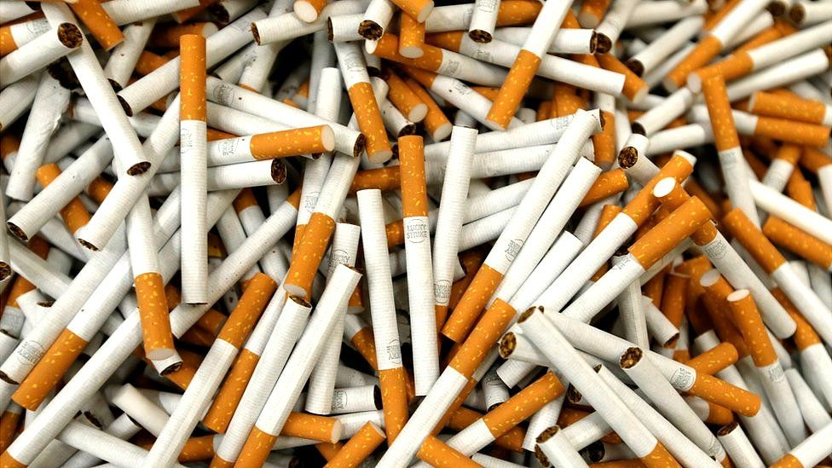
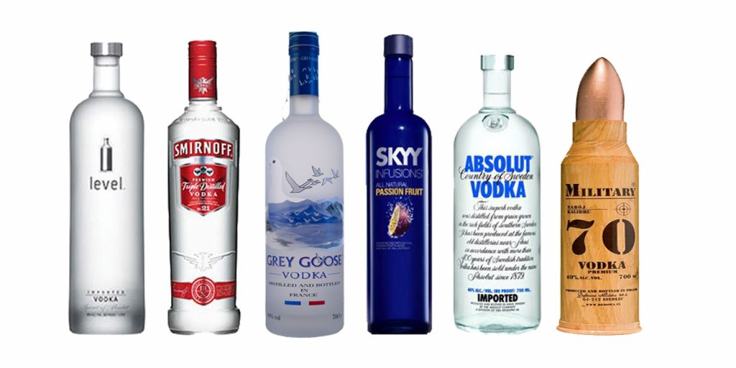
People who use drugs are denied basic consumer protections – health vs safety

Slide 24
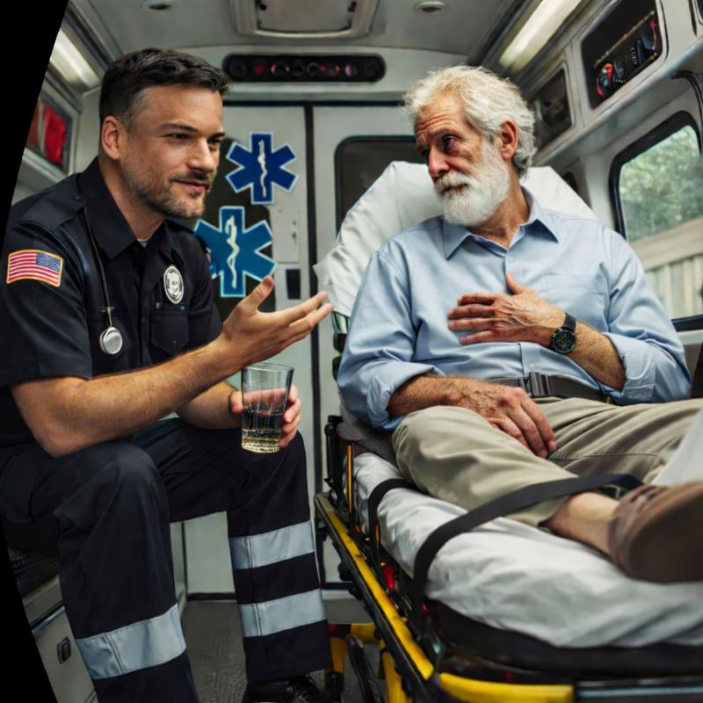
There are no bad drugs or good drugs
The "good drug" vs. "bad drug" binary is harmful. It fuels stigma, moralization, and ineffective policies.
Many risks come from prohibition, not the substances themselves. A safer supply and regulation reduce harm more effectively than criminalization.
All substances have benefits and risks. The effects depend on context, dosage, and individual use.

Slide 25
I came to this work as someone who identified as an “addict” – for many years I thought that all drug use terminated in addiction

Slide 26
Having a substance use disorder may be PROTECTIVE from overdose… and here is why
Opioid Tolerance
Medications for opioid use disorder
Drug knowledge, established routines and safety techniques
More stable supply sourcing (better communication with supplier about potency)
Harm reduction access
Using with experienced friends (spotting)

Slide 27
Over 90% of fatal overdoses in Massachusetts happen in a private residence
Source: State Unintentional Drug Overdose Reporting System (SUDORS) 2023

Slide 28
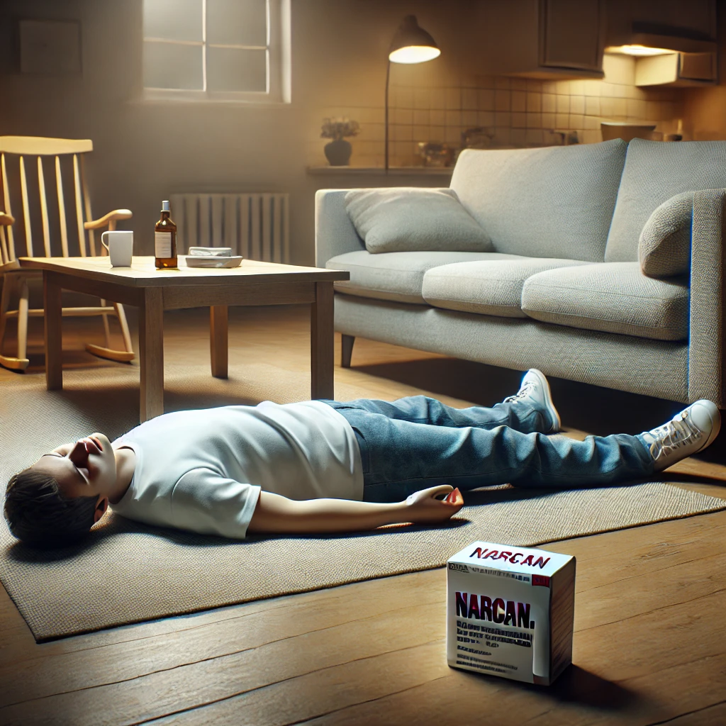
Naloxone does not prevent death from solitary drug use
What happens when a person is alone and no one is there to push the plunger?

Slide 29
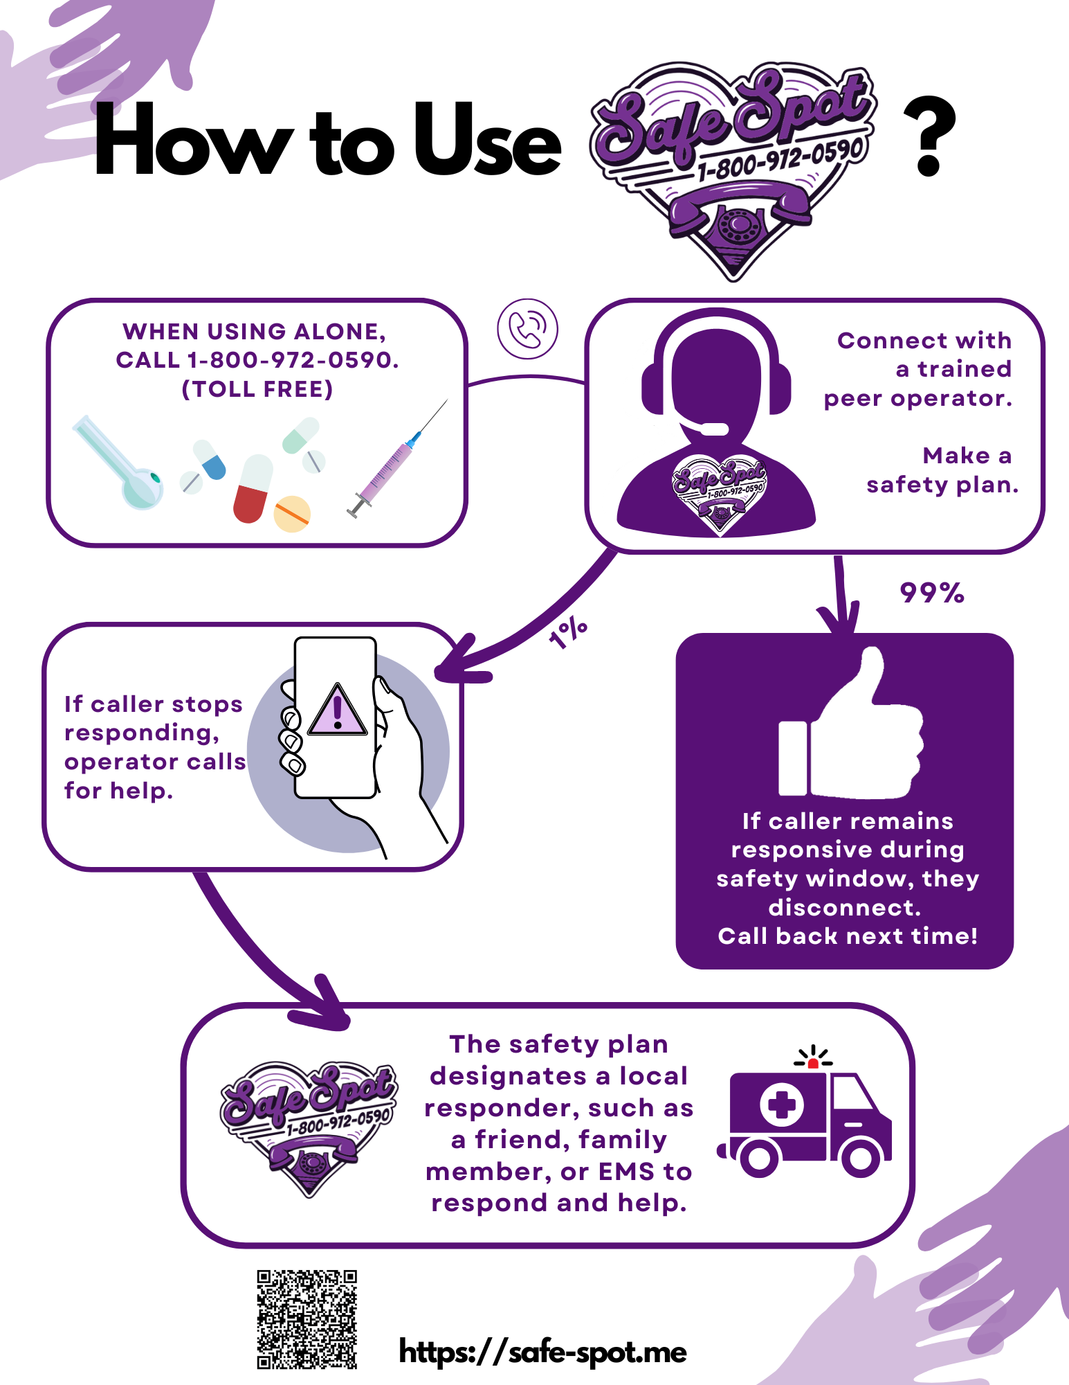
Virtual Spotting via Hotline as a tool

Slide 30
What has the hotline taught me about working with people who use drugs?
People are not used to being given safety without conditions
Unconditional care gives them a sense of value
Having value is the opposite of social disapproval
People call us in many different stages of use (recreational, binge, chaotic, experimental)
The more chaotic someone is the more likely they are to already have been exposed to treatment
Preliminary data suggests that the more chaotic a caller is, the lower their overdose risk

Slide 31
People die when they have to hide.

Slide 32
To anyone here who is still actively using…

Slide 33
When someone walks into your meeting, your group, or your life… …are you someone they don’t have to hide from?

Slide 34
According to a 2024 survey by RAND…
nearly half of Americans know someone who has died from an overdose

Slide 35
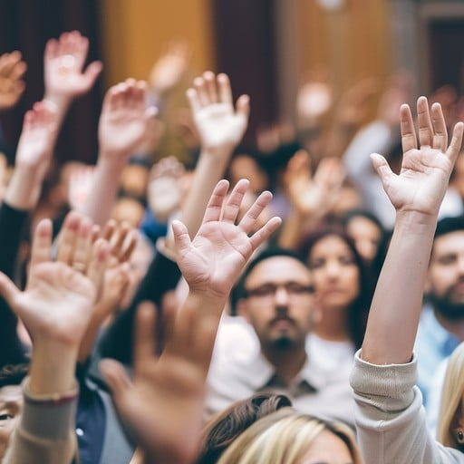

Slide 36
Step up
Speak up
Stand up

Slide 37
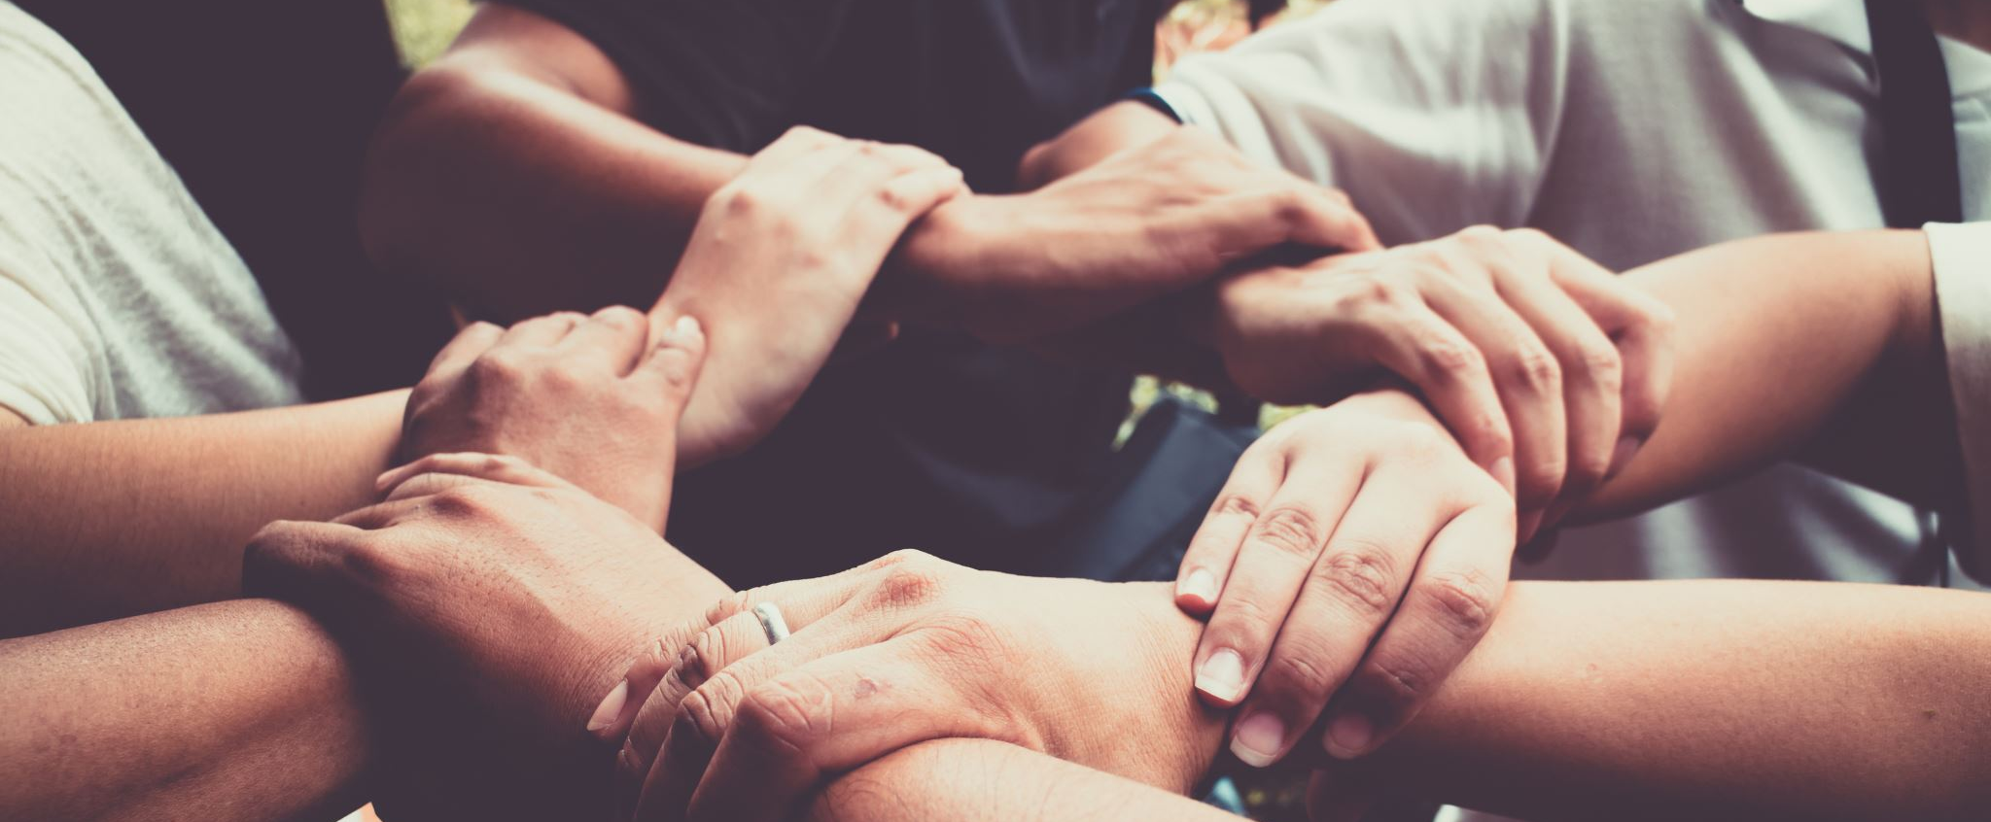
We are safer together.

Slide 38
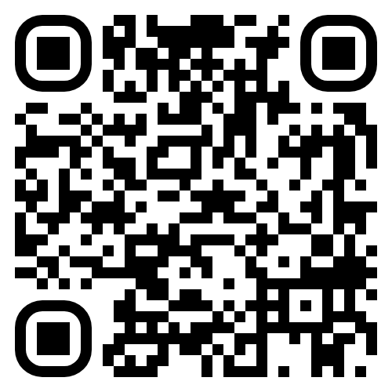
Connect with me on LinkedIn

