Slide 1
Peer Support in Action
How PRN Integrates SMART Recovery Across Community Spaces

Slide 2
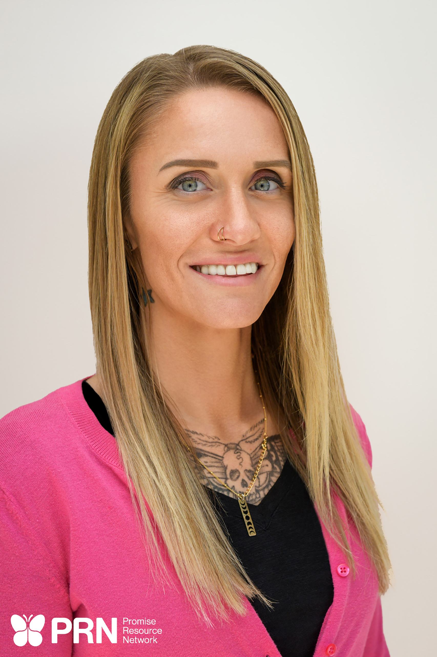
Meet Your Presenters...
Ashley Stephens is a resilient advocate and Peer Support Specialist whose journey through domestic violence, incarceration, hospitalization, mental health challenges, and substance use recovery has become the foundation of her life’s purpose. Beginning her peer support work in May 2024, Ashley was quickly introduced to SMART Recovery, where she found both connection and direction. She became trained and began facilitating meetings multiple times a week, rapidly expanding access to SMART Recovery by helping establish meetings nearly every day of the week across shelters and treatment facilities.
Ashley is a Peer Support Specialist trained by Cherene Caraco and is also trained in Intentional Peer Support, bringing a values-driven and connection-focused approach to her work. Drawing deeply from her lived experience, she transforms adversity into impact—leading a domestic violence support group for women and empowering others to reclaim their lives.
Now a proud homeowner and devoted parent of two sons, Ashley lives her belief that every person carries value and wisdom, and deserves to be treated with dignity and respect.

Slide 3

Meet Your Presenters...
Elliott Brooks is a complex childhood trauma, suicide attempt, and psychiatric system survivor. Survival led to zir developing an entire internal team or 'system'. Today, zie lives openly and authentically as zir selves and works to break down the stigma surrounding multiplicity/plurality. Zir existence isn't a horror story and zie stives to bring hope and community to others who navigate life in this way.
Elliott's peer support journey began in Salem, OR where zie provided peer support at a drop-in day center. Zie supported people with system navigation and crisis co-regulation during intense situations and conflicts. Zie began working at PRN in 2024 supporting people moving through crises and extreme states at PRN's Raleigh Respite, the Retreat @ Fernwood. Elliott is currently the program manager of PRN's newly opened Raleigh Recovery Hub and Recovery Cafe. There, zie facilitates SMART Meetings and a peer support group for people to explore their experiences with voices, visions, and parts.

Slide 4
Learning Objectives
Objective 1: Participants will be able to explain how peer support, Recovery Café spaces, and SMART Recovery work together to create safe, supportive, and person-centered pathways to recovery.
Objective 2: Participants will be able to describe how peer support grounded in harm reduction and self-directed recovery paths help foster environments grounded in respect, mutuality, and hope while breaking down stigma.
Objective 3: Participants will be able to recognize how SMART Recovery tools can be offered in ways that honor autonomy, encourage self-determination, and strengthen confidence in personal decision-making.

Slide 5
Shared Visions, Shared Missions
How PRN, RCN, and SMART Align

Slide 6
About PRN
PRN was the first standalone peer-operated organization in NC in 2005
PRN inspires individuals and families to reclaim their lives and find identity beyond labels following self-determined recovery paths
PRN inspires well-being and healing through peer-based support services that are designed to plant, seed, water, and grow wellness
PRN embraces all recovery journeys including but not limited to mental health recovery, substance use recovery, trauma, emotional distress, houselessness, and/or incarceration recovery
Operates over 25 peer-led programs including two Recovery HUBs and two Recovery Cafés, one each in Charlotte and Raleigh that provide classes based in the 8 Dimensions of Wellness

Slide 7
About Recovery Café Network
Founded in 2003 in Seattle, Washington, a Recovery Café is "a healing spaces for individuals seeking recovery from anything that blocks one’s capacity to love and be loved"
Recovery Cafes are founded on the principles of "radical hospitality" and "loving accountability"
Currently, there are Recovery Café’s in over 90 communities throughout the US, Canada, and Virgin Islands
Membership model: free of cost, three commitments:
1) being drug- and alcohol-free in the space
2) participating in a weekly Recovery Circle
3) contributing to the Café

Slide 8
Promise Resource Network | Recovery Café Network | SMART Recovery
"Through the wisdom of lived recovery experience, PRN ignites social change, inspires hope, and serves as a catalyst for personal greatness. PRN disrupts traditional systems to reshape the way mental health, substance use, homelessness, incarceration, domestic violence, and trauma are understood and treated by introducing survivor-led, recovery based alternatives to illness based systems and treatments." | "We welcome people of all identities, backgrounds, and worldviews with radical hospitality. We believe that real relationships that cross socio-economic, racial, religious, political, and other divides not only transform us, but also ignite change in the broader communities surrounding each Recovery Café." | "Self-Management - People can manage their own behaviors Mutual Support - There is great value in connecting with and learning from peers with similar experience Choice - People choose their own goals, skills and tools. Evidence Led - All our programs are based on scientific evidence and we encourage their on-going evaluation Person Centred - People with lived experience are central in guiding what we do."
· Empowers individuals through peer support & community · Honors lived experience and multiple recovery pathways | · Creates healing spaces built on belonging and connection · Supports long-term recovery through radical hospitality | · Provides science-based, self-empowering tools · Focuses on building balanced, purposeful lives

Slide 9
Alignments of Values
Lived Experience as the Foundation
  All three models believe that people in recovery are not just participants — they are leaders, teachers, and change agents.
Social Change & Community Impact
  Each mission moves beyond individual sobriety and focuses on community transformation. Recovery is not just personal — it’s social.
Hope + Personal Greatness
  All emphasize that recovery is about growth — not just abstinence. It’s about stepping into purpose and possibility.
Empowerment vs. Powerlessness
  All three are empowerment-based, strengths-focused, and future-oriented.

Slide 10
Breaking Down Stigma in Recovery
Harm Reduction, Mutuality, Lived Experience, and Self-Determined Recovery

Slide 11
Principles of Harm Reduction
Harm reduction is a set of techniques aimed at reducing the risks and harms of substance use
  Safe consumption sites like bars
  Provision of safer use supplies like test strips, clean syringes, cookers, and filters to reduce chances of transmitting communicable diseases and/or infection risk like cotton fever
  Access to naloxone and other overdose reversal supplies
  Access to peer support warmlines like Never Use Alone
  Access to medication-assisted treatment options
  Education around substance use that isn't rooted in stigma and shame
Harm Reduction is also based in principles of social justice
  Based in radical hospitality, respect, and dignity for people who use drugs
  Centers the lived experience of people who use drugs and what is important to them

Slide 12
Principles of Harm Reduction cont.
Meets people where they are, not where we want them to be
Values progress over perfection
Harm reduction recognizes and honors that substance use is complex and that the stigma around it prevents many from accessing supports around it due to:
  Fears of incarceration and the long-lasting impacts of incarceration
  Support groups and treatment options that don't honor medication-assisted recovery options
  Support groups and treatment options that stigmatize and punish return to use
  Support groups and treatment options that say the only path is abstinence and you can't have moderation

Slide 13
Peer Support and Harm Reduction
Peer support is rooted in harm reduction – at its core peer support reduces the isolation, stigma, and pain of navigating recovery
Peer supporters honor dignity of risk and self determined recovery paths
Peer supporters create safety in relationship by redefining safety and risk
  Peer support honors that self injury and substance use are coping skills to survive
  Peer support is responsive and supportive instead of reactive and restrictive

Slide 14
Peer Support and Harm Reduction
Peer support is rooted in empowering people to be in charge of their recovery, their way
  Honors and supports voice and choice
  Advocates for self-determined recovery paths
  Mentors and build skills to prevent creating further systems and narratives of dependence and patienthood

Slide 15
Fighting Stigma
Relationship and community are extremely important in predicting success and preventing trauma
Stigma surrounding substance use recovery leads to many people losing community when they need it the most
Peer support stands in direct opposition to stigma by saying "I've been there too; you're not alone; you have a community here"

Slide 16
SMART, Peer Support, and Harm Reduction
SMART and peer support organizations recognize that healing comes through meaningful community and connection with others who deeply understand
Recovery comes through building new skills and identities through new understandings of ourselves
In summary:
Harm Reduction provides A Foundational Mindset (valuing life and progress over fearing risk, respect for all
·Community (PRN & Recovery Cafe) provides The Support
SMART meetings and facilitators provide The Skills

Slide 17
Harm Reduction in Action
Putting SMART Meetings and Peer Support into Practice

Slide 18
SMART Meetings
SMART meetings begin with check ins that guide the rest of the meeting
  Mutuality: facilitator and meeting members all share and check in about their current goals, wins, and obstacles
  Self-directed recovery: facilitator takes these check-ins and uses them to guide what tool is practiced in the meeting

Slide 19
SMART Tools
SMART Recovery provides a variety of skills that support harm reduction as a recovery path:
Cost-Benefit Analysis (CBA): Explore choices without judgment and make informed decisions
Urge Surfing: Manage cravings safely
ABC Tool: Change thinking to change outcomes
Goal Setting: Small, realistic, self-directed steps
Change Plan: Personalized path to growth
Lifestyle Balance Tool: Build a life that supports recovery and wellness

Slide 20
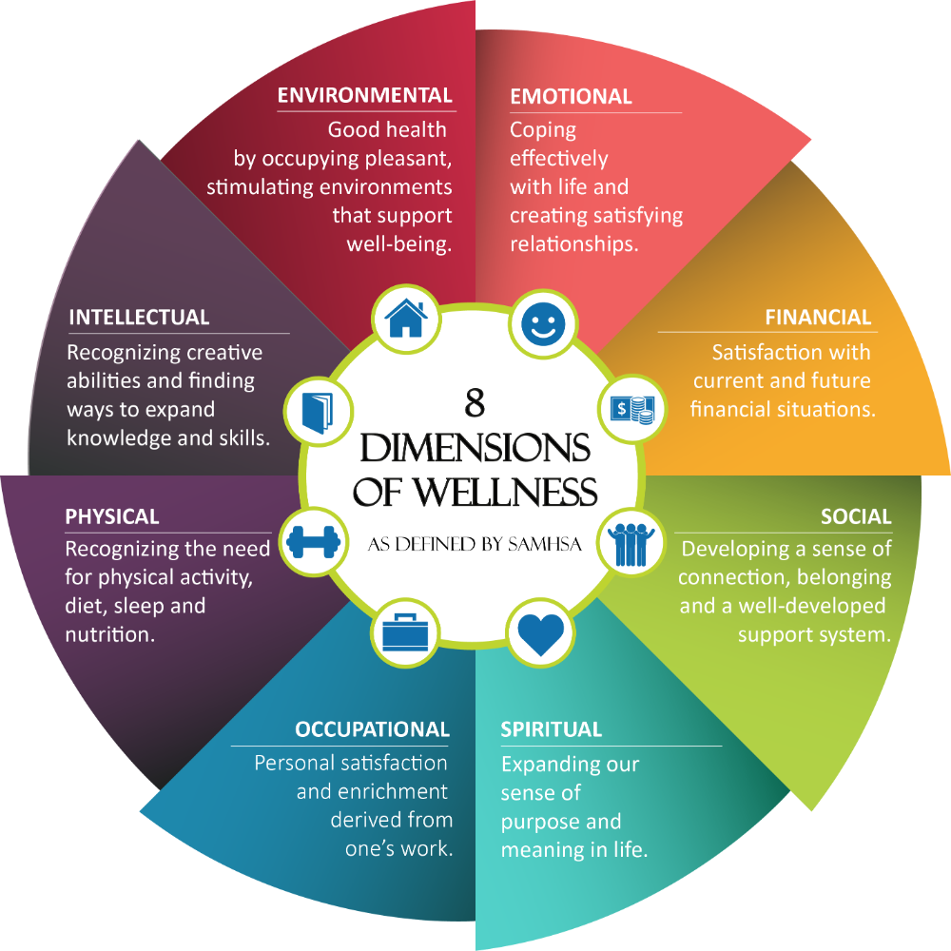

Balancing Wellness
SMART Recovery's Lifestyle Balance Tool is a way we can examine the balance of the 8 Dimensions of Wellness in our own lives

Slide 21
Let's Practice Together!
Let's practice the lifestyle balance tool and 8 Dimensions of Wellness together
Spend 5 minutes filling out the Lifestyle Balance worksheet and then we will come back together and reflect

Slide 22
Let's Reflect...
How did it feel to practice this tool?
What did you learn or notice when practicing this tool?
What surprised you when you filled it out for yourself?

Slide 23
Astephens@promiseresourcenetwork.org
Ebrooks@promiseresourcenetwork.org

