Slide 1


You Can Do This…
Gwilym Roddick, DSW, LCSW
Founder, CBT of Central & South Florida
Vice President, OCD Central & South Florida
Co-Founder: CBT-Trainers.com
Founding President, CBT Alliance of Florida
One Plan, Two Challenges:
Shared Principles and Processes in Helping People with Substance Use Disorders and OCD

Slide 2
  What does this sound like to you?
Often involves patterns of avoidance: physiological, cognitive, done through behaviors and rituals both physical and mental
Provides short term relief, often leads to more rituals/behaviors in an effort to modify experiences and reduce or avoid negative consequences
Results in low distress tolerance, enhances unhelpful beliefs about self/others/world, leaves people feeling they have limited behavioral choices
Feelings & Thoughts dictate Behavior
Efforts focused on making the thoughts & feeling go away as quickly as possible vs tolerating and working though
Intention is to feel better/less bad (e.g. Relief = Pleasure)
Sound familiar?

Slide 3
Current Treatment Models
For or People With a Substance Use Disorder

Slide 4

Single-Focused Programs & Interventions
Residential
Intensive Outpatient Programs (IOPs)
Medication-Assisted Treatment (MAT)
SMART, 12 Step, Against the Stream
The Elephant in the Room
(Glasner-Edwards & Rawson, 2010)

Slide 5

Positives of Current Practices
Empowering, Translatable Skills
Peer support & role models
Ongoing free and open access (SMART, 12 Step)
De-emphasize stigma
Long-term recovery associated with improved quality of life
Utilization of more adaptive coping behaviors (e.g. enhanced problem solving)
Decrease in the avoidant behaviors
Significant results with medications
Elements of different interventions

Slide 6

Problems With “Traditional” Models
  Efficacy & outcome research inconclusive
  Mortality rates
  “One Size Fits All”
  Low completion and adherence
  Re-emphasize stigma and shame
  Lack of education, training, and supervision of primary providers, particularly EBPs
  Unequal access
  Potential to exploit vulnerable consumers
  Significantly inadequate attention to co-occurring mental health issues
(Flynn & Brown, 2008; Kownacki & Shadish, 1999; White, Scott, Dennis, & Boyle, 2005)

Slide 7
Current State of OCD Treatment
9-17 yrs for proper diagnosis & treatment of OCD
Medication (typically SSRIs at high doses), but most must be used “off label” (do you know Namenda?)
Most OCD specialists do not know which treatment approaches are effective with SUDs. May merely provide “treatment as usual” … (P.S. not many know of SMART!!)
Many OCD providers are generally uninformed about what people with SUDs experience and may not be willing to work with these clients, e.g. “don’t send me any of those referrals”

Slide 8
Shame & Stigma
How does it affect people with SUD?
Feeling stigmatized can make people with SUD less willing to seek treatment.
Negative stereotypes about people with SUD can make others feel pity, fear, and even anger.

Slide 9
Treatment Model for TODAY
Prioritizing Transdiagnostic Principles, Context, Culture, and Competence

Slide 10
What Obsessive Compulsive Disorder is:
A cycle of obsessions and compulsions
Obsessions: intrusive, "unwanted" thoughts, images, or urges
Compulsions: behaviors (visible or mental) done to reduce distress
Driven by anxiety, doubt, and uncertainty
Intense anxiety, fear of harm to self or others, “not just right”
Significant difficulty tolerating uncertainty
Maintained by negative reinforcement
Compulsions temporarily reduce anxiety
Relief strengthens the OCD cycle over time

Slide 11
What OCD is:
Characterized by avoidance and safety behaviors
Avoiding situation, triggers or experiences
Seeking reassurance from others or self, checking, or mental reviewing
A disorder of learning—not danger
Brain overestimates threat and responsibility
ERP works by training the brains reactions to threats, experiences, and uncertainty differently
Associated with distress and functional impairment
Interferes with life, relationships, decision-making, finances
Can consume significant time and mental energy

Slide 12
What the experience of OCD can be …
Aggressive obsessions
Contamination obsessions and rituals
Somatic and health related obsessions and rituals
Checking compulsions
Sexual obsessions
Repeating rituals
Counting, ordering, numbering, superstitions
Religious obsessions (Scrupulosity)
Obsession with need for symmetry/sameness
The need to know or remember
Fear of saying certain things or thinking them
Fear of not saying/doing/feeling “just right”

Slide 13
What OCD is NOT
❌ Not just “liking things neat or organized”
Preferences ≠ distressing, intrusive obsessions
OCD is driven by anxiety, not enjoyment
❌ Not a personality trait or quirk
It is a diagnosable mental health condition
Involves impairment and significant distress
❌ Not simply “overthinking”
Thoughts feel intrusive, unwanted, and hard to dismiss
Often ego-dystonic (in conflict with one’s values)

Slide 14
What OCD is NOT
❌ Not a choice or lack of willpower
Compulsions are driven by intense anxiety and urgency
Attempts to resist often increase distress
❌ Not always visible
Many compulsions are mental (e.g., checking, reviewing, neutralizing)
Individuals may appear “high functioning”
❌ Not solved by reassurance or logic
Reassurance provides short-term relief but maintains the cycle
OCD persists despite knowing fears are unlikely

Slide 15




Yale-Brown Obsessive-Compulsive Scale (Y-BOCS)
**Most widely used assessment measure for OCD
Clinician administered assessment
Symptom checklist
54 common OCD obsessions and compulsions
Focuses on symptoms present in the last week
Severity Scales
Based on clinician’s impression following semi-structured interview
5-point likert scale (0 = no symptoms, 5 = extreme symptoms)

Slide 16

How Therapists Can Help Someone with OCD
*CBT Umbrella
Exposure & Response/Ritual Prevention
Inhibitory Learning
*Gold Standard
Acceptance and Commitment Therapy
("Act")

Slide 17
Inhibitory Learning Model
Exposure facilitates learning through:
•Disconfirming negative expectations (feared outcome did not happen)
•Even if the feared outcome did happen, you can handle it – even if the fear itself is still present
•We are not “erasing” old fear memories (that’s not a thing, BTW).
•Instead we are creating NEW, competing memories (called inhibitory memories) that help individuals tolerate the experience and respond differently & more adaptively to the fear.

Slide 18
Maintaining Mechanisms of OCD
Inflated responsibility: belief that you can cause or prevent bad outcomes
Over-importance of thoughts: thoughts are considered important and must “mean something”, even if they don’t
Importance of controlling one’s thoughts: believing you can and MUST completely control your thoughts
Overestimations of threats: exaggerated chance for and severity of harm
Intolerance of uncertainty: absolute certainty is seen as necessary to cope, difficulty tolerating unpredictability and ambiguity
Perfectionism: believing there is one perfect solution to every problem; that acting without making mistakes is not only possible, but necessary; and conviction that making minor mistakes will have grave consequences

Slide 19
Why start with Context?
Many professionals complete graduate school with zero SUD training
Our models (ACT/CBT) require a basic understanding of social determinants of health
What we bring into the room shapes how you help someone
Helps clinicians “improvise like an actor”

Slide 20
YOUR experience & perspectives matter
What messages did you learn about substance use or mental health issues?
From family, community, training, laws, or culture?
How might these shape client conceptualization?

Slide 21
Why Behaviors Make Sense*
Behavior is functional within context
Family system, culture, socioeconomic factors
ACEs and early experiences
“There is no ‘New York’ accent” → All behavior is contextual

Slide 22

The Story of Frank…

Slide 23
When Substances HAVE Been the Solution
Increased confidence, emotion reg, social ease
Sleep support
Decreased OCD thoughts
Fast, powerful, effective relief (negative reinforcement!)
And Positive Reinforcement! (enhances pleasure!)
“It worked—and it worked quickly and consistently.”
Naming the adaptive intelligence behind substance use or OCD reduces shame and builds trust

Slide 24
Why Change is Such a “Big Ask”
Asking someone to give up something that worked
Substances offered relief when nothing else did
ERP is slow and uncomfortable
Clients have often “solved” their problem in their own way
“It’s about humility not humiliation…”

Slide 25
  Is there literature and research to support this?
YES!

Slide 26
  The Problem:
  Comorbidity, Mechanisms & Evidence
High Comorbidity & Impact
Anxiety disorders and SUDs frequently co-occur; comorbidity leads to more severe symptoms, higher impairment, and substantially higher relapse risk.
OCD/SUD comorbidity is high (AUD lifetime comorbidity in OCD ≈24%). OCD often precedes substance use; comorbid cases show poorer insight, higher self-harm risk, greater functional impairment.
Why They Co-Occur (Mechanisms)
Self-Medication Model: ~75% develop SUD after anxiety/OCD; substances act as maladaptive “safety behaviors.”
Substance-Induced Anxiety: Withdrawal/intoxication amplifies anxiety in ~25% of cases.
Mutual Maintenance: Each disorder reinforces the other.
Shared Neurocircuitry: Overlap in OFC, ACC, and related circuits supports transdiagnostic, mechanism-focused treatment.
Evidence for Integration
Meta-analysis of 11 RCTs: Integrated behavioral treatment > SUD-only for both substance outcomes (d=0.31) and anxiety outcomes (d=0.34), benefits maintained at follow-up.
Level 3 (transdiagnostic) approaches: moderate effect (d=0.40) on shared mechanisms.
(Kushner et al., 2024; Babangida & Akosile, 2021; LaSalle et al., 2004)

Slide 27
MECHANISMS Matter!
OCD is a debilitating psychiatric illness associated with multiple psychiatric comorbidities, with up to 92% of individuals in one study having a co-existing psychiatric disorder.
Self-Medication Hypothesis: OCD is associated with increased anxiety, stress, and negative affect, and substance use may provide temporary symptom relief.
Neurobiological Link: OCD and SUDs share similar brain pathways, and a dysfunction in these common brain circuits may contribute to the increased rate of comorbidity. Brain regions like the orbitofrontal cortex (OFC), anterior cingulate cortex (ACC), and head of the caudate nucleus are implicated in both disorders.
Symptom Cluster Association: Specific OCD symptom clusters are significantly associated with alcohol and substance use disorders: aggressive, sexual, counting, religious, and somatic obsessions, as well as checking and ordering compulsions.
Impact of Substances: Central nervous system (CNS) depressants, such as alcohol, can reduce anxiety and severity of OCD-related symptoms in the short term, which may account for the high comorbidity rate. Stimulants, however, are reported to worsen obsessive and compulsive behaviors.
(Kushner et al., 2024; Babangida & Akosile, 2021; LaSalle et al., 2004)

Slide 28
You Can Integrate Treatment Models*
Content Tailoring (Adjunctive)
Adds anxiety-focused treatment (e.g., CBT) to existing SUD program.
Example: CALM ARC adapted CBT for anxiety within SUD treatment
Unified Dual Treatment (Fully Woven)
Single, manualized program combining/modifying components for both disorders
Based on mutual maintenance; delivered simultaneously
Transdiagnostic / Mechanism Targeting
Streamlined modules addressing shared drivers (anxiety sensitivity, negative urgency, distress intolerance).
Most scalable; largest effect in meta-analysis
Key Finding Across Levels
No significant difference between levels; all were effective
Kushner et al., 2024; Babangida & Akosile, 2021
Notes:
not talking about EMDR +12 step, another training, find that research

Slide 29
Why Treatment Integration Matters
Sequential/Parallel Treatment Fails
Historically SUD treated first, anxiety/OCD delayed → untreated anxiety → revert to old learning
Early sequential CBT sometimes worse than SUD-only treatment.
Comorbidity-Related Risks
OCD/SUD: Higher self-harm, reduced insight, impaired functioning, earlier onset.
CNS depressants temporarily reduce anxiety/OCD symptoms → reinforce use.
Certain OCD symptom clusters (aggressive, sexual, religious, counting; checking/ordering) show elevated AUD/SUD association.
Clinical Takeaway
Treating one disorder alone is insufficient.
Integrated care reduces relapse, improves anxiety/OCD outcomes, and targets underlying mechanisms.
Babangida & Akosile, 2021; Sharma & Sommer, 2023; LaSalle et al., 2004

Slide 30

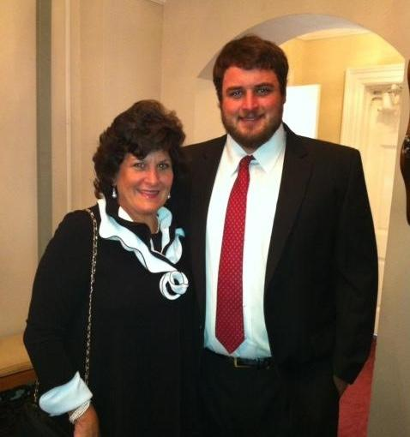
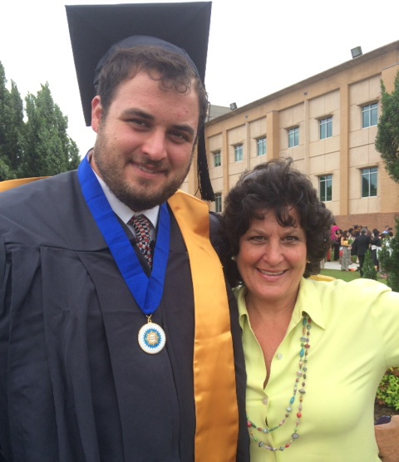
Why This Work is Important
Riley’s Story
Notes:
Today, I want to share a story that doesn’t shy away from the messy, hard truths of life: mental illness, addiction, shame, and grief—and the ways these struggles often intersect. It’s a story that reminds us that even individuals who appear “successful” or come from families that love them and support them, often too end up falling through the cracks while seeking help and can have horrible outcomes. That those with good grades, achievements, and accolades—can be silently battling mental illness, sometimes turning to substances as a form of self-medication.
But this is also a story of hope. It teaches us that through honesty, better clinical practices, community, and collective advocacy, we can build safer, more inclusive spaces for those facing multiple issues (the rule not exception). It is a call to recognize that mental health issues and substance abuse are often deeply linked—and that true healing requires addressing both, without shame or stigma.
This is the story of Riley, a remarkable young man whose life was marked by both struggle and brilliance. Riley began showing severe anxiety and obsessive-compulsive disorder symptoms around the age of 11 or 12. He experienced intense reassurance-seeking, engaged in destructive checking behaviors—to the point, as he was a big guy, breaking doorknobs and showerheads (often reinforcing the fear but unintentionally)—and suffered from physical manifestations like panic attacks and even morning panic/sickness. Yet his OCD went largely unrecognized and untreated. He spent years in generic talk therapy that didn’t address OCD nor SUD.
As Riley’s anxiety and experience of OCD worsened, he turned to alcohol, and later other substances, not socially, but as a way to “turn off” his intrusive thoughts. This is a critical point: substance use can act as a safety behavior in OCD, a form of self-medication born of desperation rather than choice.
Riley faced systemic challenges that left him caught between two worlds. Residential OCD programs required prolonged sobriety, while addiction programs rarely addressed OCD. Certain medications, like benzodiazepines, triggered relapse, and shame over his substance use made him hide the truth from clinicians, preventing the care he desperately needed.
And yet, despite all of this, Riley excelled. He was salutatorian, captain of his football team—where teammates would help reassure him during OCD episodes—and he pursued a master’s in social work, driven by a desire to help others avoid his fate. Tragically, he died from an accidental overdose of a substance he didn’t know he was taking.
In the wake of this tragedy, Riley’s mother, Margaret, founded Riley’s Wish Foundation to honor his legacy and prevent similar losses. The foundation promotes integrated treatment for OCD and substance use disorders, educates therapists, and supports collegiate recovery communities.
From Riley’s story, we learn some essential lessons:
Mental illness and substance use often overlap, and self-medication is a response to untreated suffering.
Integrated treatment for dual diagnoses is crucial; forcing someone to choose between sobriety or mental health care can fail them.
Shame and stigma prevent disclosure and treatment, making safe, nonjudgmental spaces essential.
Early recognition and specialized care for OCD can dramatically change outcomes.
Ultimately, Riley’s story is both heartbreaking and inspiring. It is a call to action—through advocacy, awareness, and better clinical practices, we can build support systems that honor those who have suffered and help others navigate similar challenges. His legacy lives on through compassion, education, and systemic change.
Riley’s life reminds us that behind every struggle, there is a human being who deserves understanding, care, and hope. Let us work together to make that hope a reality.

Slide 31
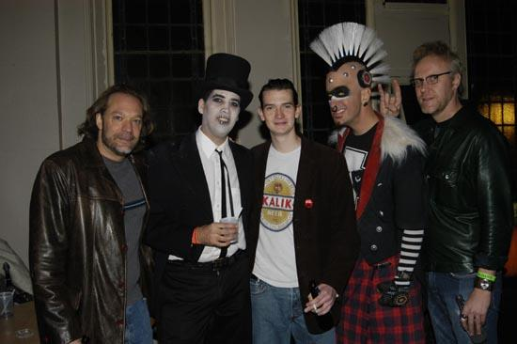
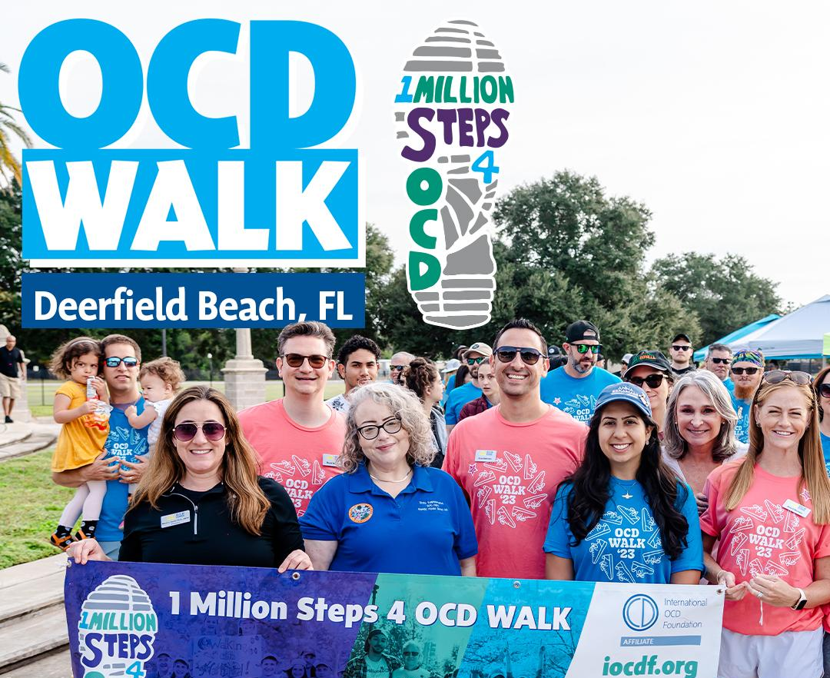
Why This Work is Important to Me
A Personal Story

Slide 32

On the Surface
OCD & SUDs look like relatively different disorders.
But are they?

Slide 33
Patterns of Learned Behavior in OCD & SUDs
View emotional experiences as unwanted and intolerable
Use symptoms to avoid, control of suppress the intensity of the uncomfortable emotion
Individuals get stuck in this short-term solution cycle with a limited range of emotional regulation strategies/behavioral repertoire
Notes:
Boredom, Frustration, Could be enhanced attitude, less important, less fun, likely more powerful than washing your hands but same dopamine,

Slide 34
Similarities in the cycle OCD and SUD
I have uncomfortable thought/feeling
Use a symptom
Get relief (temporarily)
Notes:
GR
Let’s be sure to show an example for a lay person

Slide 35
This cycle results in patterns of behavior/habits that are very difficult to break
So what’s a clinician to do?!

Slide 36
Utilize Evidence-based, transdiagnostic treatment principles that cut across disorders/symptoms by addressing the SHARED MECHANISMS

Slide 37
The Importance of Addressing
“Co-occurring” Disorders through Integrated, Concurrent Treatment
Treating OCD → Increased Anxiety → Increased urge to use substances
SUD Recovery can be triggering (e.g. moral scrupulosity, contamination, etc.) and avoidance of SUD supports → relapse

Slide 38
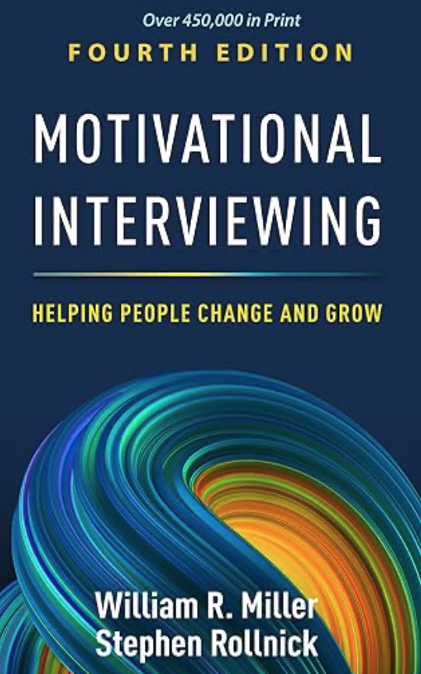
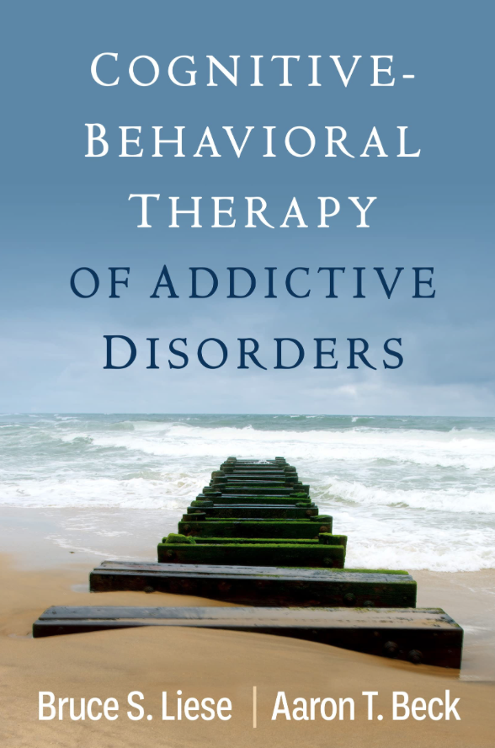
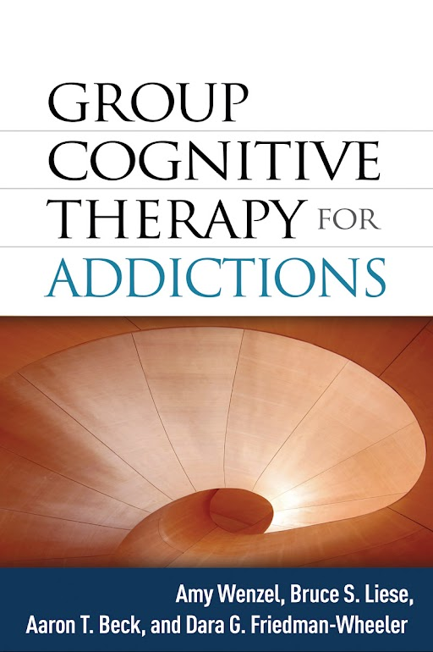
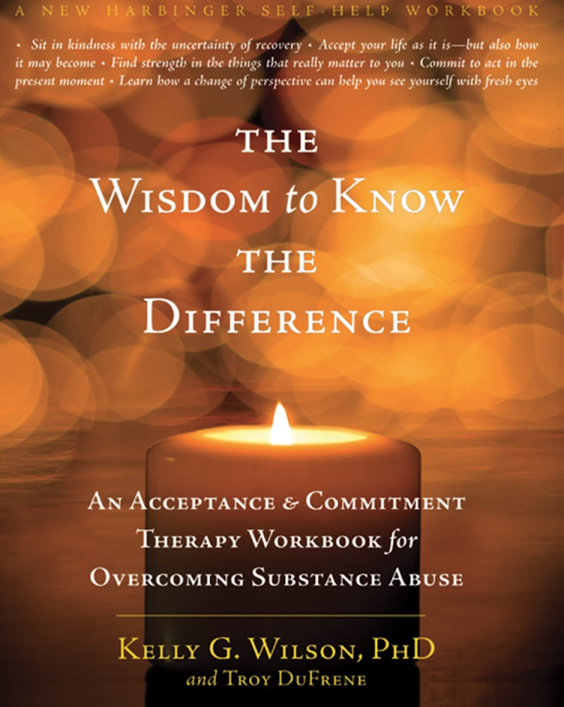
Good News!!
Evidence-based treatment (EBTs) for both issues
Cognitive Behavioral Therapy (including exposure-based therapies and Group)
Acceptance and Commitment Therapy
Motivational Interviewing
Notes:
I just saw Dr. Liese at SMART and ABCT, he runs a virtual SMART Group, wanted to change the title

Slide 39
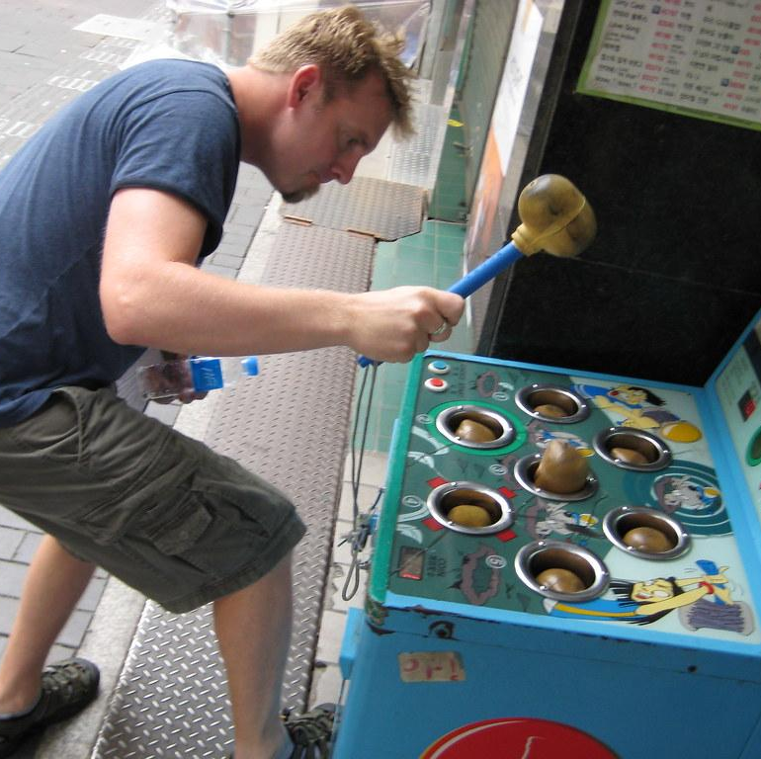
Context of the Problem:
Whack-a-Mole
When symptoms are used to cope, it is not uncommon for new/different symptoms to arise when working on reducing or eliminating original symptoms
This Photo by Unknown Author is licensed under CC BY-SA-NC
Notes:
Also known as symptom swapping

Slide 40
Questions to Form Your
Case Conceptualization
How and why did this person develop these SUD and OCD behaviors?
How do they make sense to them?
How did the SUD and OCD behaviors escalate to the present level?
How effectively did this person function before using substances, often OCD first?
What triggers/obsessional thoughts precipitate behaviors/compulsions or reverting back?
What unique schemas, thoughts, or beliefs maintain addictive and OCD behaviors?
What role does the environment play (e.g. reassurance seeking, accommodations)?
What barriers have prevented the person from stopping compulsions or SUD behaviors?
Are there other mental health problems contributing to the OCD and substance use?
Guided by these questions, therapists can structure sessions and formulate effective strategies. Without an accurate case conceptualization, therapy lacks direction, like a ship without a rudder

Slide 41
Avoidance is the PROBLEM,
NOT the Solution
Emotions themselves are not unsafe, dangerous, threatening or “wrong”/undesirable.
Certain emotions can remind us of a time when we felt unsafe or were unsafe, but the emotion or thought itself is not unsafe or “wrong”
Attempts to avoid uncomfortable and painful emotional experiences drives unsafe, threatening and dangerous behaviors (substance use).
Notes:
The more a person acts on impulses to avoid difficult thoughts and emotions, the stronger and more destructive these impulses become.
A patient who turns away from unpleasant internal states by using ED behaviors will enjoy transitory relief, but will reinforce the association between distress and this avoidant action in the future

Slide 42
Transdiagnostic Treatment for OCD and SUD
In essence it's all ERP…the creation of New Learning…
Cognitive & Behavioral Flexibility
  Movement towards
  Not about symptom reduction
  I’m allowed to be imperfect as I change my behavior, I have learned a lot of things and it takes time to learn NEW ones with both OCD or SUD recovery
  “One day at a time”
  “What is the function of this thought or behavior and is it helpful?”
  “I learned more about Geometry than how to be married or a parent!!!”

Slide 43
Values Clarification
Facilitate Values Exploration
  "What brings meaning to your life?"
  "What kind of person do you want to be in relationships, work, health, etc.?"
  "When have you felt most fulfilled?"
Provide values sorting exercises (e.g., ranking a list of values or writing down the top 5).
Identify Barriers to Living by Values
Explore experiential avoidance (e.g., fear, doubt, discomfort) that may block value-driven action.
Use defusion techniques to help clients distance themselves from unhelpful thoughts.
Connect Values to Committed Action
Help clients set small, value-driven actions (e.g., "If kindness is important, what’s one way you can practice it this week?").
Emphasize process over perfection—values are about ongoing effort.
Reinforce Values-Based Living
Encourage clients to check in regularly on their values and realign their actions as needed.
Use mindfulness practices to stay present and aware of choices that align with values.
Notes:
Value of relationships over alcohol: “Brenda and Samantha’s love feels better than any bottle of booze, and their love doesn’t give me a hangover.

Slide 44
SMART is Transdiagnostic Treatment!!
The Goal: Stop giving in to the behavior. In SMART, the behavior is substance use. In OCD treatment, the behavior is a compulsion (like checking a lock or washing hands).
The Strategy ("Riding It Out"): Both teach that extreme discomfort—whether it is a craving for drugs or intense OCD anxiety—is a false alarm in the brain.
In SMART: This is called Coping with Urges.
In OCD treatment: This is called Response/Ritual Prevention.
The Lesson: If you just sit with the discomfort and refuse to do the behavior, the brain eventually realizes you are safe, and the feeling fades away on its own.
The Motivation: Both recognize that sitting with that discomfort is exhausting. To get through it, you have to focus on why you are doing it. In SMART, you do a "Cost/Benefit Analysis." In OCD treatment, you focus on your "Values." Both mean focusing on the life you want to build instead of the temporary relief.

Slide 45
Additional Methods for Treating Co-Occurring OCD/SUD
Addressing Family Over-Accommodation: SPACE (Supportive Parenting for Anxious Childhood Emotions) **principles can be applied to adults
Using ACT to support caregivers
Using CRAFT to support caregivers
Notes:
SC
Study: parent’s experiential avoidance predicts their child’s anxiety.
One theory: Parental experiential avoidance of anxiety about their child’s anxiety may lead to accommodation and enabling and perpetuate the disorder through negative reinforcement
Study:
•ACT helps family members of individuals with Schizophrenia in navigating the psychological toll of their loved one’s mental illness.
•Meta-analysis:
•ACT for Caregivers was associated with decreases in:
•Depressive symptoms
•Stress
•Anxiety
•It was suggested that ACT’s beneficial impact on caregiver was secondary to the six ACT processes.

Slide 46

Long-term Maintenance
Recovery can look different over time
Continued focus on values is key!
Notes:
SC

Slide 47
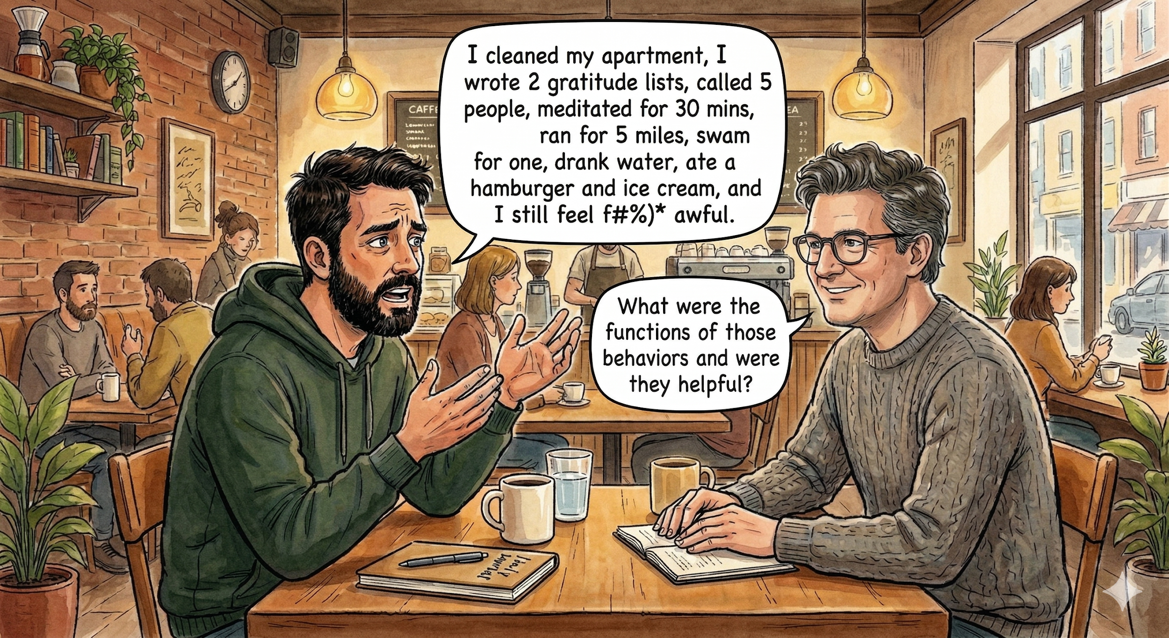

Slide 48
Making the case for Collaborative Care
Creates a treatment “team” environment
Reduces isolation
Increased contact and connection
Allows for the specialists to “do their thing”
More comprehensive, holistic care of the WHOLE PERSON
If we address the core underlying mechanisms, there is no longer such a need to find new symptoms to cope

Slide 49
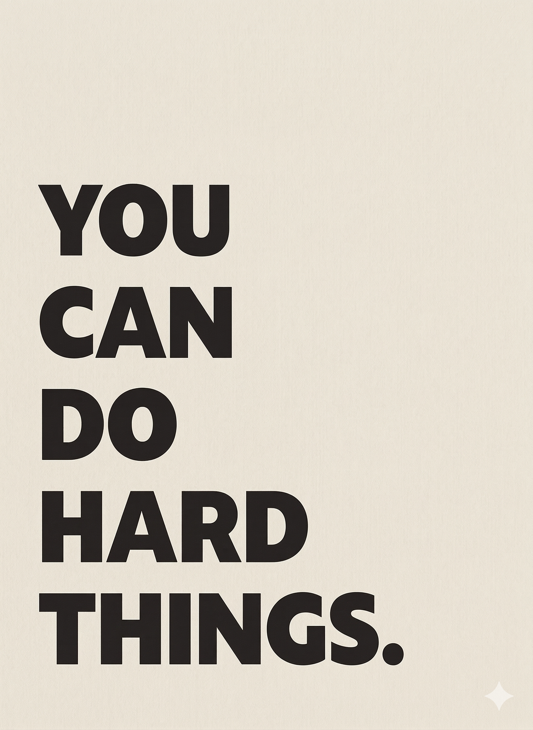
The Goal:
Empower clients to courageously approach rather than avoid painful, anxious, uncomfortable emotions.

Slide 50
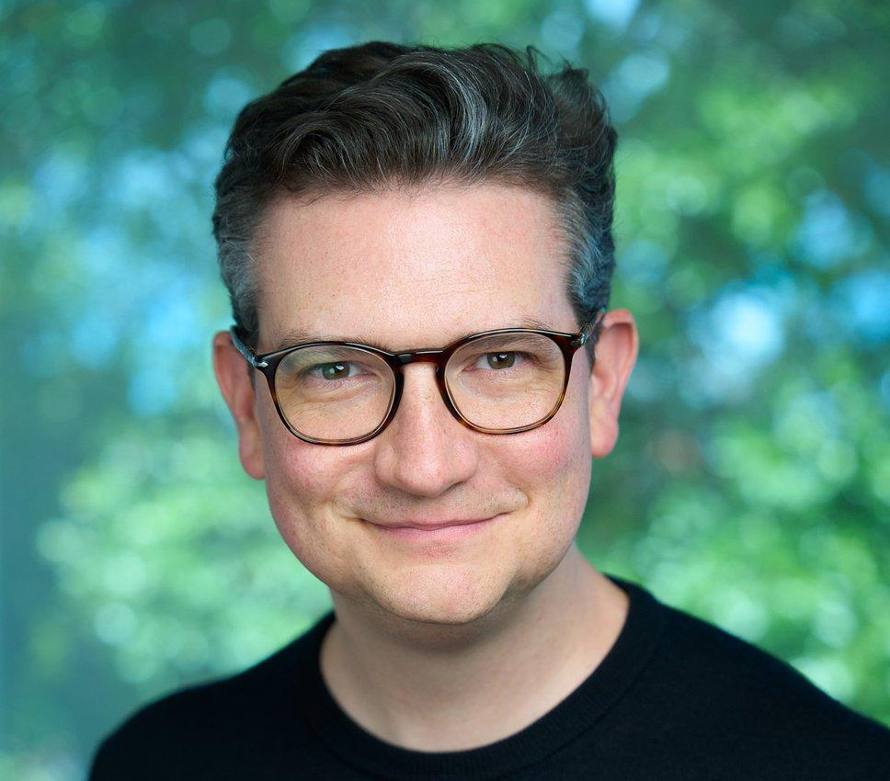

Gwilym Roddick, DSW, LCSW
dr.roddick@cbtcentralflorida.com cbtcentralflorida.com
CBT-Trainers.com
(407)-307-0300
Notes:
GR

