Slide 1
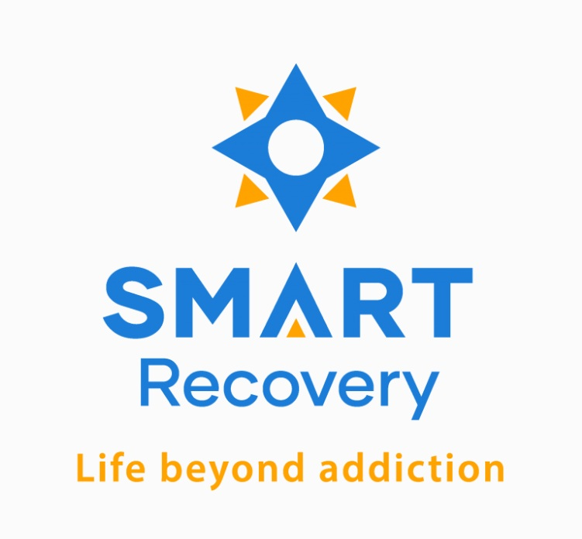

From Relapse to Resilience: Building a Veteran-Led SMART Recovery Network in the VHA
BRIDGES TO EMPOWERMENT
LEARNING STORY
A journey of transformation led by Rob Martin, Greg Edwards, and Corey Ginkel — clinicians and Veterans bridging clinical treatment with sustainable recovery through peer leadership and innovation.
Notes:
This presentation highlights the Veterans SMART Network, a VHA-supported innovation created to address the 94% relapse rate among Veterans after SUD treatment. Developed during the COVID-19 pandemic, the program empowers Veterans to become SMART Facilitators and Certified Peer Recovery Specialists through scholarships, technology access, and peer-led support groups.
The presentation will explore how this model bridges treatment and long-term recovery, integrates CBT tools with lived experience, and fosters Veteran leadership. Attendees will gain insights into replicating this peer-driven approach to recovery in other systems.

Slide 2

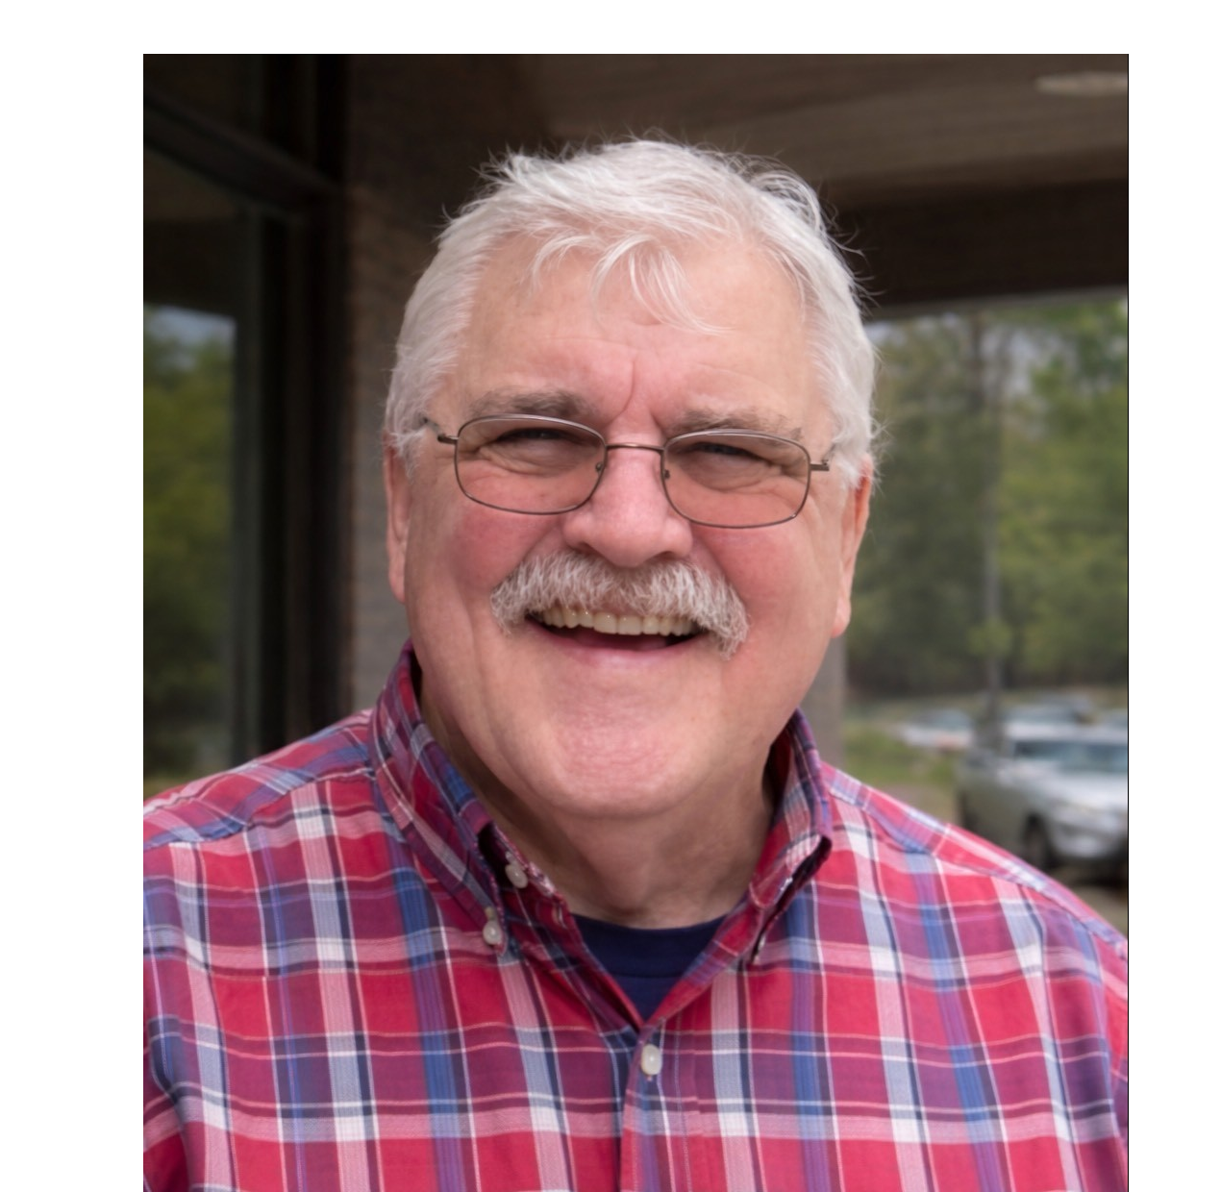

Meet the Team
Who We Are
Rob Martin
Greg Edwards
Corey Ginkel
Clinical supervisor with 30 years of experience and 35 years in recovery. Rob bridges clinical expertise with peer innovation, envisioning a system that supports Veterans beyond acute treatment.
Vietnam Combat Veteran (USMC) who brings authenticity and humor to recovery work. Greg represents the resilience of older Veterans and leads with lived experience that commands respect.
Gulf War Army Veteran who rebuilt his life through Whole Health and SMART Recovery. Corey represents network expansion and brings structure, creativity, and passion to peer facilitation.
2
Notes:
VA and VSN both using Peer support: VA uses peer support specialists
SMART Facilitators = using peers
Identify people to become facilitators. And use their SMART tools in VA recovery programs
Story and SMART Experience of Corey
Found a different set of tools
Practical tools for real life

Slide 3
Agenda
Rob Martin – Why the Movement Started
  Developing relapse prevention support for Veterans
Greg Edwards – How the Movement Works
  Identifying Veterans to become facilitators and using SMART tools in VA recovery programs
Corey Ginkel – The Impact of the Movement
  A Veterans Story and SMART Experience: A new set of tools for real life
3

Slide 4
Why The Movement Started: The Relapse Crisis
94%
The VHA system excelled at treating acute addiction but struggled to support sustainable recovery once Veterans left residential care. We faced a revolving door of readmissions.
Relapse rate among Veterans discharged from residential SUD treatment
The challenge wasn't the medical care itself — it was the lack of community infrastructure to bridge the gap between "patient" and "person living in recovery."
We needed a bridge to empower Veterans beyond the hospital walls.
Notes:
**“Imagine this: a Veteran completes substance use disorder treatment, ready to rebuild their life, but as they leave the program, there’s no structured support system to sustain their recovery. At the Richmond VA Medical Center, we saw this all too often, and the results were heartbreaking—94% of Veterans relapse after treatment.
As someone in recovery myself and a clinician who has worked in countless treatment settings, I knew this wasn’t just a local issue—it was systemic. But I also saw a solution. Veterans in recovery have a natural drive to help their peers, and with the right training and tools, they could become powerful leaders in the recovery process.
That’s why we launched the Veterans SMART Network. Partnering with the central VA healthcare system, we secured funding to train Veterans and providers as SMART Recovery facilitators—offering an evidence-based, CBT-focused alternative to traditional 12-step programs. The result? A growing network of peer-led support groups designed specifically for Veterans, bridging the gap between treatment and long-term recovery.
This program works because it’s built by Veterans, for Veterans. It empowers those in recovery to lead and inspire others while creating a lasting support system that’s desperately needed.
Today, we’re talking to you about a program we started that we are expanding nationwide through the Innovation Center of the Veterans Health Administration and the SMART Recovery community. If you’re a leader in SMART Recovery, you have the power to replicate this model, offering hope to the participants in the meetings. And if you’re a Veteran in recovery, this is your chance to join a movement that’s changing lives. Together, we can ensure no Veteran has to face recovery alone. Let’s build a stronger future—one group, one leader, one life at a time.”**

Slide 5
The Innovation: The Veterans SMART Network
Peer Connection
Evidence-Based
Ongoing Support
Veterans leading Veterans through shared lived experience and authentic understanding
SMART Recovery's 4-Point Program integrated with VHA's Whole Health approach
Sustainable community beyond treatment discharge, preventing the revolving door
We didn't just want attendance — we wanted empowerment. Our strategy shifted from pathology-based models to peer-driven recovery, training Veterans not just to attend meetings, but to lead them.

Slide 6
The Strategy
Finding and Training Recovery Leaders
The ‘Recovery Corps’ Approach
We identified Veterans with lived experience who could command respect and offer authentic hope. This wasn't just a coffee social — it involved rigorous training to become certified SMART Facilitators.
Professionalizing the peer role through SMART Facilitator certification
Using scholarships to remove financial barriers for facilitator training
Discerning between participants and future facilitators
Building a leadership pipeline, not just a support group

Slide 7
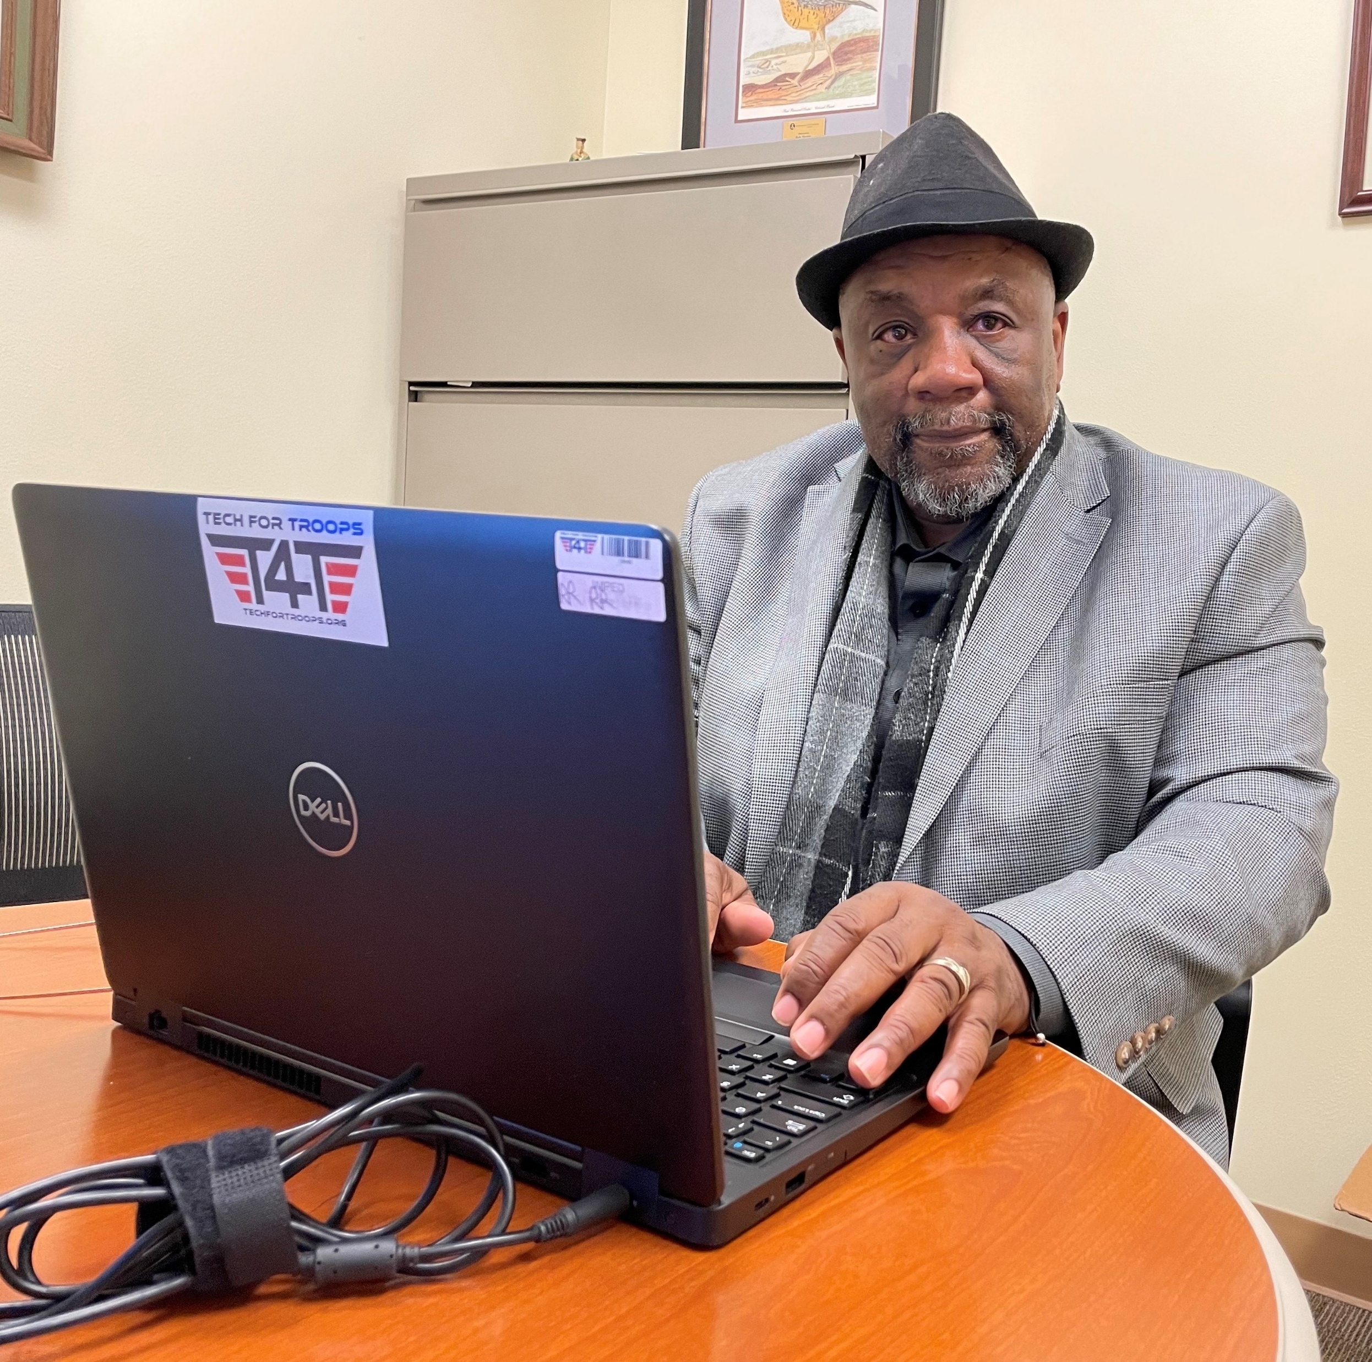

What Worked: Technology as a Bridge
Bridging the Digital Divide
Many Veterans lacked the digital equity to attend or lead virtual meetings. Geographic isolation and mobility issues created barriers to participation.
Our Partnership: We collaborated with Tech for Troops to provide laptops and technology access, removing this critical barrier.
The Impact: We launched virtual meetings every Monday night, accessible to Veterans regardless of physical location or mobility limitations. Rural Veterans could now participate fully.
This technology partnership became transformative for our network's reach and sustainability.
7

Slide 8
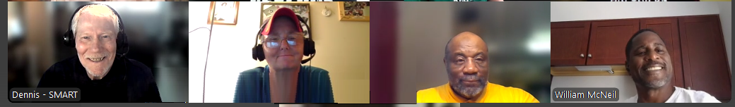
Overcoming Barriers: What We Learned
The Data Challenge
The Readiness Gap
The Pivot to Systems
For funding through the VHA, we learned we needed more data-centric evidence to prove viability and secure widespread adoption beyond individual charisma.
Not every Veteran was ready to lead immediately. We had to learn how to identify and nurture potential facilitators while supporting all participants.
We shifted focus to creating a replicable guide and structured systems rather than relying on individual leaders alone.

Slide 9
The Impact: From Relapse to Resilience
61.5%*
$768K*
Prevention Rate
Healthcare Savings
Veterans prevented from returning
to residential treatment
Potential cost reduction
from decreased readmissions
Measurable Transformation
Survey data revealed that 61.5% of participating Veterans credited the Veterans SMART Network with helping them avoid returning to residential treatment.
This reduction in readmissions represents over $768,000 in potential healthcare system savings — but the human impact is immeasurable.
Real change: Veterans transitioning from chronic relapse to becoming peer facilitators, leading others on the same journey.
*Annual estimate based upon 2024 data from one VA Medical Center.

Slide 10
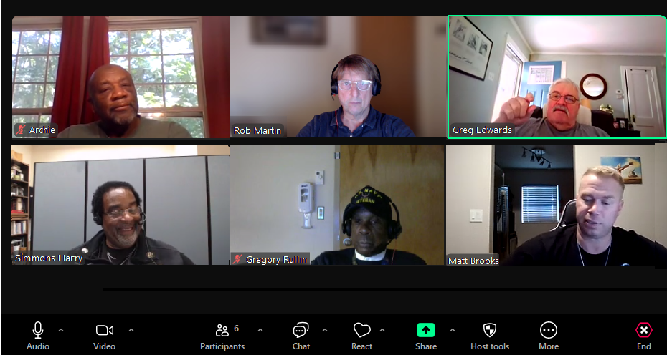



The Secret Sauce:
Lived Experience
& Authentic Connection
"Recovery is serious work,
but it doesn't have to be
without humor."
— Greg Edwards
Authenticity
Humor & Hope
Creative Expression
Veterans trust Veterans. We speak a language that transcends clinical terminology, creating genuine peer-to-peer understanding.
Breaking down stigma through humor creates safe spaces distinct from clinical therapy groups, making recovery approachable.
Integrating writing and creativity into SMART's 4-Point Program gives Veterans new tools for self-expression and healing.

Slide 11

The Future = Replication & Scale: Our Vision for Growth
Current Status: We're in the Replicate/Scale phase, expanding from Richmond to Durham, Asheville, and Hampton across VISN 06.
The Goal: Launch a SharePoint-based implementation guide enabling other VAMCs to adopt this model by Q2 FY26.
National Vision: Ensure Veterans' voices shape recovery-oriented systems of care nationwide.

Slide 12
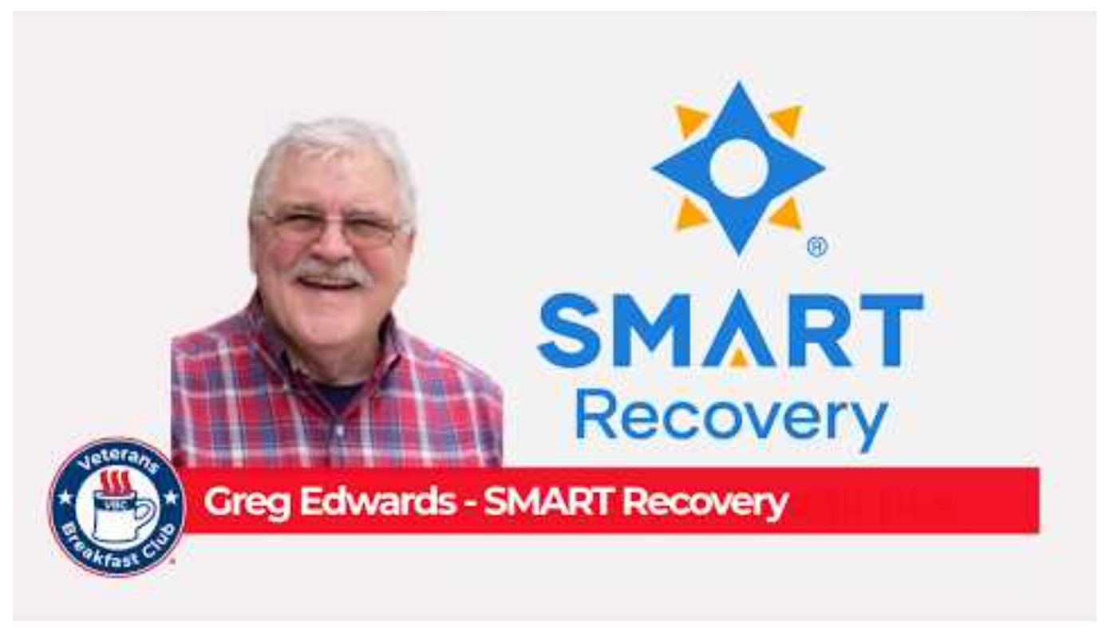
How the Movement Works
Greg Edwards
  Veterans Breakfast Club YouTube Podcast: https://youtu.be/VAMEx4UaQME
My journey — from the jungles of Vietnam to becoming a beacon of hope for Veterans (and others) in recovery.
12
Notes:
VA and VSN both using Peer support: VA uses peer support specialists
SMART Facilitators = using peers
Identify people to become facilitators. And use their SMART tools in VA recovery programs
Story and SMART Experience of Corey
Found a different set of tools
Practical tools for real life

Slide 13
A Marine Shaped by Service
Family Legacy of Service
Enlisting in 1969, I was inspired by family members who served across WWI, WWII, and Korea — military service was in his blood.
Vietnam Instead of the Mediterranean
After accelerated boot camp and jungle training, I was rerouted to Vietnam, serving with the 2nd Battalion, 1st Marines as a chief clerk and later in field operations.
Lessons That Lasted 40 Years
Though I left after two years, the discipline, structure, and reliability forged in the Marines anchored a four-decade civilian career.

Slide 14

Challenges After Service
COMING HOME
Like many Vietnam-era veterans, I returned home carrying invisible wounds — untreated PTSD and progressively worsening alcohol use that shadowed his post-service years.
VA Inpatient Program
Searching for the Right Fit
A 28-day program introduced me to Cognitive Behavioral Therapy — a turning point in understanding his own patterns.
AA's religious framework and stigmatizing labels didn't resonate. SMART Recovery's practical, non-judgmental approach did.
Notes:
What challenges did you have after service.

Slide 15
Stepping Up to Lead
From Participant to Facilitator…
When COVID moved my local meeting to Zoom and the previous leader passed away, I stepped forward — and never looked back.
Using the SMART handbook, values clarification exercises, and the Stages of Change model, I foster a space where lapses are met with understanding — not punishment. Many members have stayed since the pandemic began.
Notes:
What made you decide to start leading and becoming a facilitator?

Slide 16
How I Describe SMART Recovery
A science-based, mutual-support program built on empowerment, personal responsibility, and choice.
CBT-Based Tools
No Labels, No Stigma
Structured exercises help participants build motivation, manage urges, and create balanced, fulfilling lives.
SMART discourages terms like "alcoholic," replacing shame-based language with empowering, identity-neutral framing.
Open Dialogue Welcome
Any Addictive Behavior
Cross-talk is encouraged — real conversation between participants, not just one-way sharing.
Alcohol, gambling, PTSD-related coping, and more — SMART supports the full spectrum of addictive challenges.
Notes:
What important to you as facilitator of groups for Veterans, 1st Responders and others?

Slide 17
Building a Veteran-Led Recovery Network
NATIONAL OUTREACH
Expanding SMART Recovery Across the VA
We are developing a national outreach plan with a clear mission: train more veteran facilitators, embed SMART programs in VA hospitals nationwide, and offer ongoing, evidence-based support that outlasts the traditional 28-day cycle.
High relapse rates after short inpatient programs signal the urgent need for sustained, veteran-centered recovery communities.
17

Slide 18
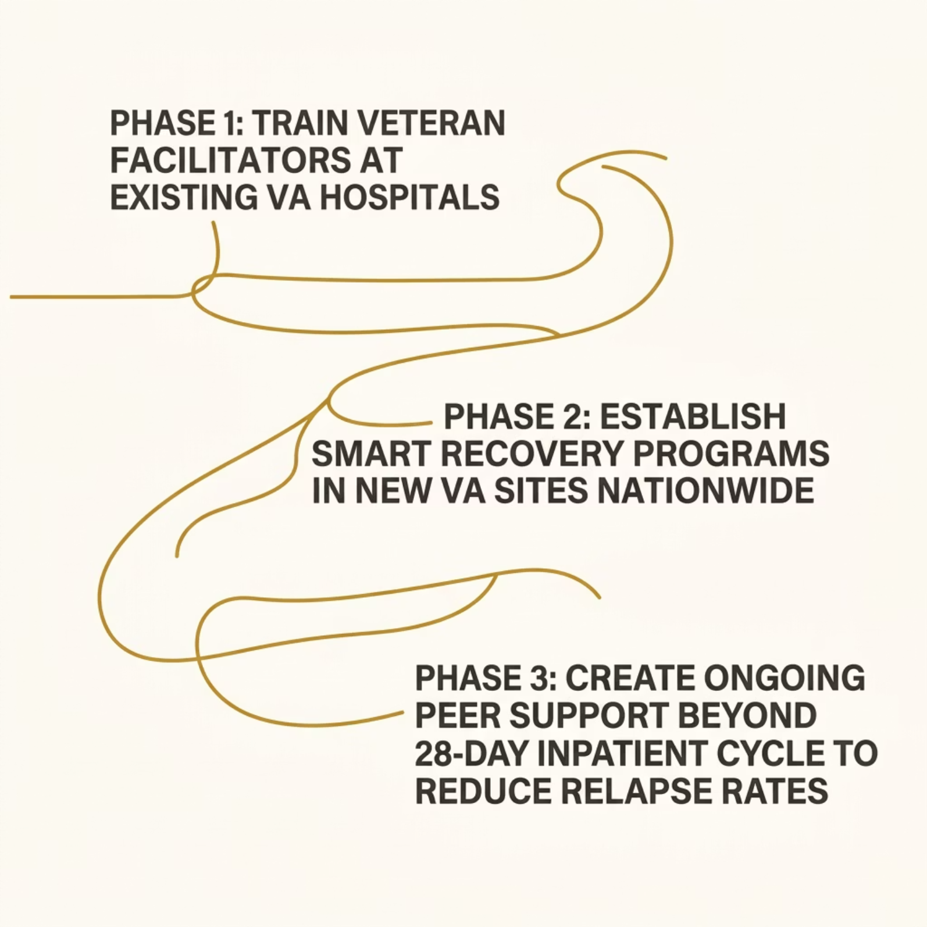
Building a
Veteran-Led
Recovery
Network
NATIONAL OUTREACH
18

Slide 19
The Impact of the Movement
Corey Ginkel
19
Notes:
VA and VSN both using Peer support: VA uses peer support specialists
SMART Facilitators = using peers
Identify people to become facilitators. And use their SMART tools in VA recovery programs
Story and SMART Experience of Corey
Found a different set of tools
Practical tools for real life

Slide 20
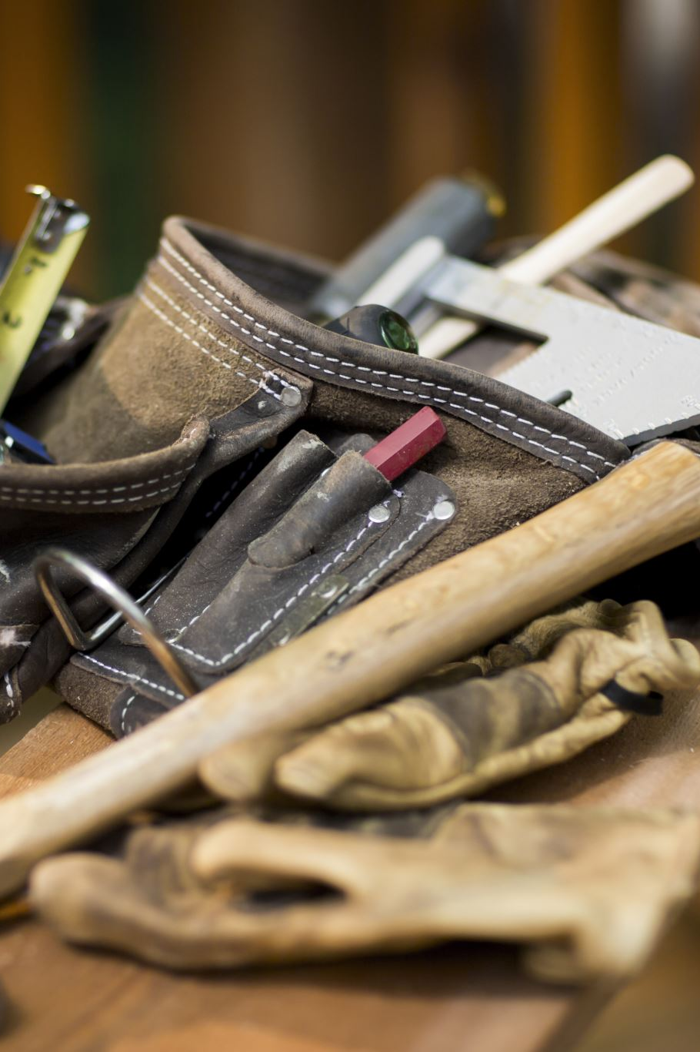
From Burying Problems to Building Tools
A Journey Through Military Life, PTSD, and SMART Recovery
20
Notes:
- Introduce myself and set the tone for the journey.
- Emphasize the shift from burying problems to building tools.
- Frame this as a veteran-to-veteran conversation.
- Highlight SMART Recovery as the turning point.

Slide 21
Growing Up Military
Military brat upbringing
Learned early: "Bury the emotion, keep moving"
Parents doing their best
Father likely carrying undiagnosed PTSD
21
Notes:
- Describe what it meant to grow up in a military household.
- Explain how emotional suppression was modeled early.
- Mention my father’s likely undiagnosed PTSD.
- Connect this upbringing to later coping patterns.

Slide 22

The First Coping Skill
Only emotional strategy modeled: bury it
No space for growth
Silence became the default
22
Notes:
- Explain how burying emotions became my default.
- Share how silence felt like the safest option.
- Note how this shaped my early identity.
- Set up how this strategy eventually failed.

Slide 23

Joining the Army
Enlisted right out of high school
Reinforced the same mindset
Issued four tools: E-tool, 550 cord, duct tape, hammer
23
Notes:
- Talk about enlisting right after high school.
- Describe how the Army reinforced the same mindset.
- Mention the four tools issued and what they symbolized.
- Connect these tools to my emotional toolkit.

Slide 24
The Army Mindset
"If it doesn’t fit, force it. And if it doesn’t force… F*ck it."
Great for equipment, terrible for emotions
24
Notes:
- Explain the Army mindset phrase and its impact.
- Contrast its usefulness for equipment vs emotions.
- Share how this mindset shaped my reactions.
- Lead into the consequences of forcing everything.

Slide 25
The Problem With Burying
You can’t get all the dirt back in the hole
Dirt piles up over time
Eventually you’re digging yourself into your own hole
25
Notes:
- Describe how burying problems accumulates over time.
- Use the dirt metaphor to illustrate emotional buildup.
- Explain how I eventually dug myself into a hole.
- Transition toward leaving the military.

Slide 26

Leaving the Military
Carried same tools into civilian life
PTSD, depression, anxiety, aches and pains
Old tools created new problems
26
Notes:
- Share the challenges of transitioning to civilian life.
- Mention PTSD, depression, anxiety, and physical pain.
- Explain how old tools didn’t work anymore.
- Set up the need for new tools.

Slide 27
Seeking Help
Entered Substance Abuse Residential Rehabilitation Program (SARP) in DC and Georgia
Completed 6‑month outpatient program
Information didn’t stick
27
Notes:
- Describe entering SARP and what I hoped for.
- Explain why the information didn’t stick.
- Share the frustration of wanting change but not having tools.
- Lead into discovering SMART.

Slide 28
Discovering SMART
Found SMART Recovery
Realization: The problem is not the problem
I didn’t have the right tool
Notes:
- Explain how I found SMART Recovery.
- Share the realization that the problem wasn’t the problem.
- Emphasize the importance of having the right tool.
- Transition to the new toolbox.

Slide 29

A New Toolbox
Tools for managing thoughts, emotions, urges, behaviors
Practical system that works in real life
Notes:
- Describe SMART’s practical tools.
- Explain how they helped manage thoughts and emotions.
- Share how these tools worked in real life.
- Prepare the audience for the metaphor story.

Slide 30
How SMART Became More Than a Program
Discovering SMART gave me new tools.
Becoming a facilitator helped me learn how to use them.
Helping others helped me help myself.
That’s how I, Build and Maintain Motivation.
Notes:
• When I first found SMART, the tools made sense — but using them consistently was the challenge.
• Becoming a facilitator changed everything. Even if I wasn’t perfect at using the tools myself, teaching them reminded me they were there.
• Every meeting I led reinforced the skills I needed in my own recovery.
• Helping others wasn’t just service — it was accountability, purpose, and connection.
• That’s what kept me in the Maintenance phase. Not willpower. Not perfection. Community.
• And that’s exactly why peer support in the VA matters so much — it’s the same principle: veterans helping veterans, learning together, staying motivated together.

Slide 31
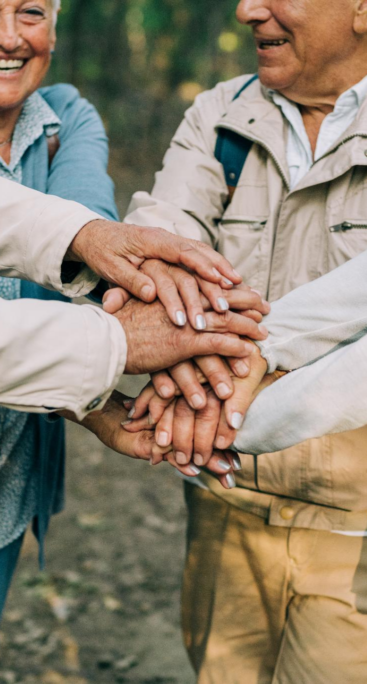
Peer Support in the VA
Fostering Connection and Belonging
  Peer support helps veterans build a strong sense of community by connecting through shared experiences, reducing feelings of isolation.
Enhancing Mental Health
  Peer support programs provide emotional encouragement and help veterans improve their mental health through mutual understanding.
Guiding Recovery Outcomes
  Veterans benefit from guidance by peers who have successfully faced similar challenges, improving recovery within the VA system.
Notes:
Image source: Microsoft 365 content library
Peer support fosters a sense of belonging among veterans, helping them connect through shared experiences. It enhances mental health by reducing isolation and providing emotional encouragement. Additionally, peer support programs improve recovery outcomes, offering guidance from individuals who have successfully navigated similar challenges within the VA system.

Slide 32

A Soldier Falls Into a Hole
A Soldier woke up in a hole and couldn’t get out.
The Soldier tried to get out, but all they did was dig the hole deeper.
Notes:
- Introduce the soldier in the hole as a metaphor for PTSD.
- Describe the Sergeant’s response.
- Emphasize how digging deeper made things worse.
- Connect this to real veteran experiences.

Slide 33
The Sergeant
A Sergeant passed by and told him to, “suck it up!”
He tossed him a shovel.
The Soldier dug, but the hole only got deeper.
Notes:
- Highlight the repeated advice to 'use your tools.'
- Explain why the shovel wasn’t enough.
- Show how effort without direction deepens the hole.

Slide 34
The Officer
An Officer walked by and told him to use the tools his Sergeant gave him.
He threw down a bucket.
The Soldier filled the bucket with dirt, but he remained stuck in the hole.
Notes:
- Introduce the Officer’s attempt to help.
- Explain why the bucket didn’t solve the problem.
- Emphasize being stuck despite trying everything.

Slide 35
The Psychologist
A psychologist sat with him and helped him figure out how he got into the hole.
They talked about patterns, triggers, and beliefs.
He understood more about what led him there —
but he was still in it.
Notes:
- Explain that the psychologist helped him understand the why, not the how to get out. Highlight that insight alone doesn’t lift someone out of a hole.
- Acknowledge that therapy can be valuable but isn’t always enough by itself.
- Emphasize the feeling of still being stuck despite “understanding the problem.”
- Connect this to many veterans’ experiences with traditional treatment.
- nSet up the contrast with what happens when a fellow veteran shows up.

Slide 36
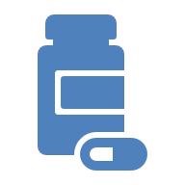
The Psychiatrist
A psychiatrist gave him medication to ease the pain.
The pills helped for a while, but when they ran out, the Soldier was still in the hole—still stuck, still alone.
Notes:
- Describe the psychiatrist’s role.
- Acknowledge medication as helpful but incomplete.
- Emphasize still being alone in the hole.

Slide 37
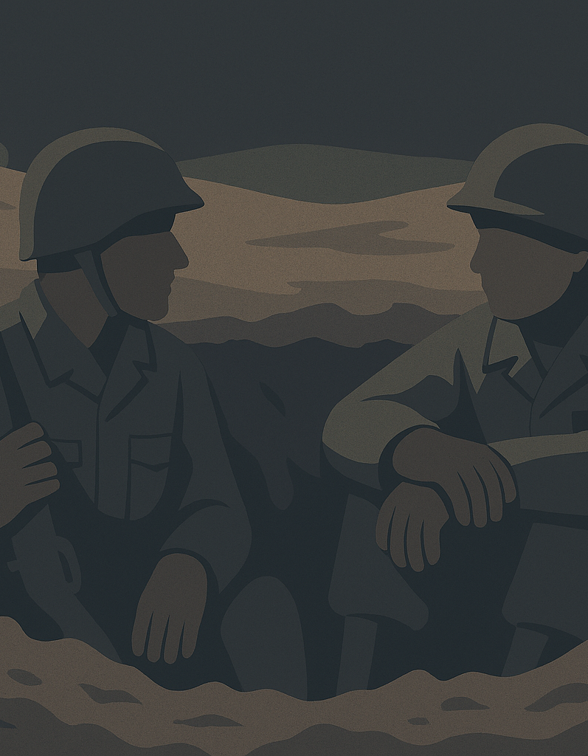
The Fellow Veteran
A fellow veteran walked by, saw the Soldier in the hole, and didn’t give advice.
He didn’t toss down a tool.
He jumped into the hole with him.
“You’re not alone,” he said.
Notes:
- Introduce the fellow veteran entering the hole.
- Emphasize the power of presence over advice.
- Highlight the importance of not being alone.

Slide 38
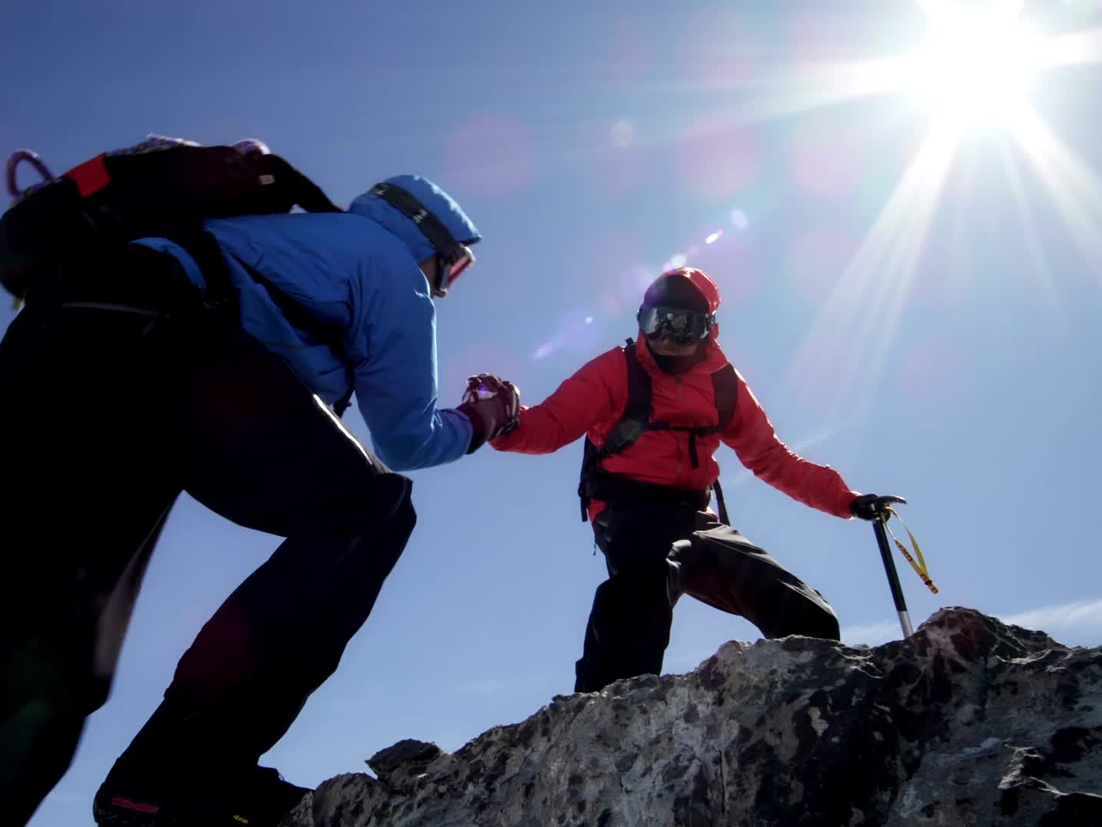
The Way Out
“Let me show you how I used each tool they gave me.”
Shovel: carved footholds
Bucket: removed weight
Medication: steadied him
Conversations: helped him understand
Faith: gave hope.
“None of these tools worked alone. But together — used the right way — they helped me climb out.”
Notes:
- Explain how each tool was used differently.
- Emphasize that tools only work when used the right way.
- Highlight the combination of tools as the solution.

Slide 39
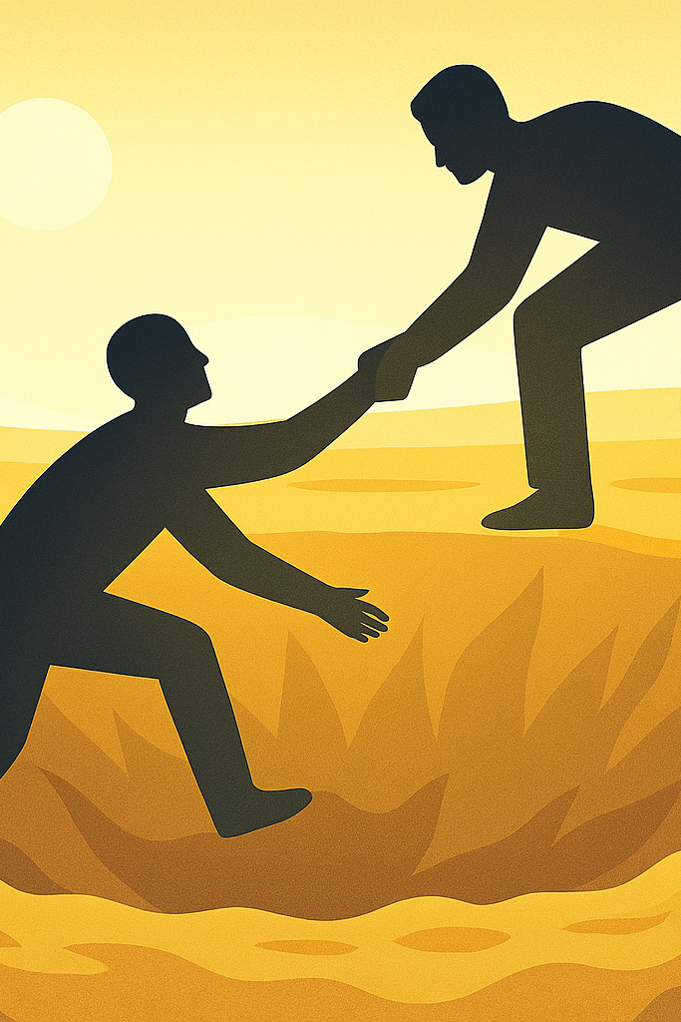
Climbing Out Together
Together, they used the right tools — and climbed out of the hole.
Notes:
- Describe climbing out together.
- Emphasize teamwork and shared effort.
- Connect this to SMART and peer support.

Slide 40
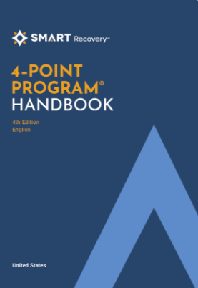
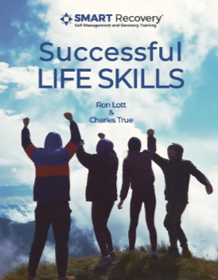
The Right Tools — and the Right People — Change Everything
Recovery isn’t done alone.
Recovery is done together.
Notes:
- Reinforce that recovery requires people and tools.
- Emphasize community and connection.
- Transition to SMART in the VA.

Slide 41

Building and Maintaining Motivation
Build and Maintain Motivation
Staying in the Maintenance phase
Facilitating meetings keeps me accountable
Notes:
- Explain how motivation is maintained.
- Share how facilitating meetings keeps me accountable.
- Highlight the maintenance phase.

Slide 42
The Power of Peer Support in the VA
Veterans connect through shared lived experience
"Me too" moments reduce shame
Peer support complements treatment
Builds motivation and accountability
Mirrors SMART’s community approach
Notes:
- Describe peer support in the VA.
- Emphasize 'me too' moments reducing shame.
- Connect peer support to SMART principles.

Slide 43
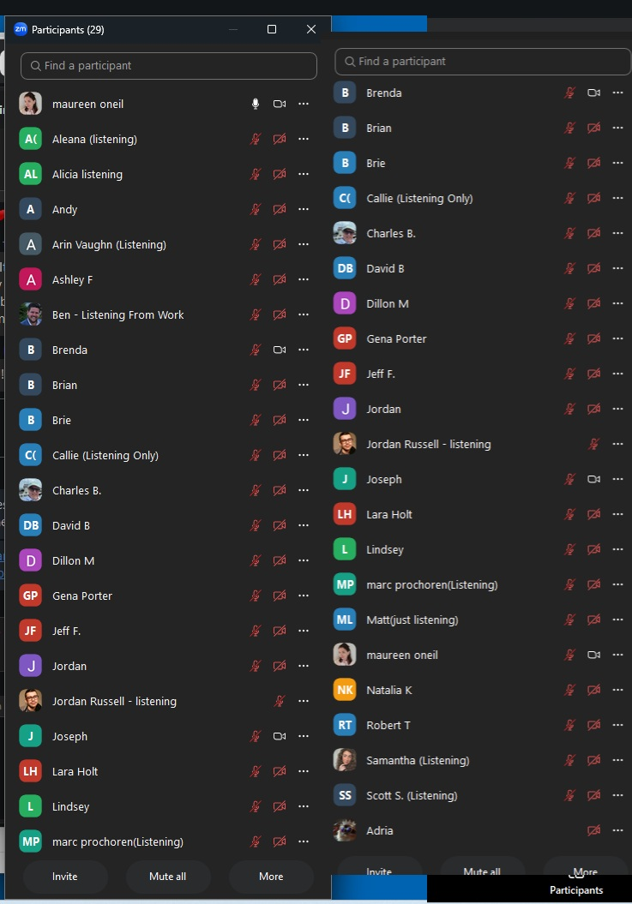
How SMART Recovery Is Peer Support
Community‑driven model
Shared problem‑solving
Accountability through meetings
Tools practiced together
Recovery done with—not to—people
Notes:
- Explain how SMART functions as peer support.
- Highlight shared problem-solving and accountability.
- Emphasize practicing tools together.

Slide 44
This Is What SMART Recovery Does for Veterans
Veterans helping veterans
Support that doesn’t end at 6–8 weeks
Skills + connection
A path out of the hole
Notes:
- Describe what SMART offers veterans.
- Emphasize long-term support beyond 6–8 weeks.
- Highlight skills, connection, and a path out of the hole.

Slide 45
My Part of the Story
From relapse… to resilience
From isolation… to connection
From being in the hole… to showing others the way out
This is what a veteran‑led SMART network makes possible
Notes:
- Share my personal transformation.
- Emphasize resilience, connection, and leadership.
- Highlight the impact of veteran-led SMART networks.

Slide 46
Closing
“I’m was part of that 94% statistic. I am now here as proof that when veterans support veterans — with SMART as our foundation — we don’t just get out of the hole… we build ladders for the next person. That’s how we turn relapse into resilience.”
Notes:
- Deliver the closing message with conviction.
- Emphasize not being a statistic.
- Reinforce the power of veterans supporting veterans.
- End with the ladder metaphor.

Slide 47
Join the Conversation
What barriers have you faced in empowering meeting participants to become leaders of new meetings?
How can we better use technology to bridge gaps for rural or isolated participants?
How can we integrate lived experience more fully into the meetings?

Slide 48


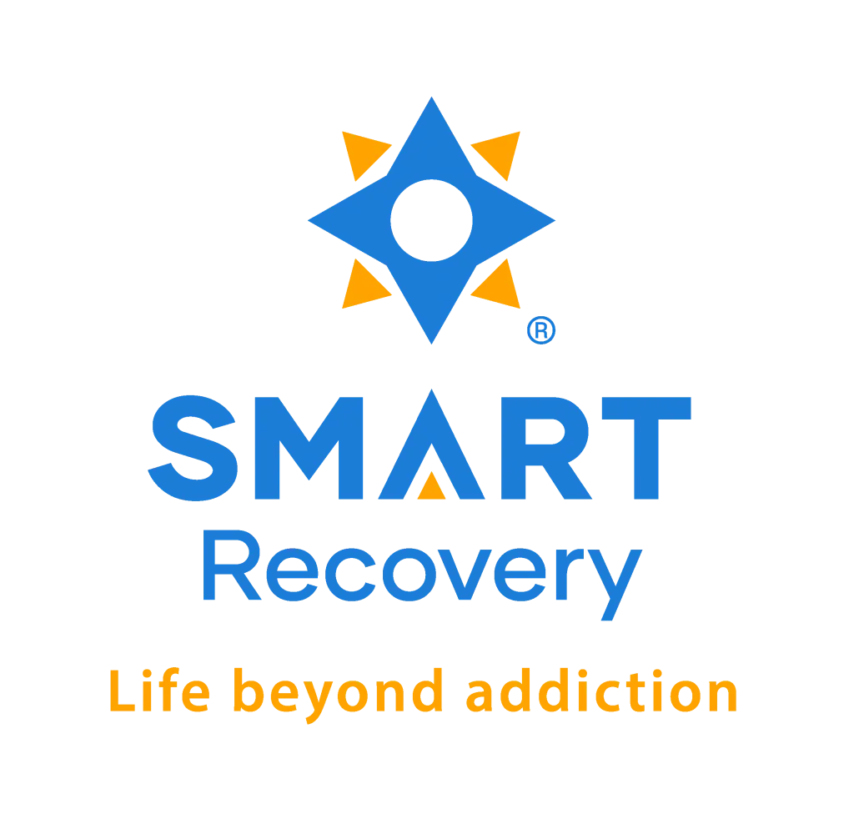
48

