Slide 1
Empowering
Adolescent Perspectives:
Working through Safer Substance Use Strategies
April 10, 2026
Notes:
Imagine you are 15 years old again, you are curious about the world around you, testing boundaries, trying to figure out where you fit and who you can trust.
And you're getting a lot of different messages, at home, from school, online. About what you should do and what you shouldn't do.
And what you really need isn't more rules, it's someone you can trust. Someone you can be real with and you know will be real with you.
Maybe you just tried substances for the first time, or you're thinking about it.
Maybe your friend is using substances and you have questions.
Or maybe you've been using substances, you tried to quit and discovered that you get really sick, you're scared and not sure what to do.
There are so many reasons a young person might turn to substances, for connection, to cope, to feel okay in a world that doesn't feel okay.
And when they reach out, IF they reach out, What happens next is what matters MOST.

Slide 2
Empowering Adolescent Perspectives: Working through Safer Substance Use Strategies
Presented by:
Jacqueline Mace, M.S., LPC, NCC, CRADC
Assistant Clinic Director
Ellie Mental Health
Kansas City, Missouri
"Nothing to disclose"

Slide 3

Welcome & Learning Objectives
Today we will:
  Describe effective strategies for engaging teens who are experimenting with or using substances, with attention to developmental, ethical, and cultural considerations.
  Explain how SMART Recovery tools align with a harm reduction approach and name 3 ways to adapt these tools to meet the unique needs of youth.
  Demonstrate 4 developmentally appropriate safer-use strategies that incorporate youth perspectives and address common barriers faced by teens.

Slide 4
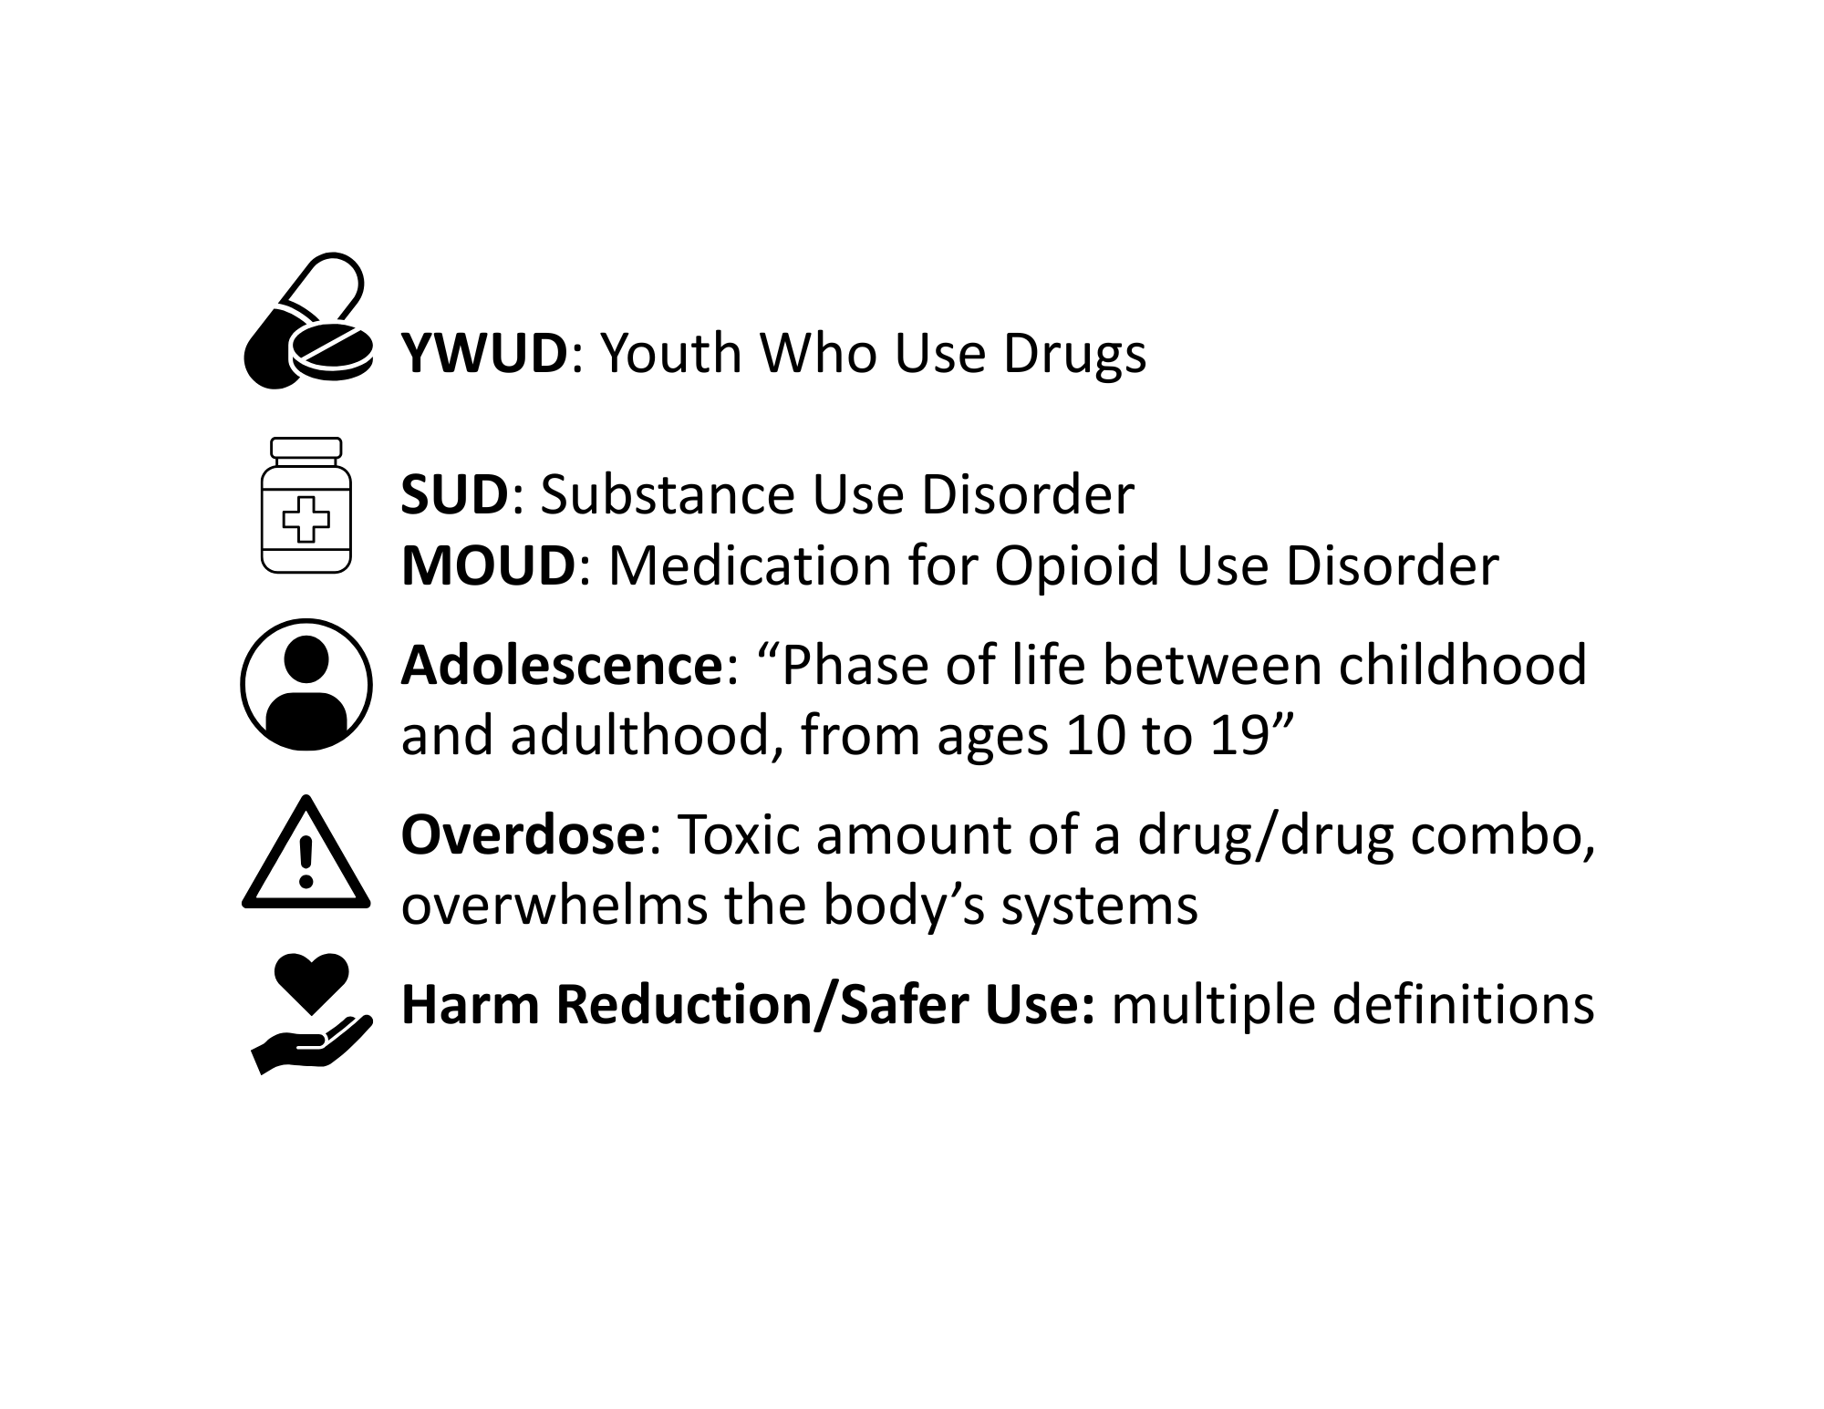
Terminology & Definitions
YWUD/YPWUD/PWUD: Youth/Young Person/Person Who Use(s) Drugs
SUD: Substance Use Disorder
MOUD: Medication for Opioid Use Disorder
Adolescence: “Phase of life between childhood and adulthood, from ages 10 to 19” ¹⁹
Overdose: Toxic amount of a drug/drug combo, overwhelms the body’s systems ¹²
Harm Reduction/Safer Use: multiple definitions
¹² National Harm Reduction Coalition, 2025
19 World Health Organization. (n.d.).
Notes:
SMART Recovery's philosophy

Slide 5
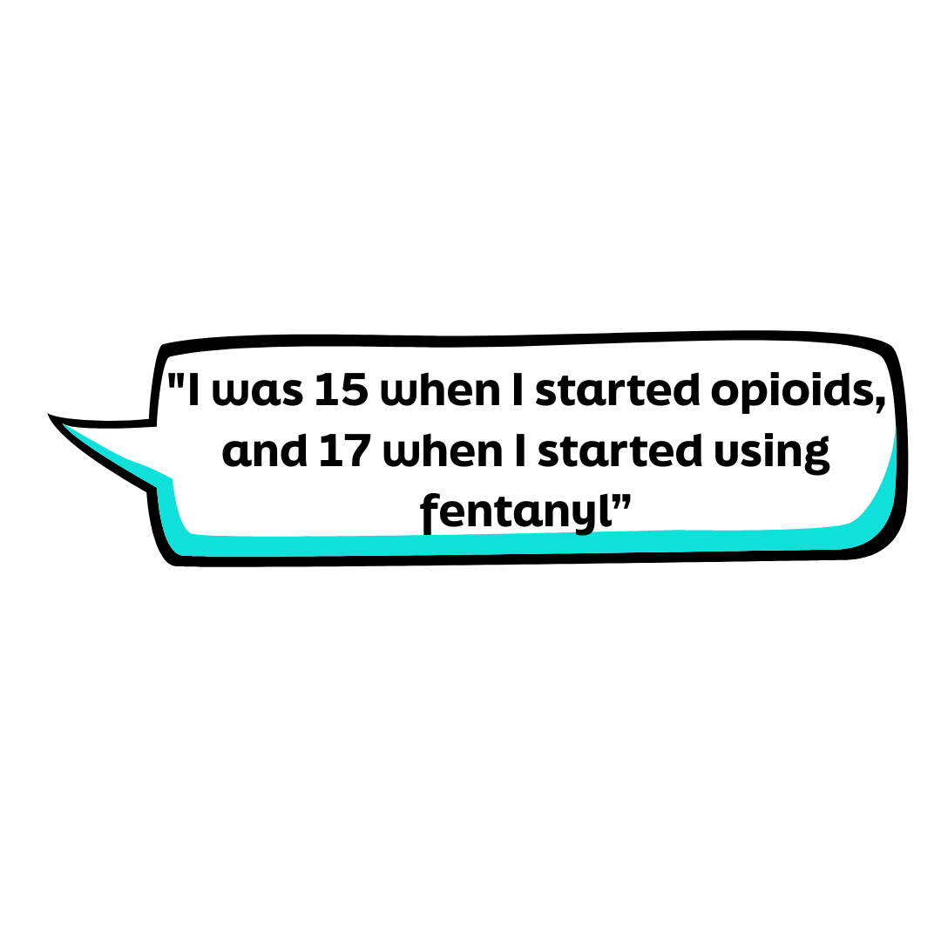
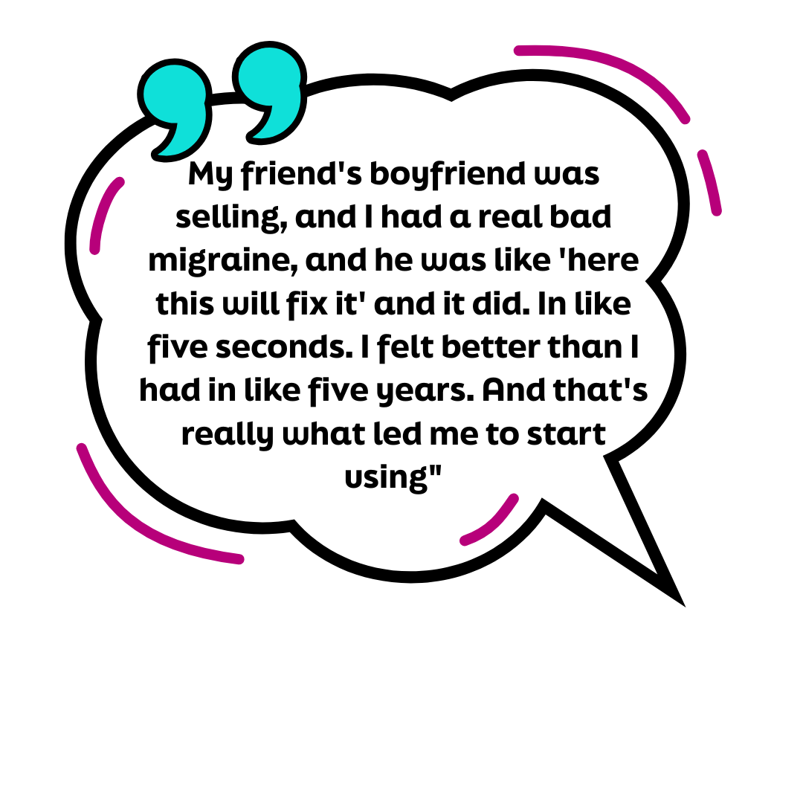
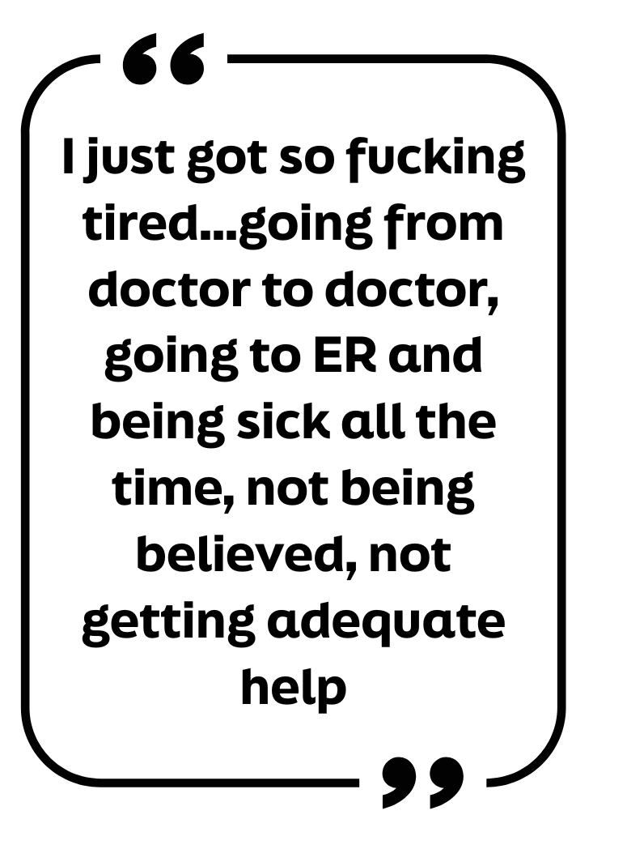
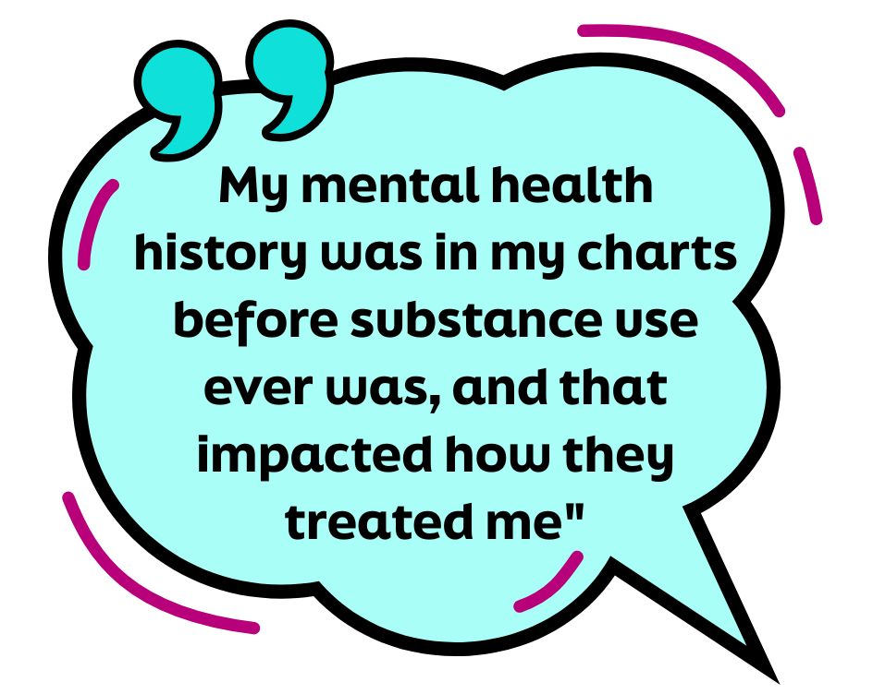
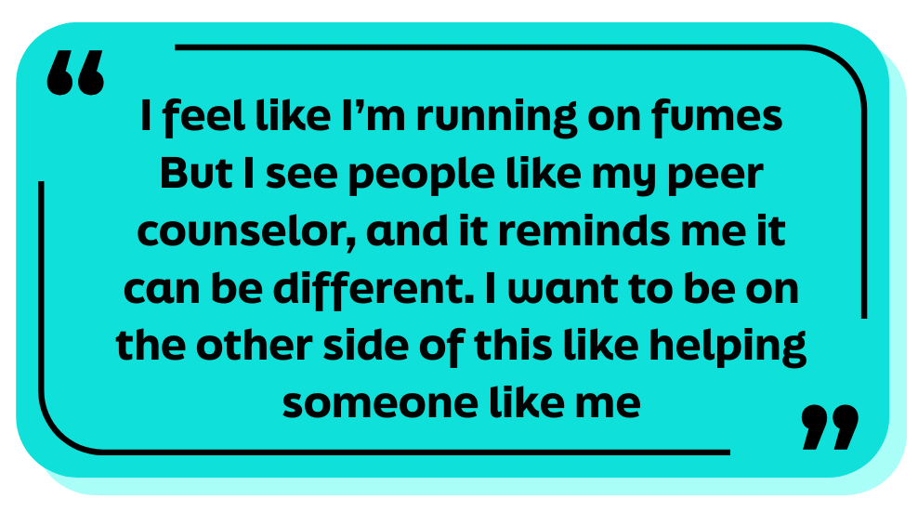
Hope's Story
*Name changed to protect confidentiality

Slide 6
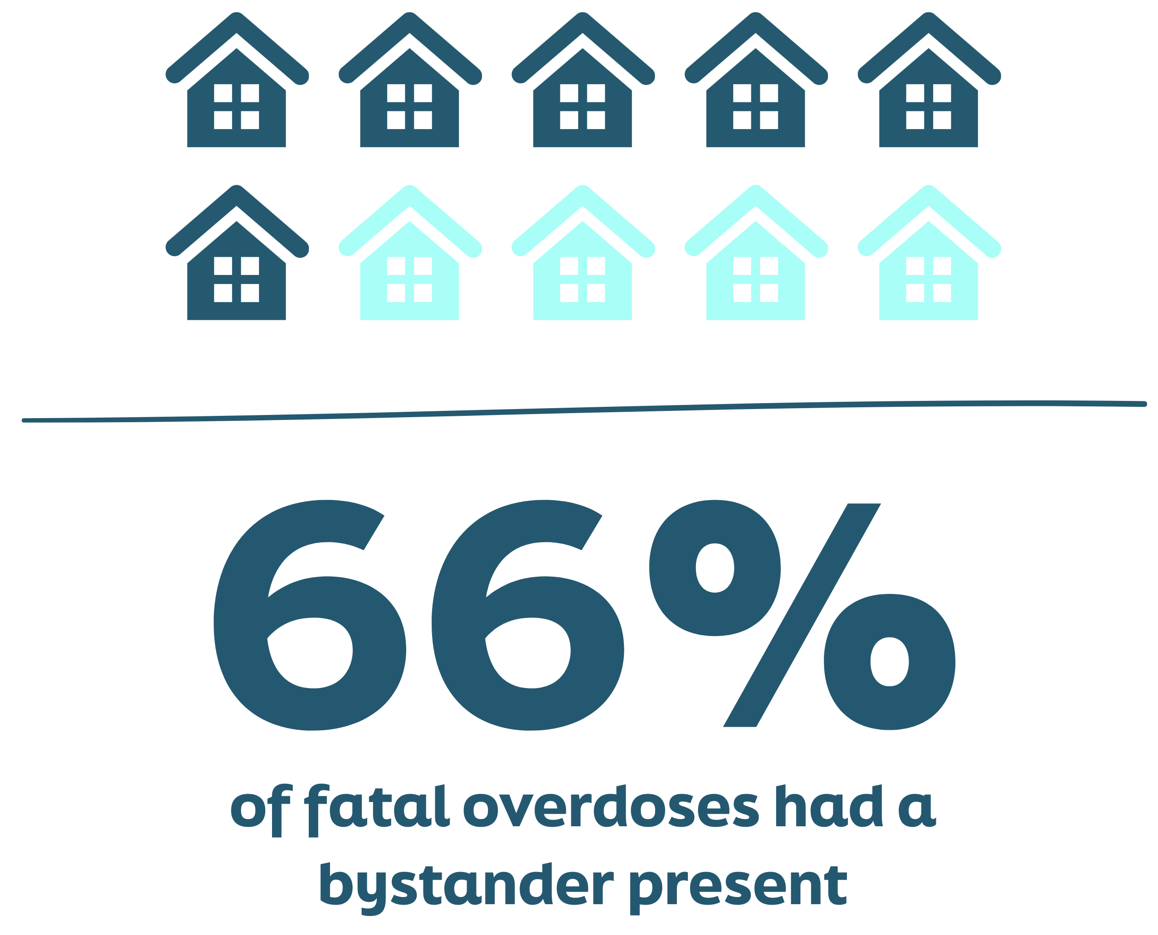
What do we know about youth drug use?
Decline in overall drug use since 1990s
Decrease corresponding with the pandemic ¹⁶
Significant increase in opioid related OD deaths ages 10-19 ¹⁶
Fatalities disproportionately higher than other age groups ³
³ Friedman, Godvin, Shover, Gone, Hansen, & Schriger, 2022
¹⁶ Tanz, Dinwiddie, Mattson, O'Donnell & Davis, 2022
¹⁶
Notes:
Overall decline in youth drug use since the 1990s.
From 2010-2020 we saw a stable rate of use.
During the pandemic, youth drug use dropped significantly (Miech, Johnston, Patrick, & O’Malley, 2024). And what might be more interesting, is that this decrease has held.
Decrease has continued-Monitoring the Future survey found that the 2024 cohort of youth had the lowest use statistics in decades (Miech et al., 2024).
Since 2020, significant increase in overdose related fatalities for adolescents ((Tanz, Dinwiddie, Mattson, O'Donnell & Davis, 2022). Only 35% of youth impacted had a known opioid use history (Tanz et al., 2022).
From 2019-2020 alone youth aged 14-18 saw a 94% increase in overdose mortality (Friedman, Godvin, Shover, Gone, Hansen, & Schriger, 2022). Fatalities for this age group surpassed the amount of any other age group over the last few years.
60% of youth overdoses occur at home. 66% of fatalities had a bystander present, a majority of which did not administer life saving medication (Tanz, Dinwiddie, Mattson, O'Donnell & Davis, 2022).
Key Takeaway: While youth drug use has decreased and continues to decrease, experimentation with substances has become more deadly for youth. Youth are at the highest risk of fatal overdose and while overdose deaths are preventable, in many cases, individuals are not prepared to act.

Slide 7
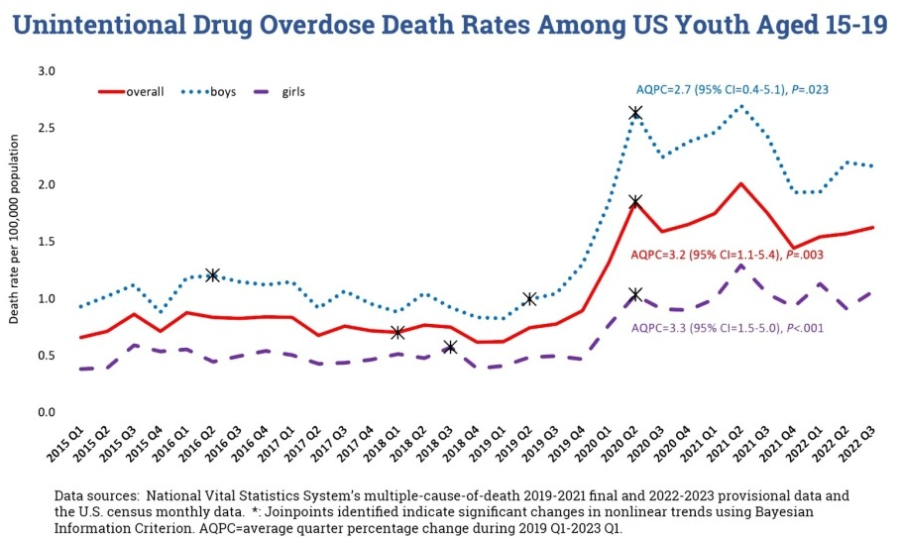
Overdose Impact
Marginalized YWUD most impacted ³
Illicitly manufactured fentanyls (IMFs) commonly involved ¹⁸
Significant loss of life ⁵ ¹⁸
¹⁷
¹⁷
³ Friedman et al., 2022
⁵ Hermans, Samiec, Golec, Trimble, Teater & Hall, 2023
Source: https://nida.nih.gov/research-topics/trends-statistics/infographics/unintentional-drug-overdose-death-rates-among-us-youth-aged-15-19
¹⁸ Witt, Greenberg, & Cantone, 2024
Notes:
Marginalized youth are at the highest risk of experiencing overdose.
In 2021, American Indian and Alaska Native adolescents followed by Latinx adolescents experienced highest OD rates.
Deaths of Black adolescents doubled from the previous year (Friedman et al., 2022)
Why has use become more deadly since 2020?
The oversimplified answer: changes in drug supply. Drug supply impacted by global shifts that occurred as a result of the pandemic as well as ongoing shifts in response to geo-social-political changes.
Illicitly manufactured fentanyls (IMFs) are prevalent in the loss of youth life. IMFs were cause for 81% of unintentional adolescent overdose fatalities in 2020 (Hermans, Samiec, Golec et al., as cited by Witt et al., 2024)
Significant Life Lost
Between 2015 and 2019, unintentional opioid overdose (UOD) deaths resulted in 1,277,223.58 years of adolescent and young adult life lost (Hall, Trimble, Garcia et al., as cited by Witt, Greenberg, & Cantone, 2024)
In 2020, Years of Life Lost (YLL) to unintentional overdose was higher for adolescents aged 10-19 years than loss of life from cancer for the same age group (Hermans et al., 2023).

Slide 8
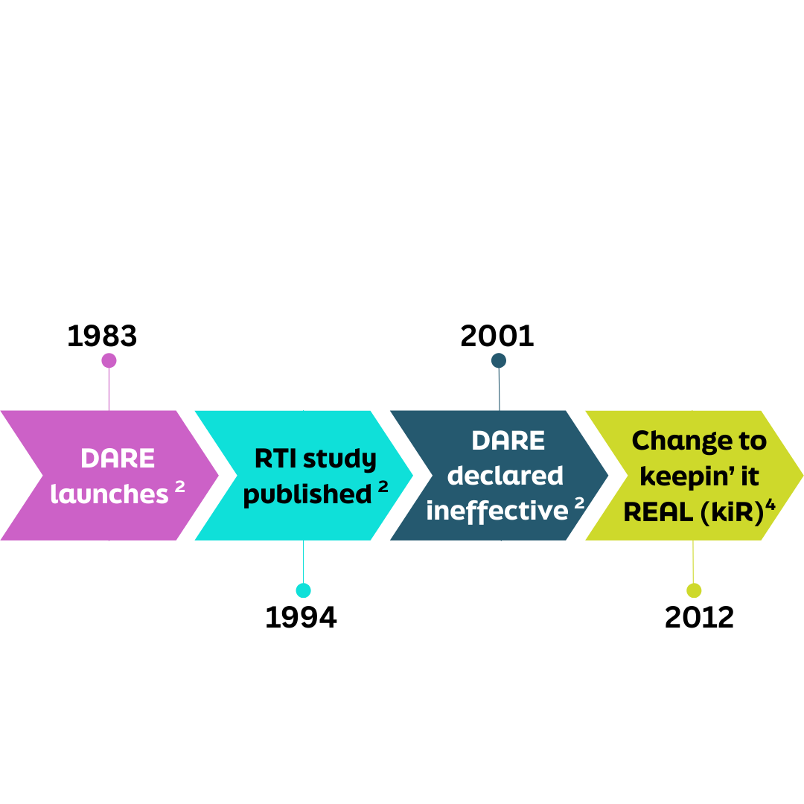
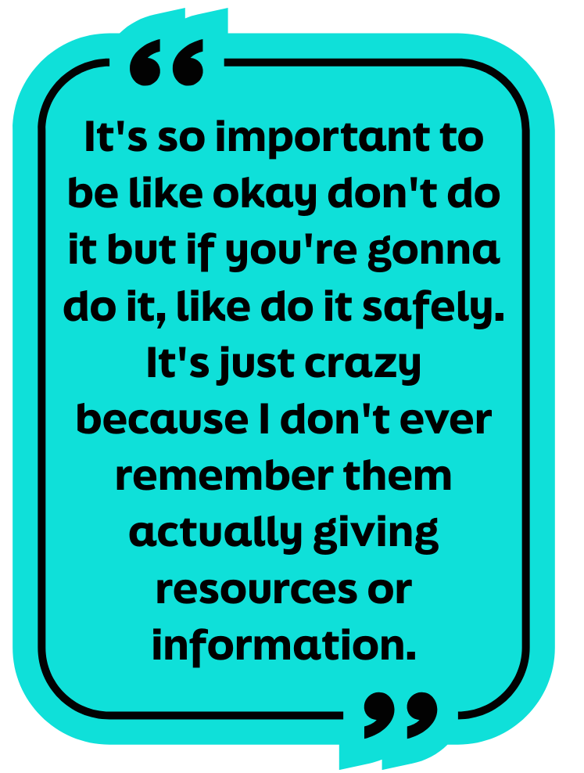
"Just Say No"
^{​2} Cima, 2022
⁴ Hansen, Beamon, Saldana, Kelly, & Wyrick, 2023
Notes:
In 1983, DARE launches
Law enforcement provide zero tolerance messaging to kids.
Officers present in an authoritative and didactic style.
Important to note, given the approach, that youth themselves do not consider law enforcement to be a primary trusted source for substance use information.
Youth most impacted by substance use, are often a part of marginalized communities where relationships with law enforcement are negative, even resulting in collective trauma for that community.
In 1994, Research Triangle Institute conducts an independent study and reports the following, "“DARE’s limited influence on adolescent drug use behavior contrasts with the program’s popularity and prevalence. An important implication is that DARE could be taking the place of other, more beneficial drug use curricula that adolescents could be receiving.” (Cima, 2022).
In 2001, after numerous calls for change, DARE makes changes and creates the "New DARE" (Cima, 2022).
In 2004, research indicated that the program failed to have any significant impact and was ineffective (West & O'Neal, 2004).
In 2009, further research confirmed the finding and recommended more culturally appropriate interventions, even suggesting that mental health professionals be involved (Cima, 2022).
In 2012, DARE evolves into keepin’ it REAL.
Law enforcement still at the forefront providing the curriculum, though the programming is much more interactive.
Officer facilitates experiential activities rather than lecturing.
In 2023, an independent study found that the students that completed kiR were more likely, over the period of the next 12 months, to delay onset of use by at least 30 days longer than the control group.
Data is limited because the study utilized 5th grade students, whom already had a very low prevalence of substance use when trying to compare the test and control groups.
Lived Experience Input:
“I remember DARE… and I thought it was ridiculous. Like, they made it seem like you’d be offered drugs on every corner, and all you had to do was say no. That’s just not real life. I get that they don’t want to hand out Narcan to a bunch of middle schoolers, but instead of pretending kids will never be exposed to drugs, maybe we should give them realistic education. Like, “If you are going to use, here’s how to do it safely.”
“Kids shut down when a cop walks in the room. It doesn’t feel authentic. They should have someone come in who’s actually been through it—someone in recovery, someone who’s lived it”

Slide 9
Compliance or Safety?
SMART Recovery provides focus on building internal motivation, coping with urges, emotion and thought management, and balanced living.
Adolescents need: Mastery, Belonging, Meaning, Agency
Compliance:
Behavior stops when authority is present
Motivation is external
Fear of punishment drives change
Success = following rules
Safety:
Skills persist without supervision
Motivation is internal
Mistakes become learning opportunities
Success = increased self-management

Slide 10
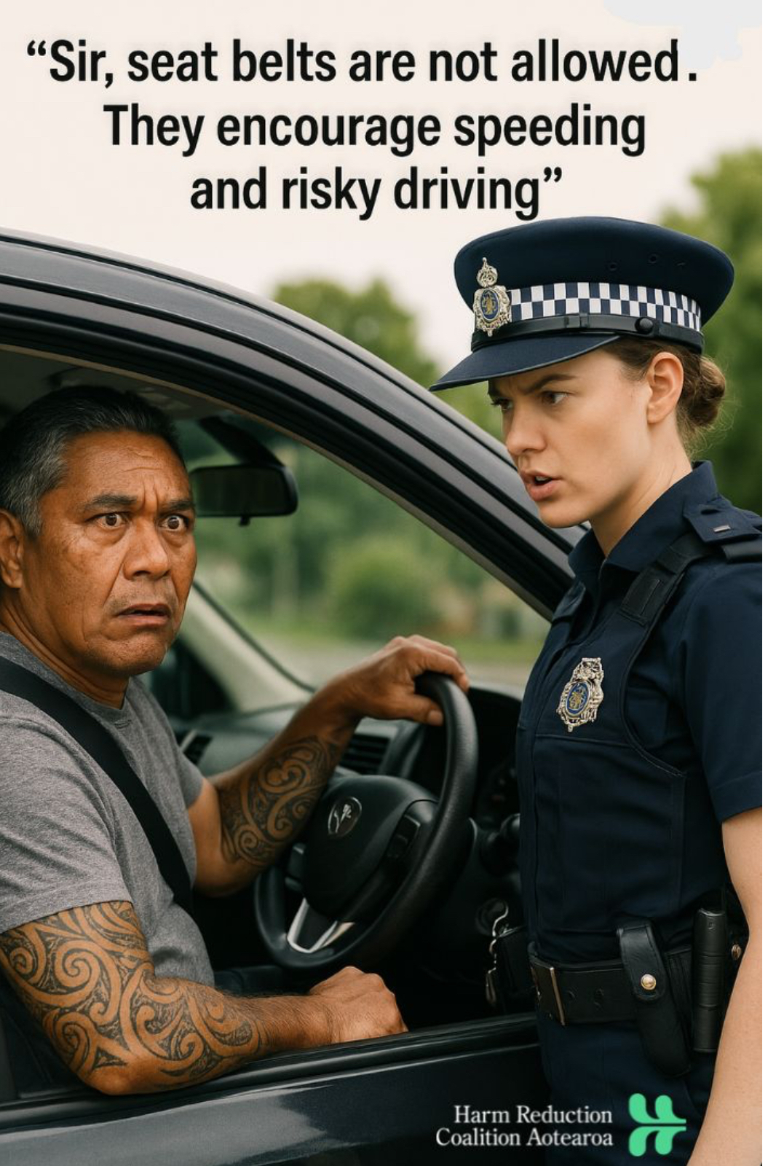
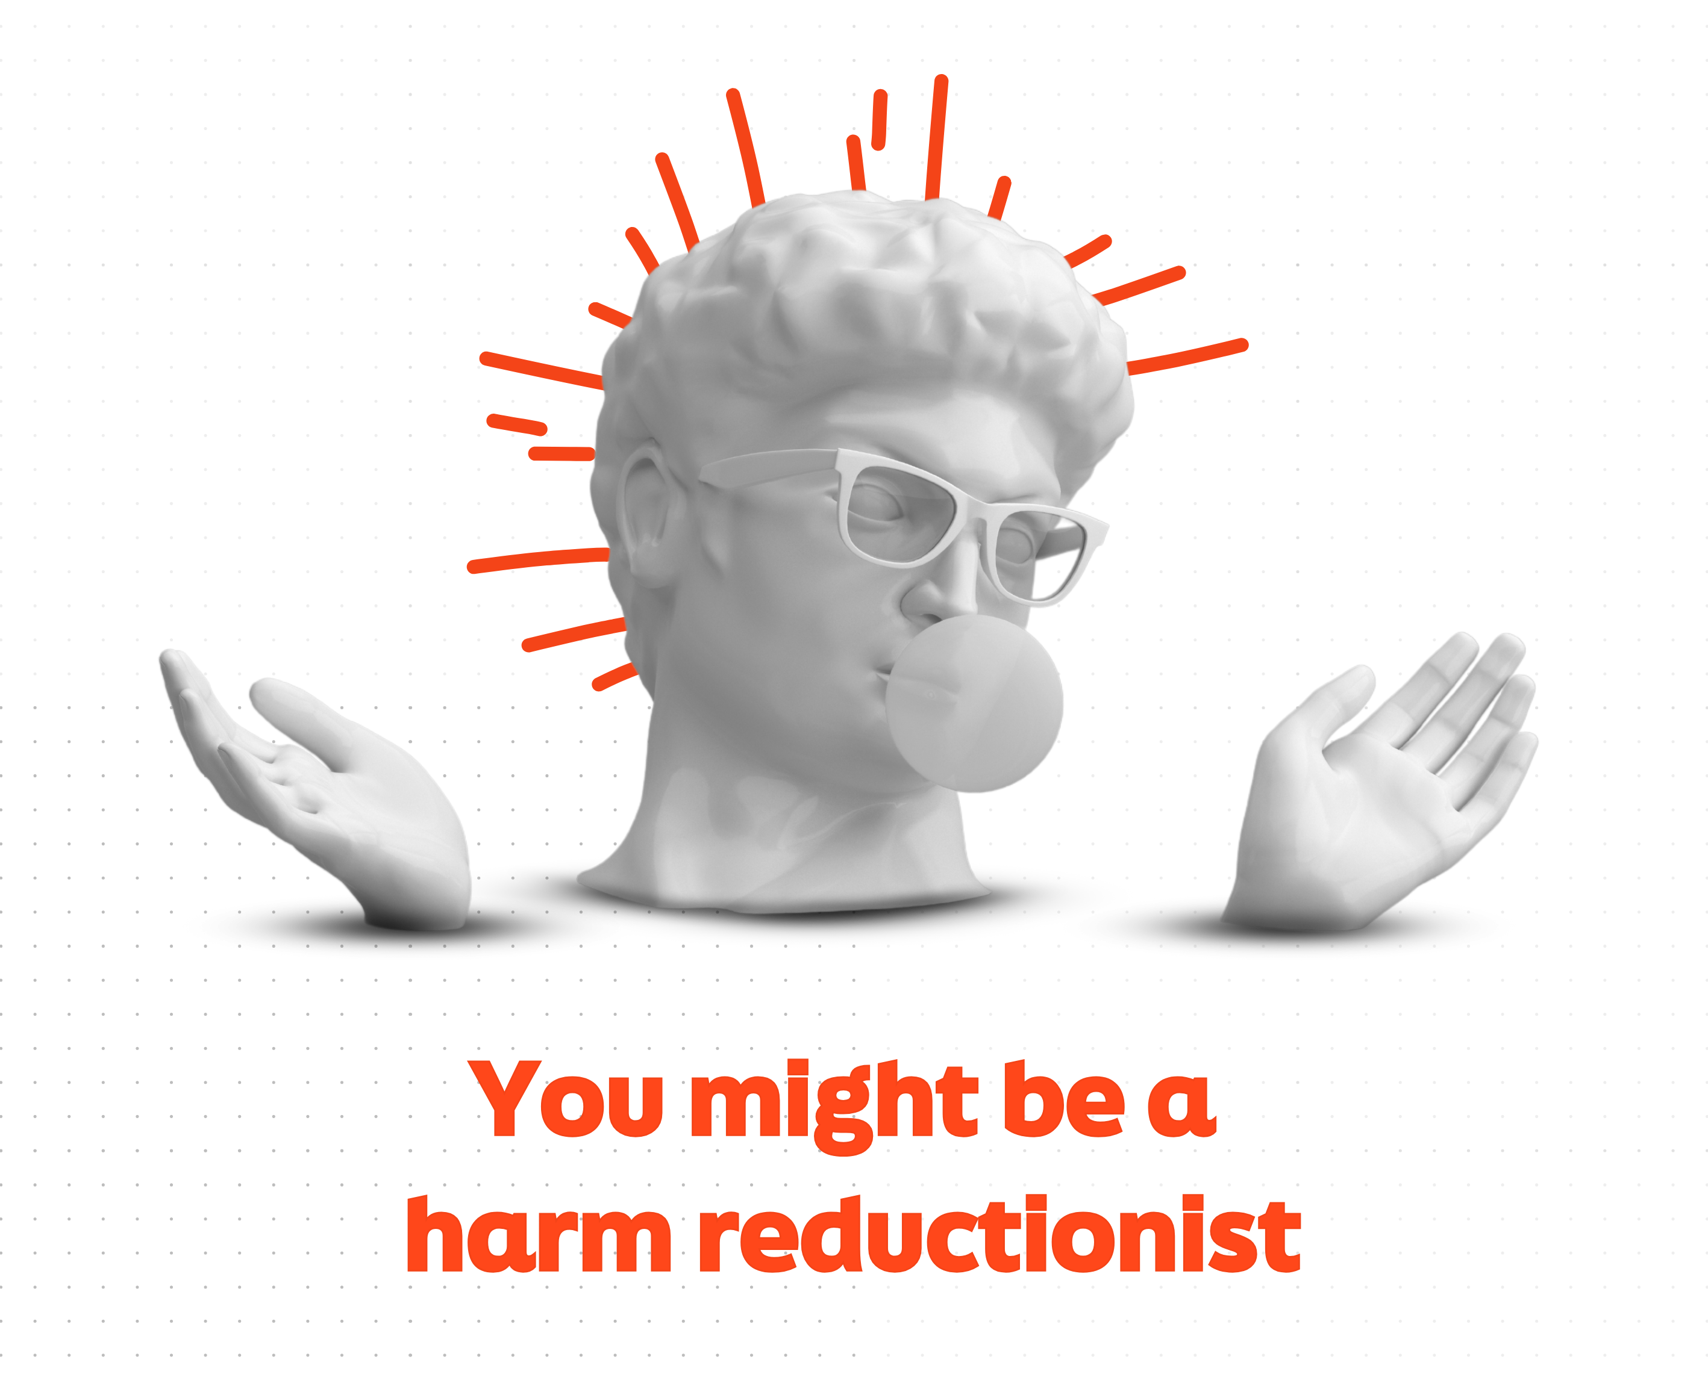
Source: https://www.linkedin.com/posts/harm-reduction-coalition-aotearoa

Slide 11
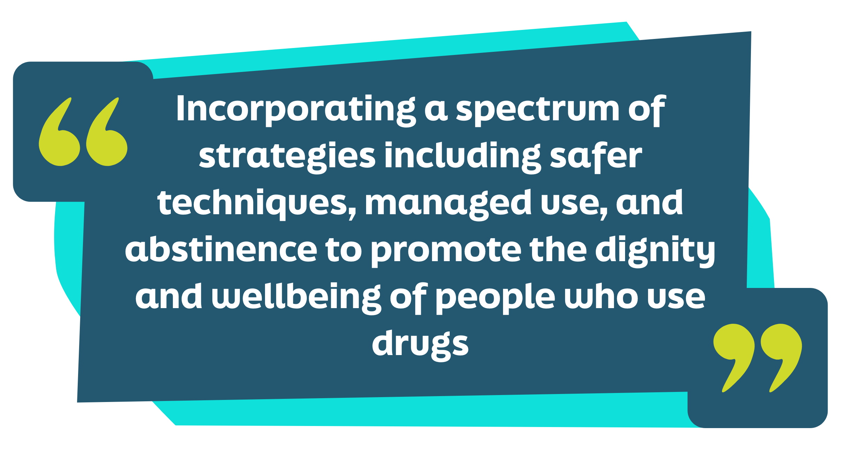
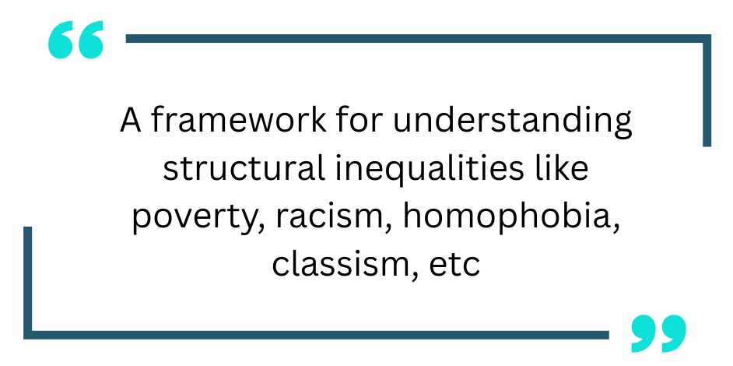
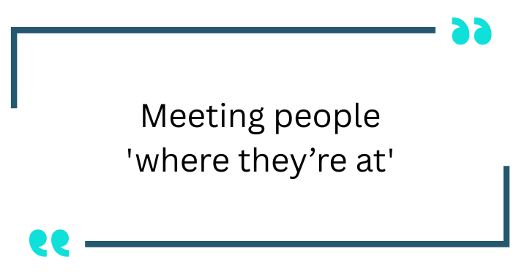
¹² National Harm Reduction Coalition, 2025
Notes:
Harm Reduction focuses on protecting from harms rather than binary focus of use/no use
Harm Reduction is a way of being, a way of thinking, a way of orienting to others
Harm Reduction is ever-evolving
Requires us to look inward, be honest with ourselves about our intentions utilizing harm reduction
Lived Experience Input: "For me, harm reduction is about making things safer for people who use, without judgment. I’ve even heard of places in certain states where people can go use safely—with pharmaceutical-grade drugs, clean needles, clean water—all of that. Some people say those places “enable” drug use, but honestly, people are going to use whether you like it or not. The difference is whether they’re doing it safely or with dirty supplies and laced drugs. Why wouldn’t we offer something that keeps people alive?"

Slide 12
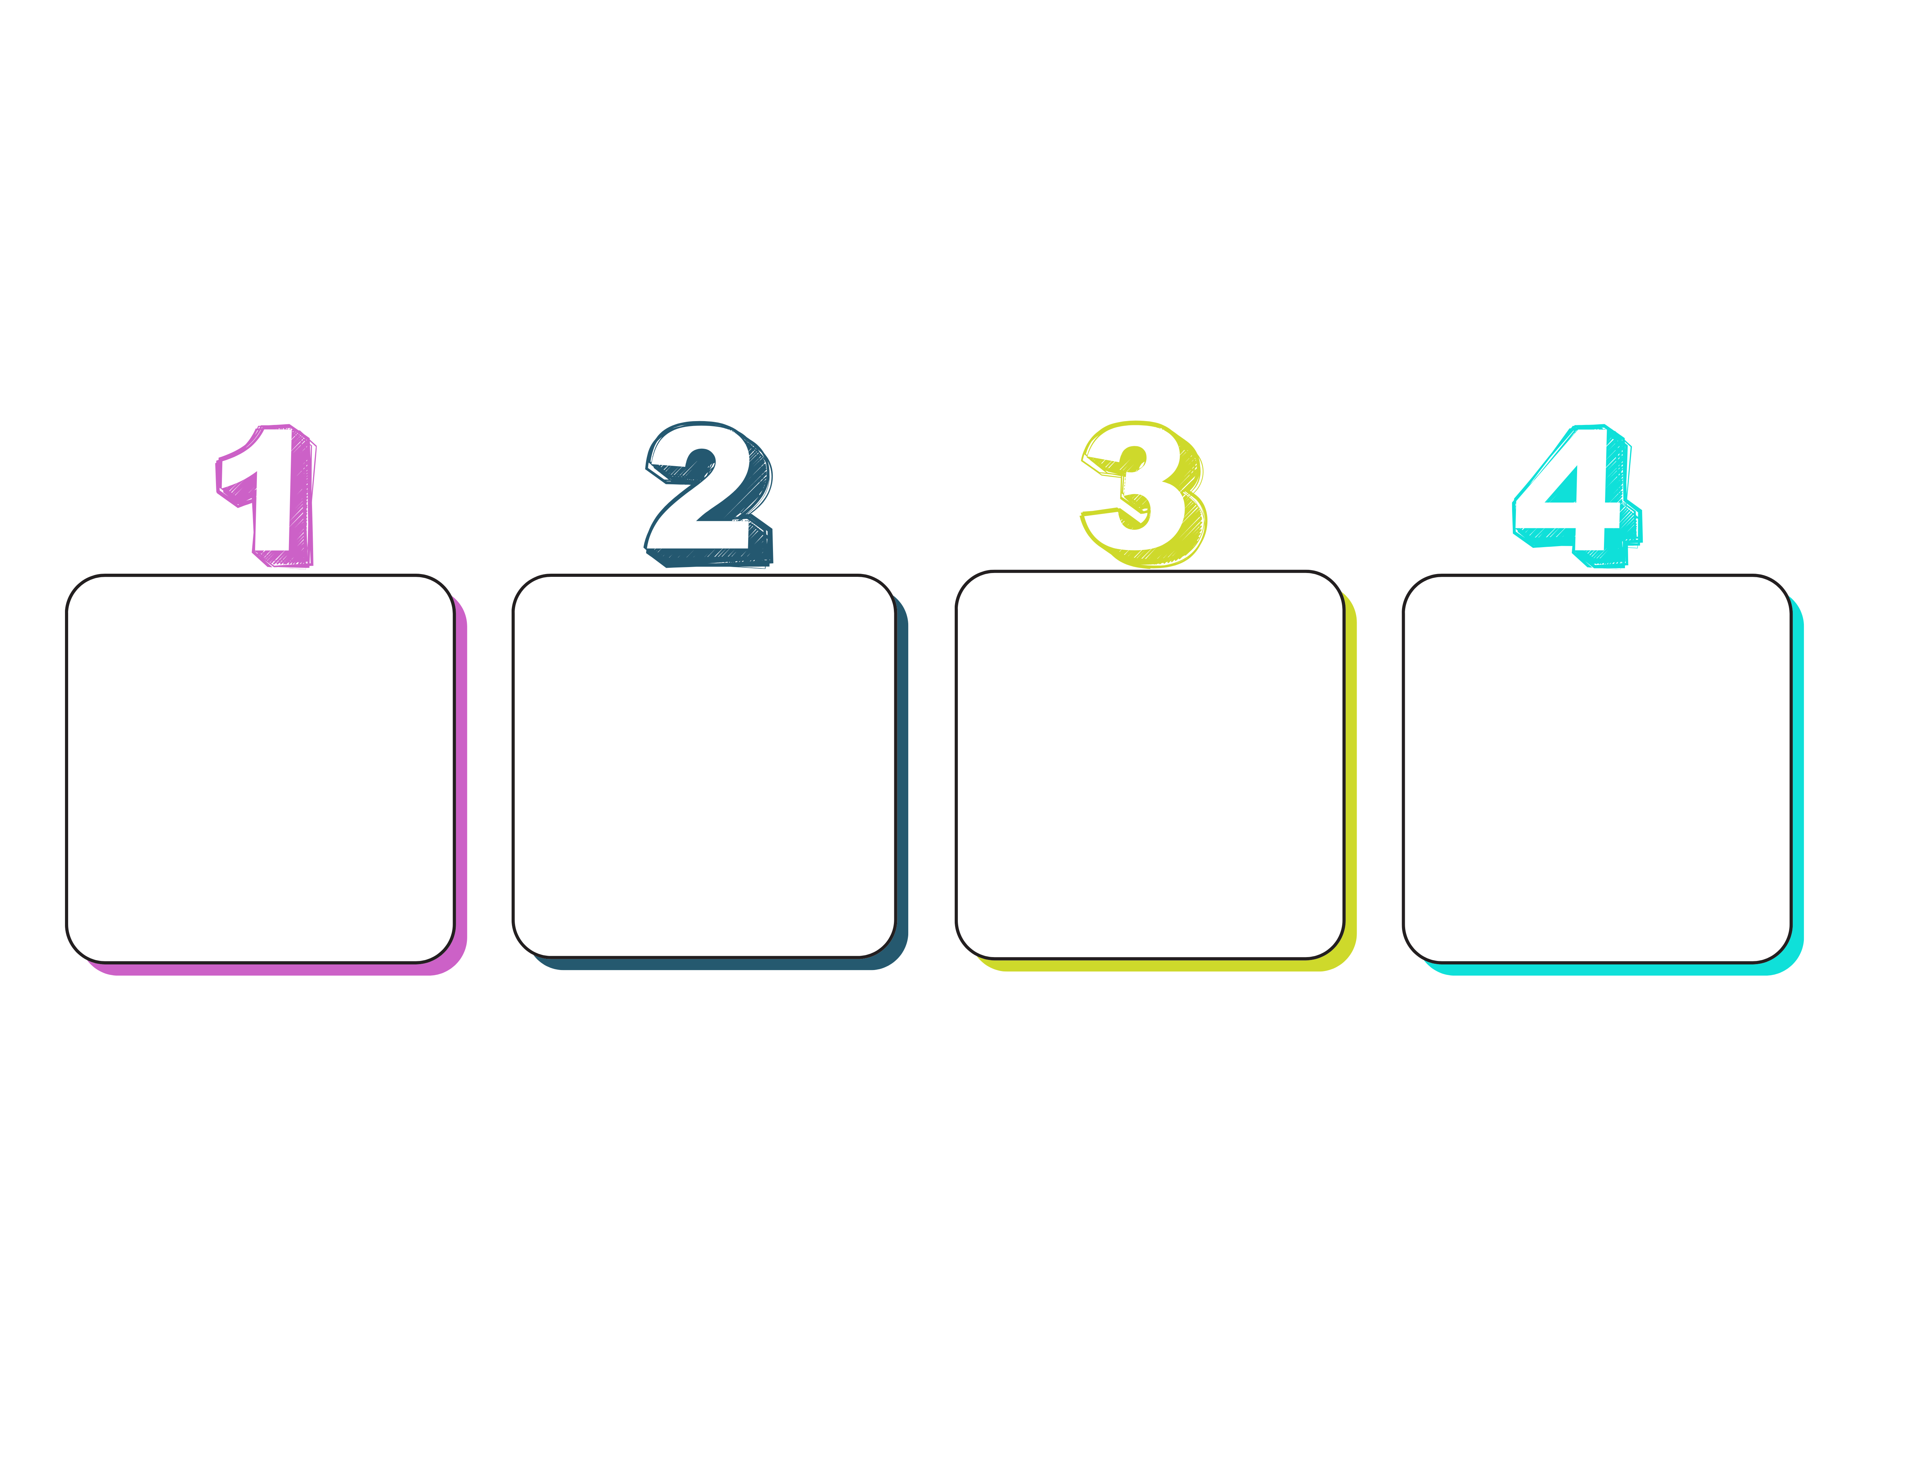
Harm Reduction Principles
​
Successful intervention measured by quality-of-life improvement, not cessation
Drug use has been, is, and will continue to be present in our world
Drug use is complex and multi-faceted
Services to PWUD must be non-judgmental and non-coercive ¹¹
¹² National Harm Reduction Coalition, 2025

Slide 13
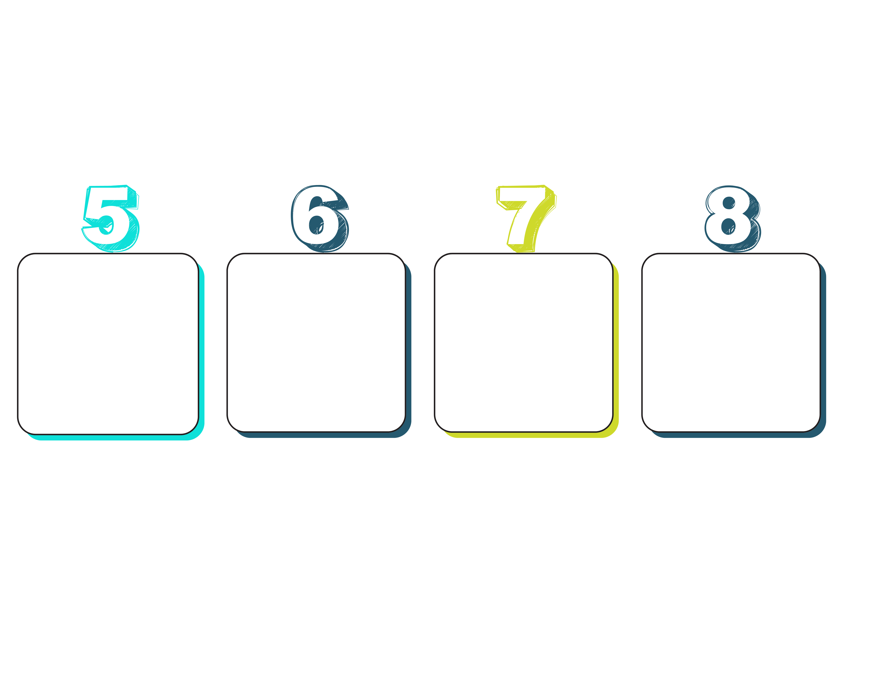
Harm Reduction Principles
Tragic harm is a reality of drug use and is not to be minimized or ignored ¹¹
PWUD have a voice in programs and policies meant to support them
Social inequalities
impact people’s ability to deal with drug-related harm
PWUD are agents of change and should be empowered to help self and others
¹² National Harm Reduction Coalition, 2025

Slide 14
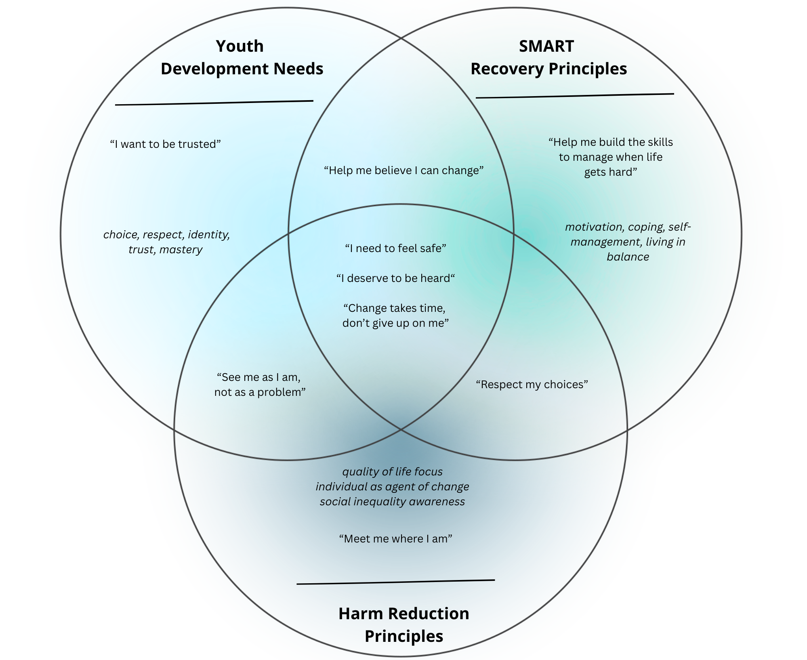
Harm Reduction ​
​
Youth Voice​
​
SMART Recovery Skills​
​
Empowered Youth
Notes:
Progress matters
Acceptance over shame
Change is self-defined
Focus on individual not the substance

Slide 15
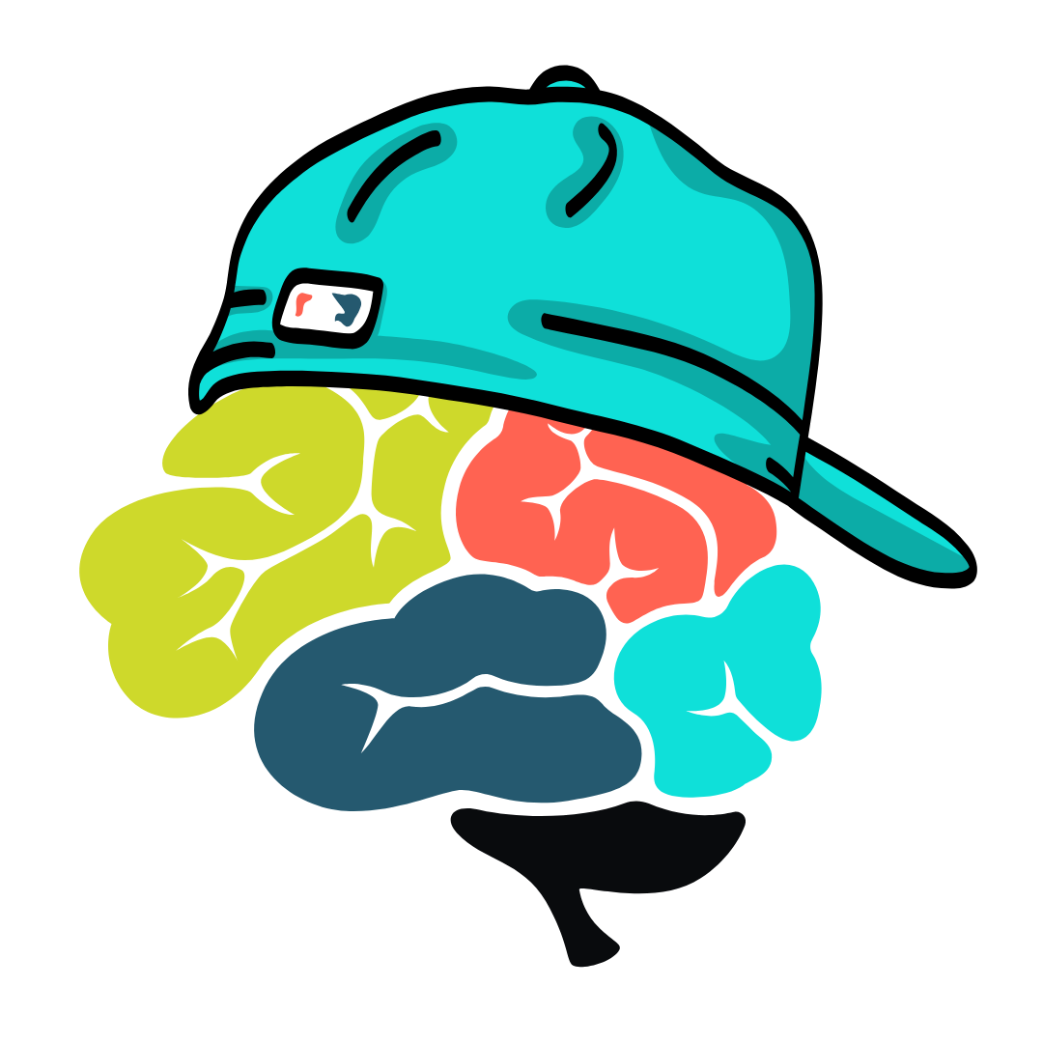
Peanut Butter & Jelly
Novelty and risk
Autonomy
Peer Influence
Unique Risks ³ ⁵ ¹⁸
³ Friedman et al., 2022
⁵ Hermans et al., 2023
¹⁸ Gray & Squeglia as cited in Witt et al., 2024
Notes:
Youth are wired to seek out novel experiences and take risks as a healthy part of development. Harm Reduction honors the curiosity teens have about substances and recognizes experimentation as a reality
Youth are seeking new levels of autonomy. Harm reduction empowers individuals to make healthy choices for themselves
Youth have the opportunity to normalize safer behaviors for their peers. Harm reduction encourages YWUD to support the safety of themselves and others
Youth have unique risks
More likely to start using substances than adults (Gray & Squeglia as cited in Witt et al., 2024)
Higher risk for overdose
"Adolescents are at a greater risk of death from substance use due to increased risk-taking behaviors, lack of experience, lower tolerance levels, and an optimistic bias that they are invincible to overdose" (Hermans, Samiec, Golec, Trimble, Teater, & Hall, 2023)
Study of youth participating in SMART Recovery identified 5 themes that youth believed would make SMART successful in adaptation 1. Youth led discussion and shared experience 2. Flexible, patient approach 3. Balance between info/skills and discussion 4. SMART as community for youth (language mindfulness in promotion) 5. Logistics/accessibility (Lum et al., 2023).

Slide 16
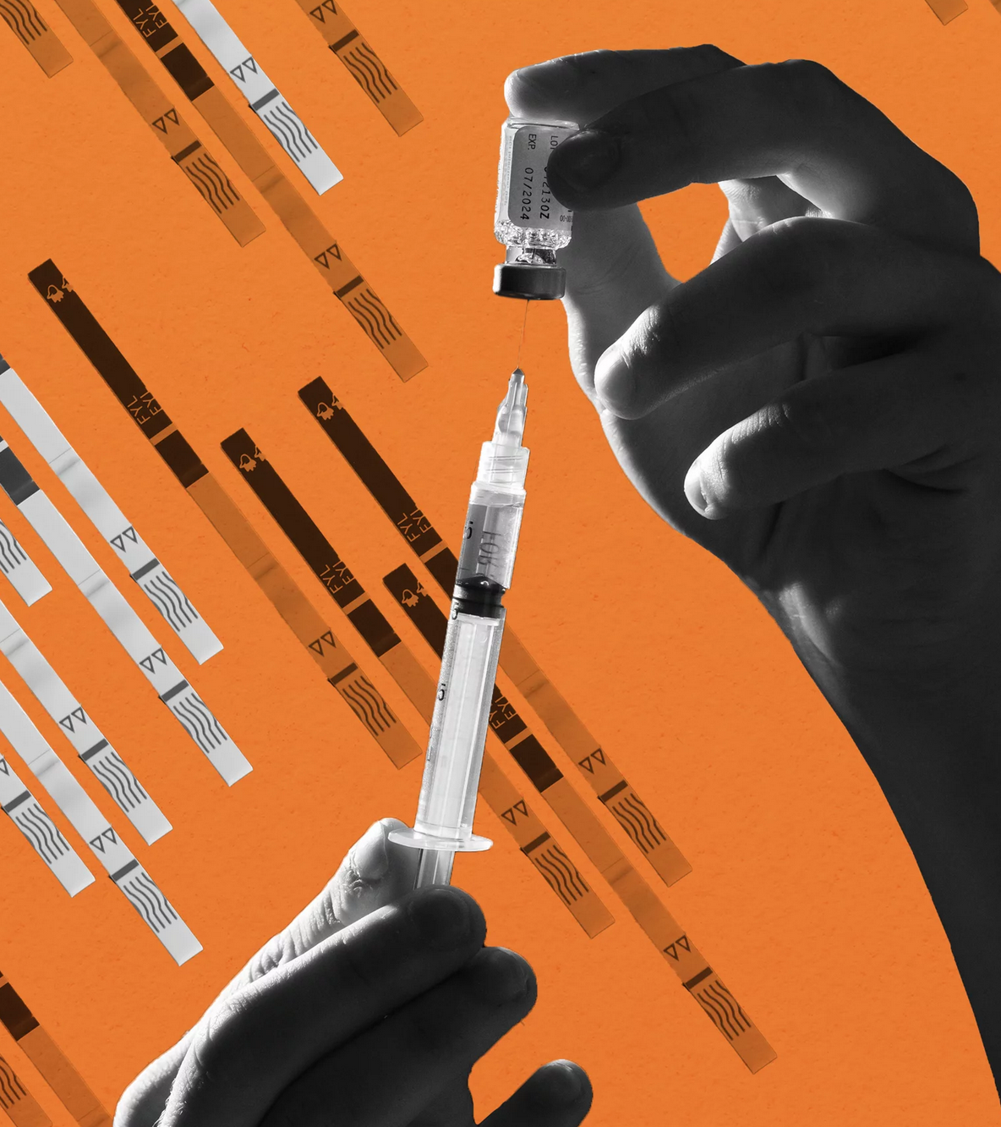
Safer Use Messaging
Safer Use Messaging
Acknowledges the spectrum of youth substance use
Uses harm reduction principles which acknowledge developmental and cultural risk factors
Acknowledges all reasons youth use drugs
Youth already practice safer use in multitude of ways ⁸
⁸ Jenkins, Slemon, & Haines-Saah, 2017
Photo illustration by LA Johnson/Cornell Watson/Getty Images/NPR
Notes:
Acknowledges the variety of ways youth use or avoid using substances.
Uses harm reduction principles in a way that apply to the unique protective factors and risks of youth as well as communicating within cultural context
Safer use messaging acknowledges ALL the reasons and ways youth use drugs
And all of these factors are more likely to resonate more effectively and personally to youth, tapping into empowering what youth are telling us they already do to practice safer use which includes staying away, using in moderation, choosing some substances while rejecting others, positively influencing safer choices with peers, and reducing amount of use when experiencing negative consequences (Jenkins et al., 2017).

Slide 17
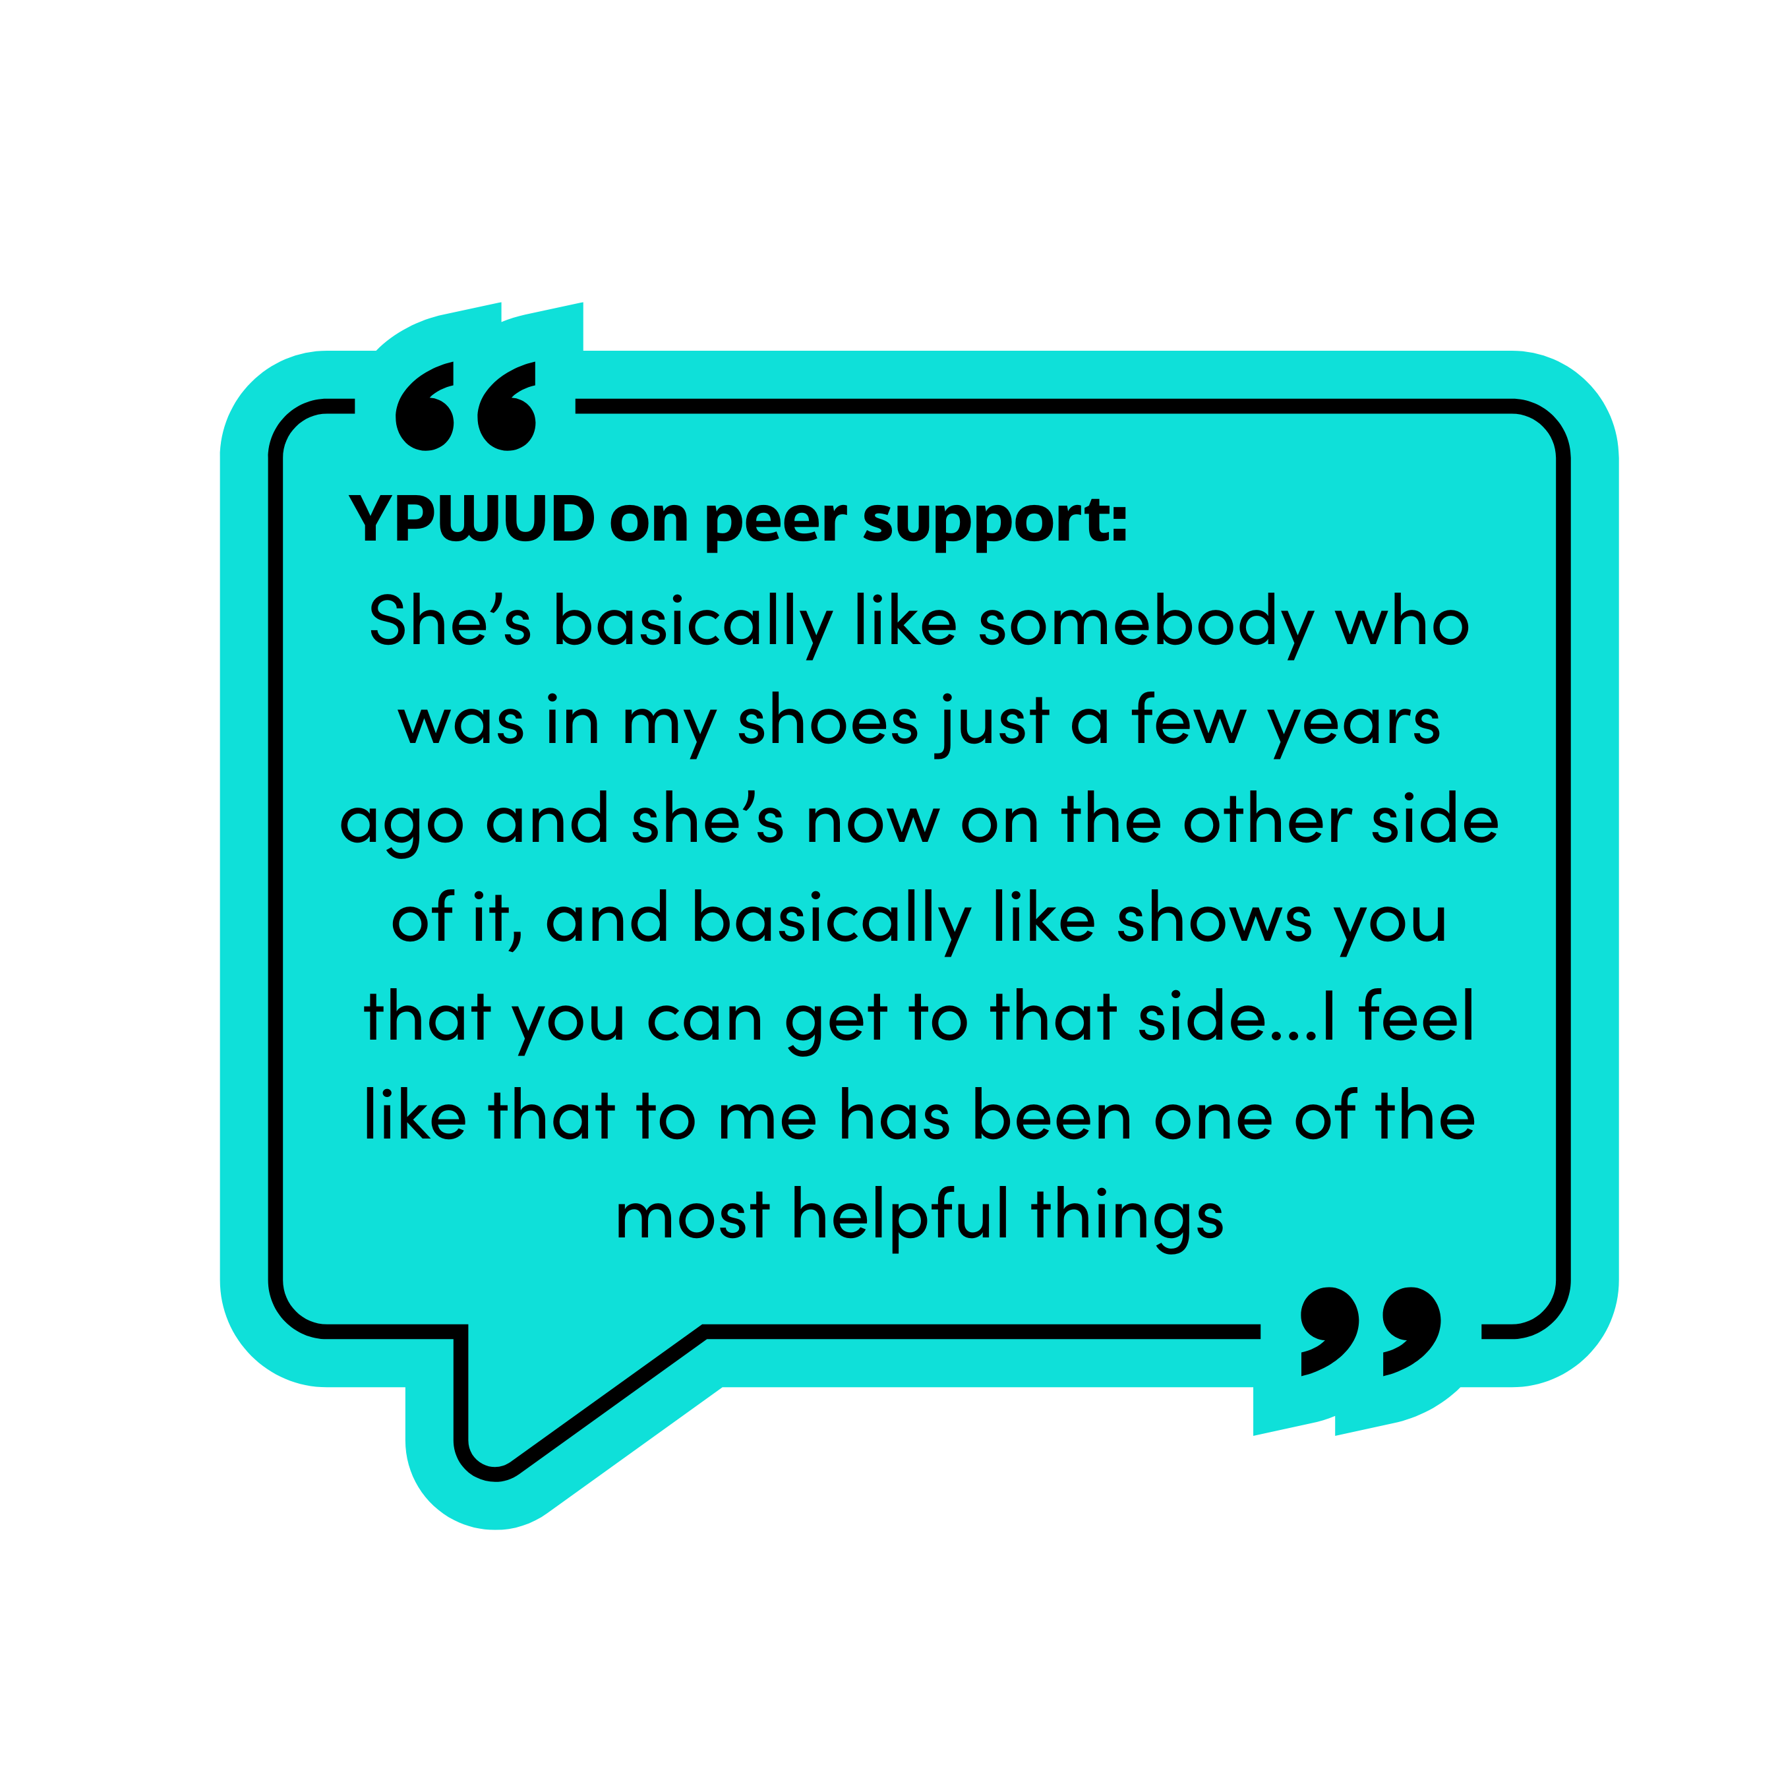
Working Across the Spectrum
Focus on developmentally and experientially appropriate interventions, paired with education
Use messaging that resonates: Getting Candid
  2,000 youth (13-18) and youth serving providers
  Youth MOST trust health care providers and individuals with lived experience ¹⁴
¹⁴ Sloyer, Stark, Woods-Razaa, Halliday, Peterson, & Pietruszewski, 2023

Slide 18
Working Across the Spectrum
Reasons youth tell us they use substances:
cope with mental health
peers are using
cope with school/friend/family stress
have fun
Reasons youth tell us they don't use substances:
could be bad for health
not interested
to avoid messing up future plans/goals
want to make healthy choices ¹⁴
¹⁴ Sloyer, Stark, Woods-Razaa, Halliday, Peterson, & Pietruszewski, 2023

Slide 19
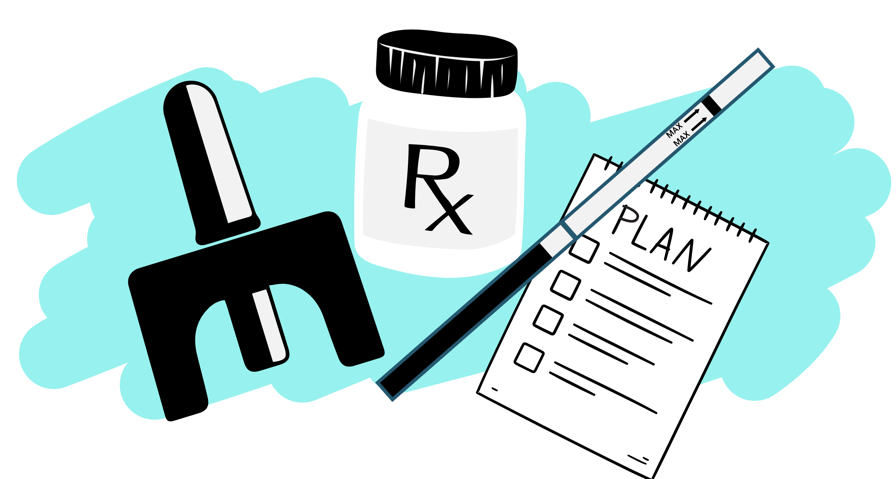
Working Across the Spectrum
Safety Plan
  'No matter what' support
  Identify an 'out' ahead of time
Naloxone training and use ¹⁶
  Safe to use in children and teens ¹
  Dosage matters, "do no harm" ⁷
¹ CHOC, 2023
⁷ Hill, Zagorski, Loera, 2022
¹⁶ Tanz et al., 2022
Notes:
Higher dosages of naloxone are not necessarily better.
High dose naloxone poses the risk of putting an individual into precipitated withdrawal, an incredibly painful experience that only leads to higher risk of continued use.
Some individuals working within the field that have lived experience consider the higher dose naloxone to be unethical practice.
It's important for us to research and listen to the voices of those who use drugs.

Slide 20
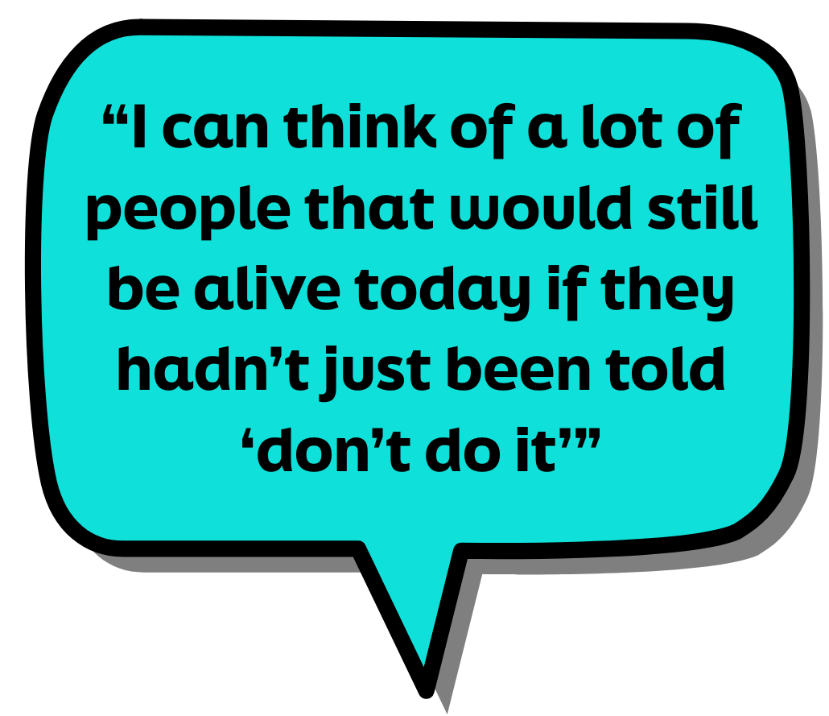
Working Across the Spectrum
Safer Use Patterns ¹⁶
  Never use alone
  Increase amount slowly
  Avoid mixing substances
  Snort over smoke over inject (bioavailability)
Medication as Treatment (MOUD, MAUD) ¹⁵
Testing Substances
¹⁵ Society of Adolescent Health and Medicine, 2021
¹⁶ Tanz et al., 2022
Notes:
According to the Society of Adolescent Health and Medicine (2021), "AYAs [adolescents and young adults] should be allowed to consent for their own addiction treatment, including MOUD, although it should be noted that treatment is more likely to be effective with the involvement of a parent or other trusted adult".

Slide 21
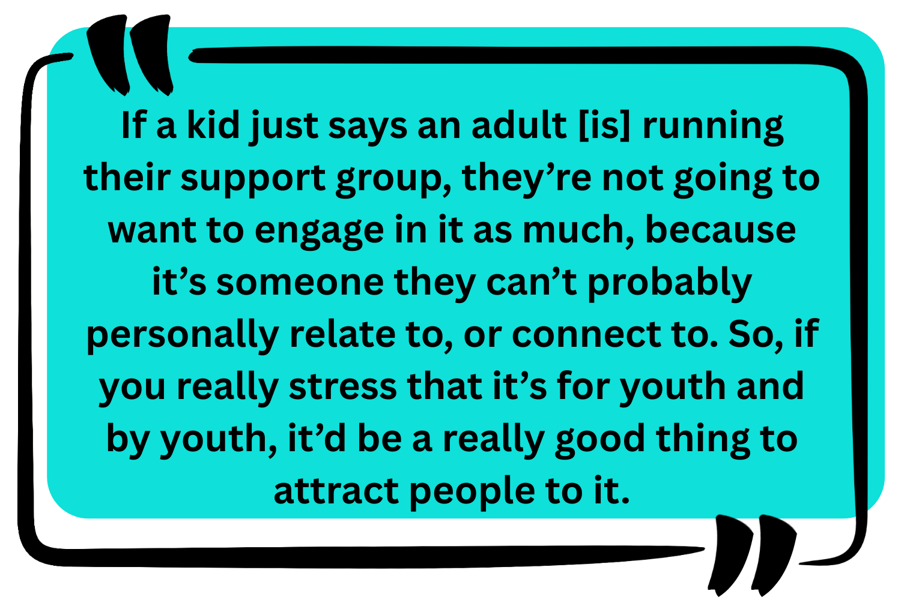
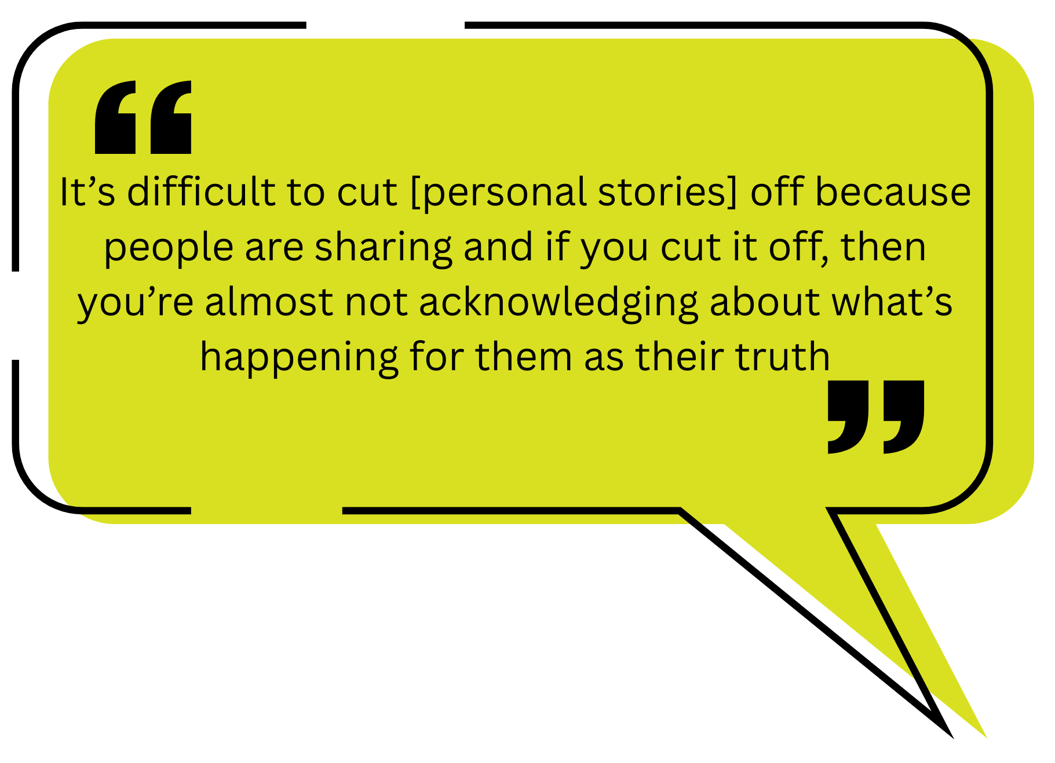
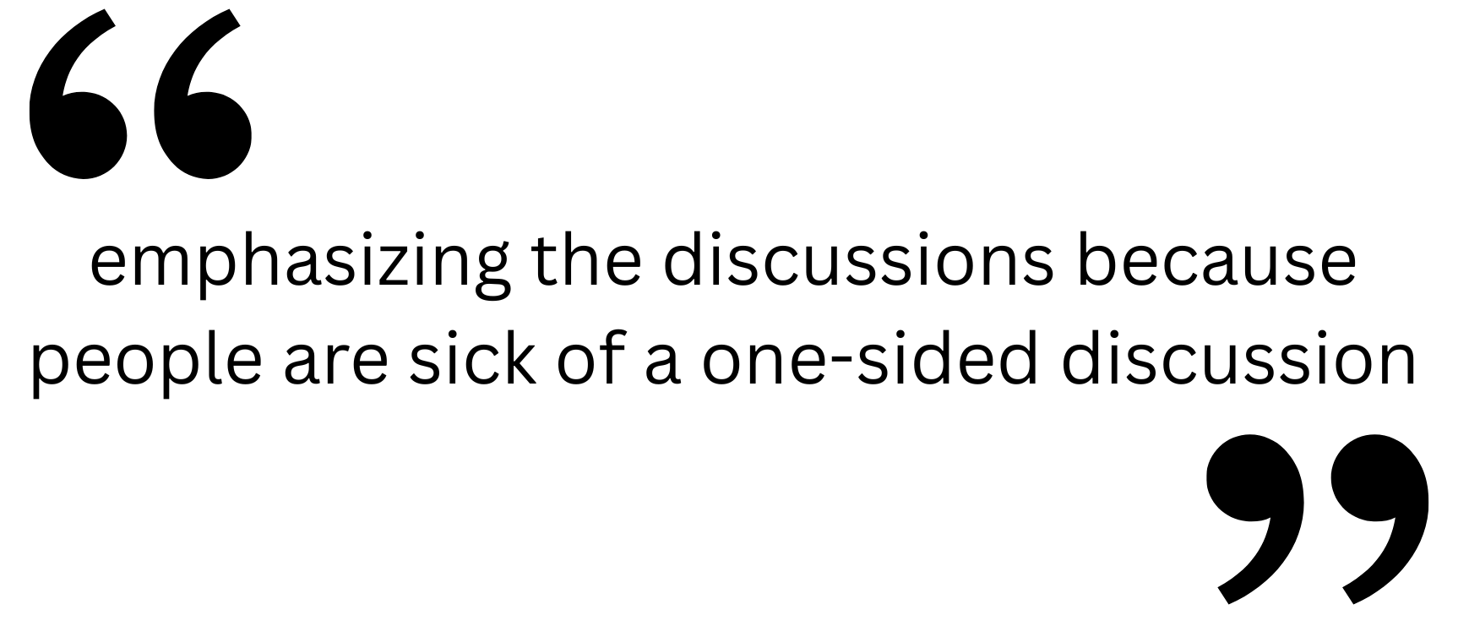
Working Across the Spectrum
SMART Implementation from Youth's Perspective
¹⁰ Lum et al., 2023
Notes:
[1]'Discussing personal experiences to promote a shared identity’
[2] ‘Flexible and patient approach’ a preference for facilitators to take a more gentle, less direct approach that allows for discussion beyond addictive behaviors (Lum et al., 2023)
"Young people recommended that the program be led by youth, for youth" (Lum et al., 2023)
Flexible Approach: "Some stakeholders recognised that discussing personal experiences in depth may not be within the SMART Recovery guidelines" and "Stakeholders agreed that the most effective way to engage youth and have them learn was by asking them to share their personal experiences with each other, rather than teaching information or skills"

Slide 22
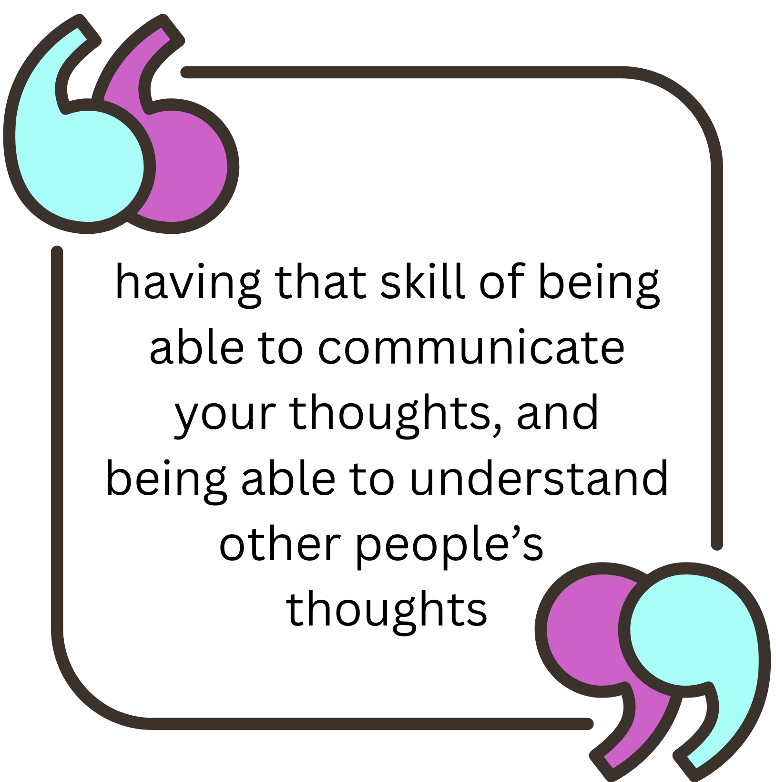
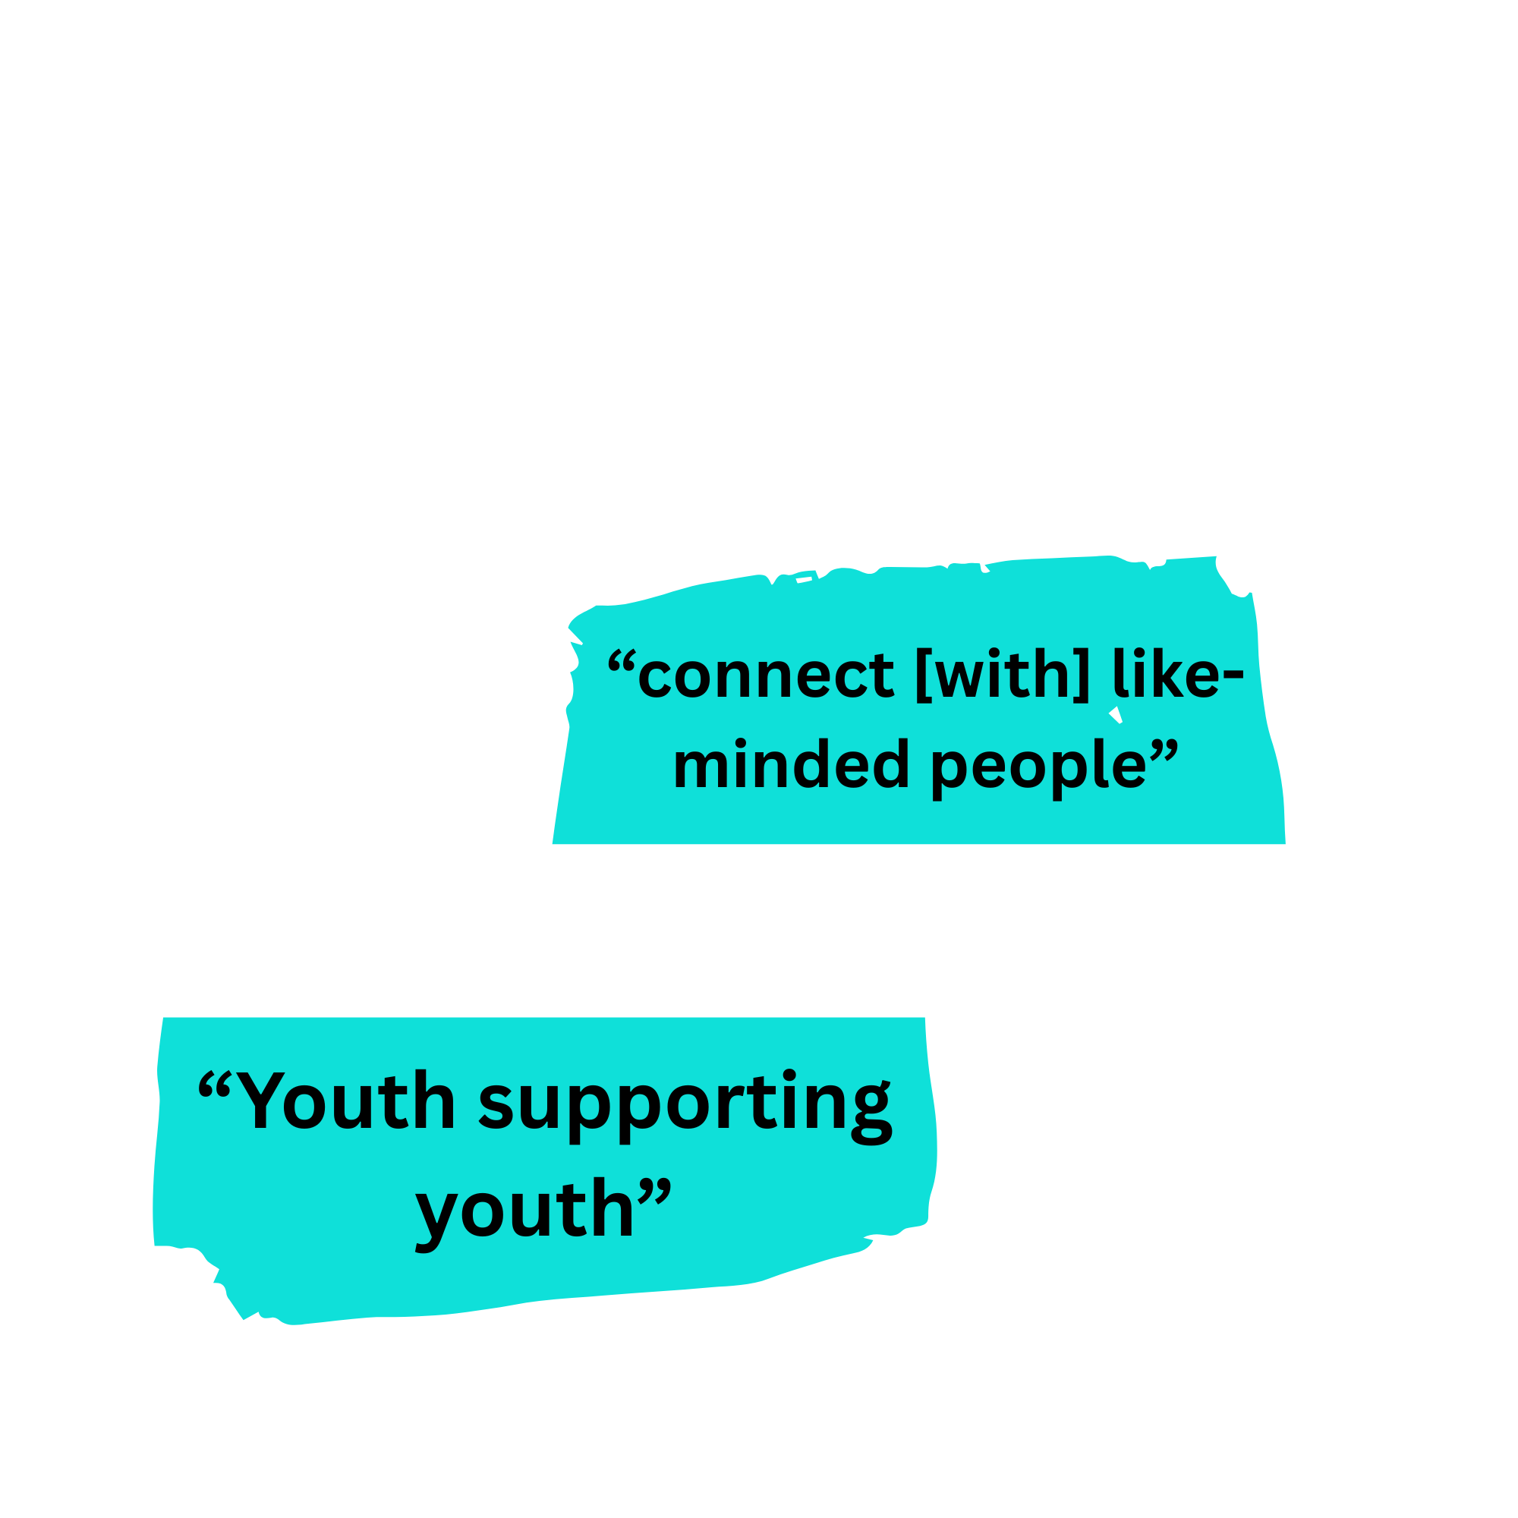
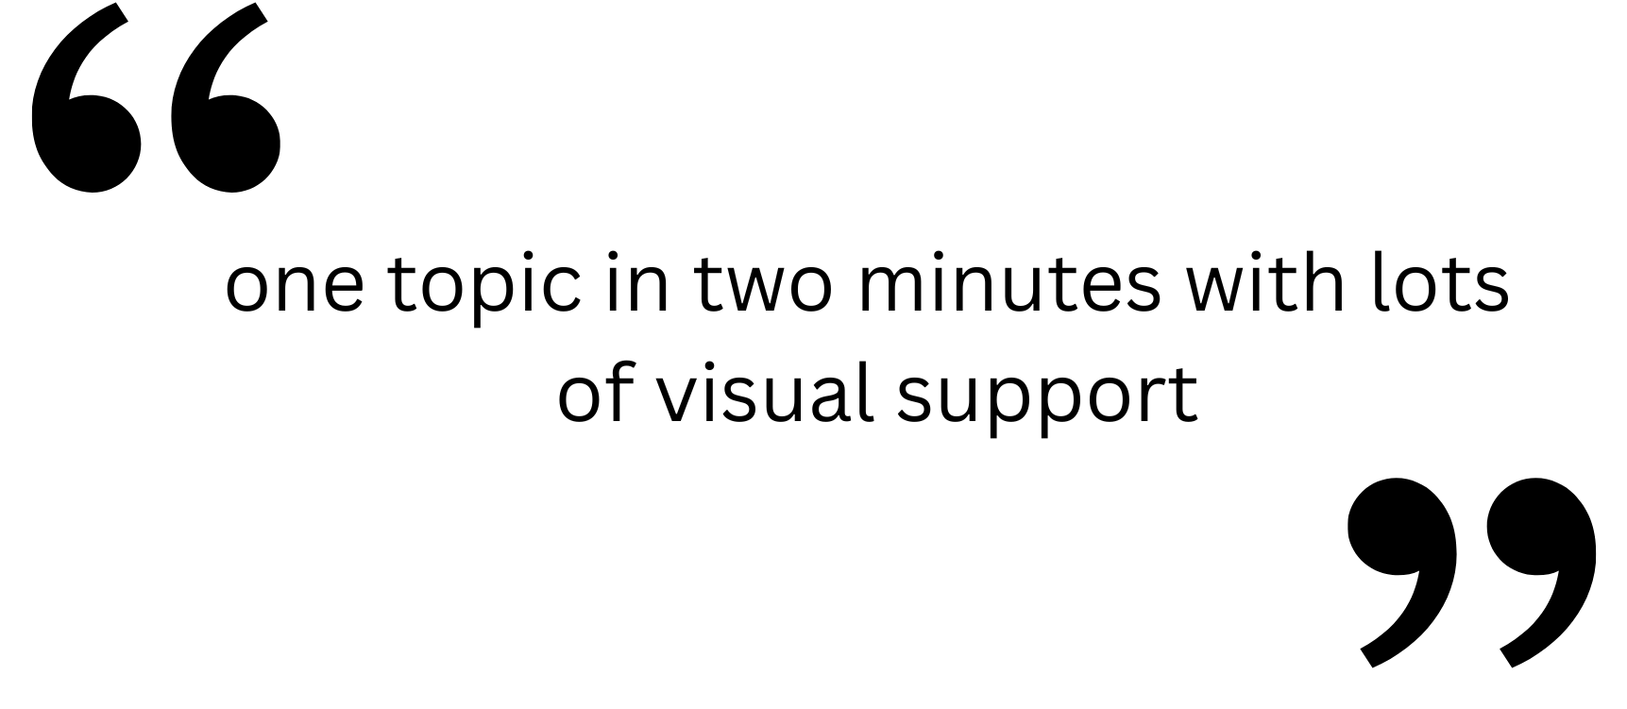
Working Across the Spectrum
SMART Implementation from Youth's Perspective
¹⁰ Lum et al., 2023
Notes:
[3] ‘Balancing information and skills with the space for discussion’ acknowledges that youth want to connect in a variety of ways, beyond discussion of addictive behaviours, and that they wish to lead skill sharing and development.
[4] ‘Conveying a community for youth through language’ highlighted the need to focus on connecting youth and to avoid the use of generic language to engage young people.
[5] ‘Group logistics and competing demands’ refers to the logistical considerations of implementing a group program for youth that takes into account their competing demands and group accessibility.

Slide 23
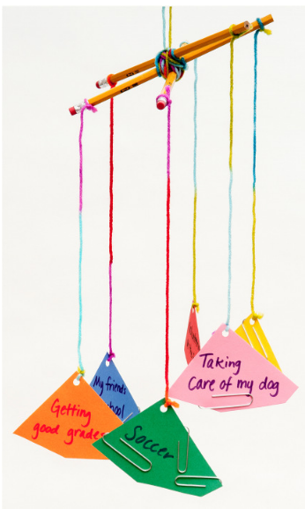

  Lifestyle Balance (Tool 6.1)
        Balance Mobile (Change to Chill)
  CBA (Tool 3.1)
    Interactive & Conversational
  New Passions and Pursuits (Tool 6.2)
    Passion development mindset
Implementing SMART tools
Ideas for the daring and caring
Source: https://changetochill.org/upl/downloads/library/balance-mobile.pdf

Slide 24
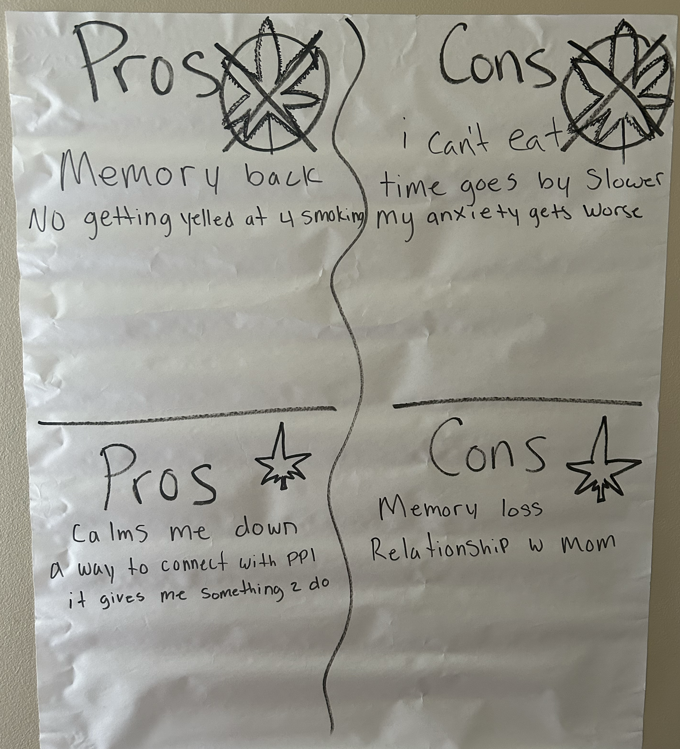
Cost & Benefit Analysis

Slide 25
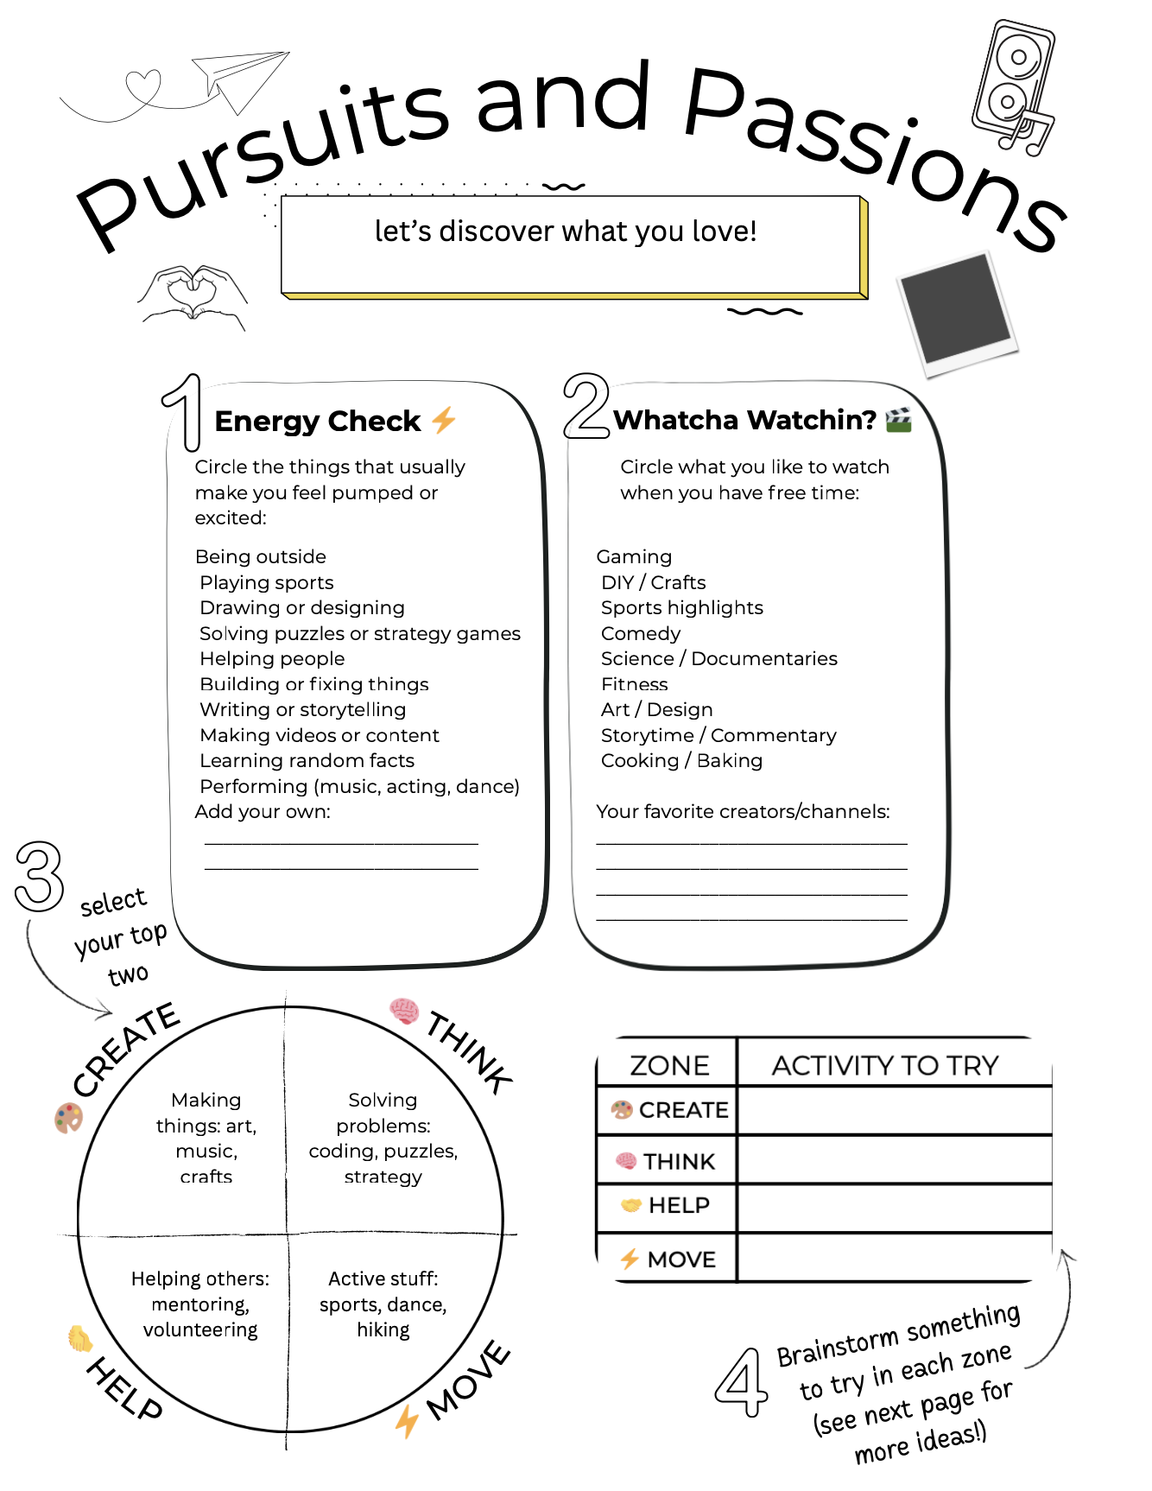
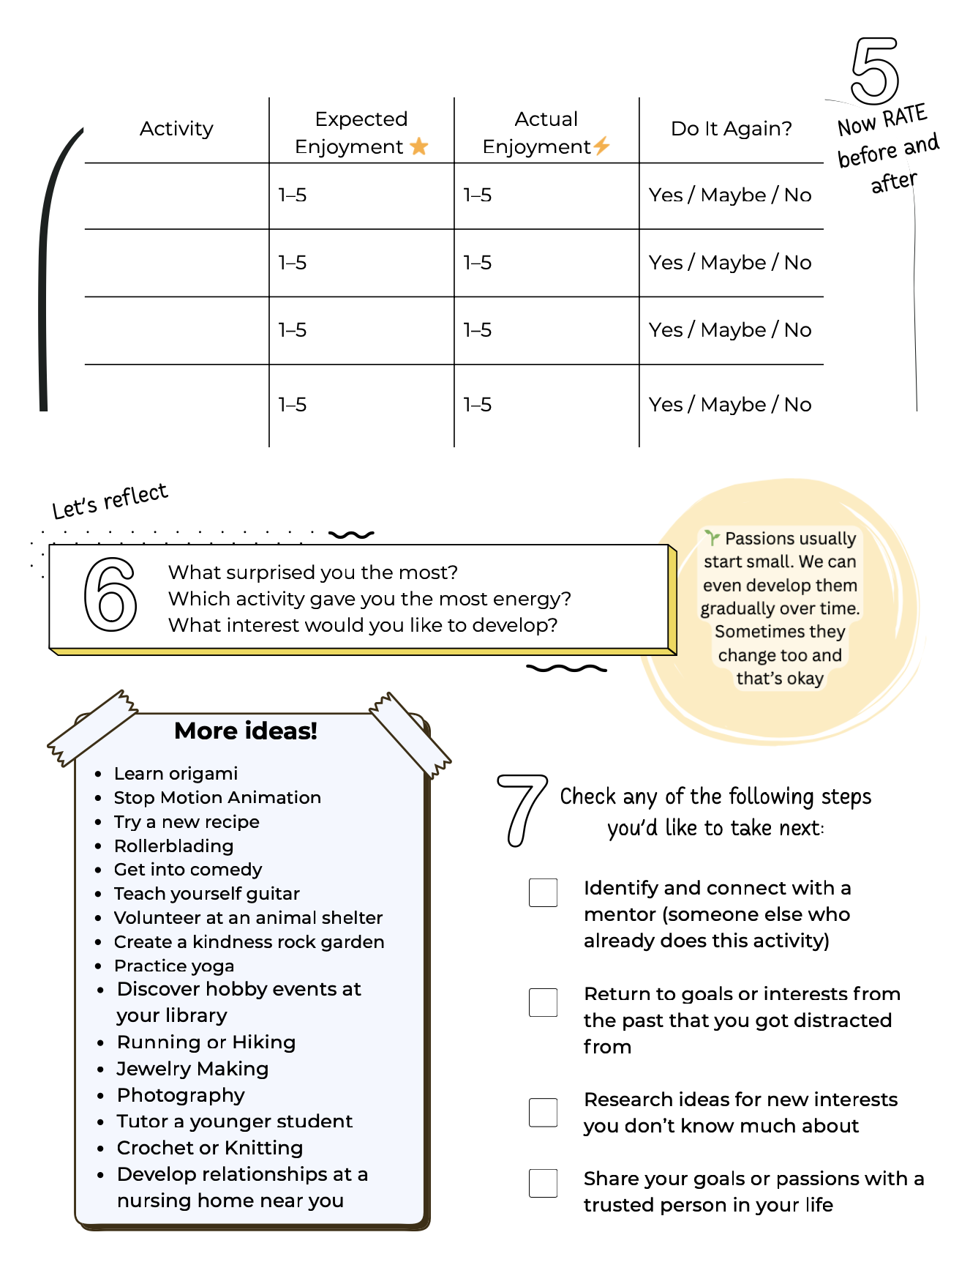
Pursuits and Passions

Slide 26
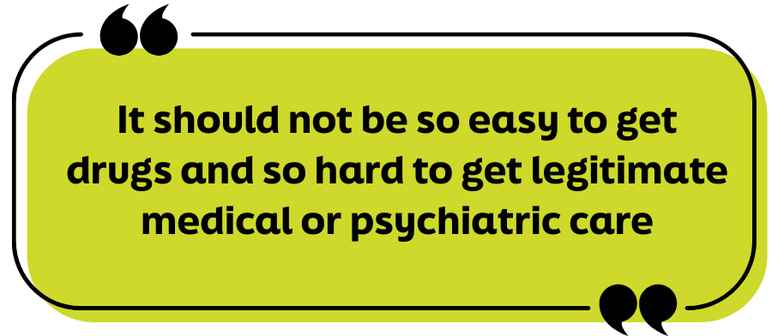
Barriers to Safer Use Approach
Longstanding normalization of abstinence-based messaging ⁸ ¹³
Stigma
Ethical dilemmas addressing acute risk with YWUD ¹³
Intricate legal requirements that vary by state ¹³
Provider uncertainty about confidentiality ¹³
Myths about harm reduction ¹³
Poor access to supplies ¹⁶
⁸ Jenkins, Slemon, & Haines-Saah, 2017
¹³ Shircliff, Cummings, & Borgogna, 2024
¹⁶ Tanz et al., 2022
Notes:
However, safer use messaging does face some barriers. A few include:
Prevalence and history of abstinence only messaging
Stigma among healthcare professionals is real and it’s our job to challenge ourselves and educate ourselves to avoid causing harm.
Lived experience input: “That stigma follows you everywhere. Hospitals, clinics, even when you’re just trying to get care for other health issues. I have a lot of chronic health conditions, and once something about drug use is in your record, it completely changes how people treat you.”
Really sticky ethical dilemmas when trying to address concern of acute risk due to substance use. There is no evidence based protocol for this, more research is needed (Shircliff et al., 2024).
Legal requirements, which differ significantly from state to state, impact youth's ability to consent to treatment, confidentiality guidelines, and ability to allow youth autonomy in their care. All meaning practice can look vastly different, depending on state laws (Shircliff et al., 2024)
And because that’s so complicated, many providers aren’t sure about what their bounds of confidentiality are, meaning they can’t communicate this accurately to youth
And many myths, including harm reduction as an enabler or encourager of further substance use (which research shows is not accurate, safer use actually helps decrease use)
Poor access to supplies (Tanz et al., 2022)
Lived experience input: “Like, I remember back when Narcan used to be really hard to get. You could get it at a pharmacy, but you had to have a prescription, and then eventually they removed that requirement—but it still cost like $30 to $50. And let’s be real: if I'm using drugs, that money is probably not going toward Narcan. It’s going toward the drugs. That’s just the reality. I didn’t even have access to Narcan until I started going to the methadone clinic. That’s something they do really well—they give out Narcan, and now they give out test strips too. It’s such a small thing, but so important. You just ask for it, no questions asked, and they hand it over. That matters. The fact that it’s free”

Slide 27
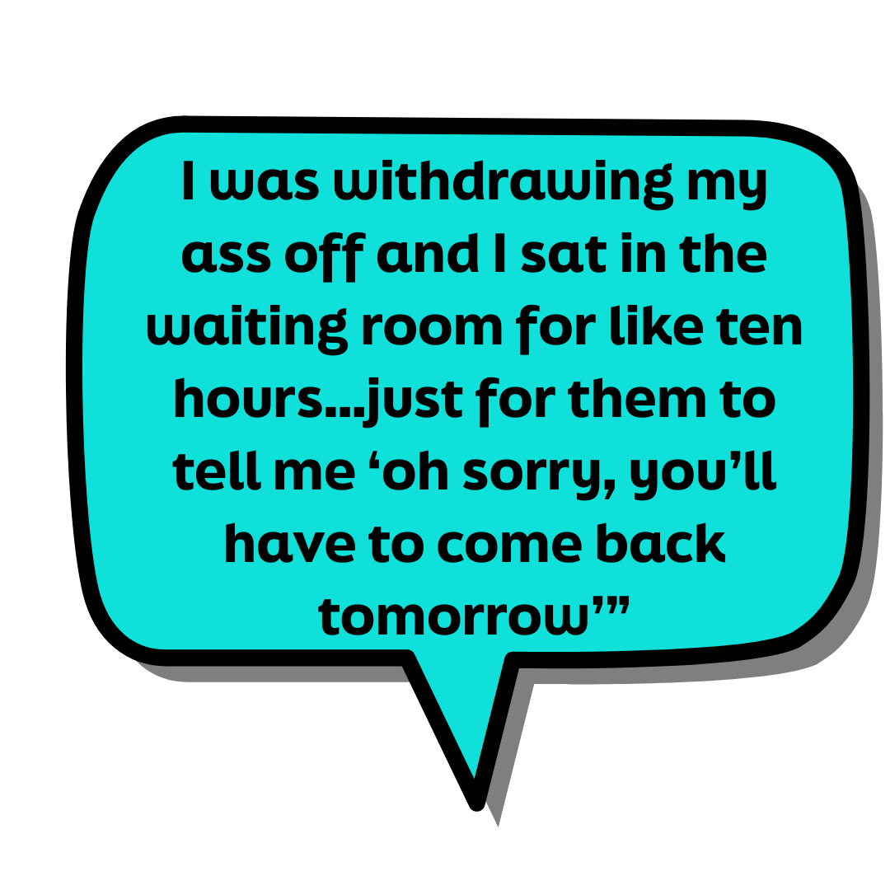
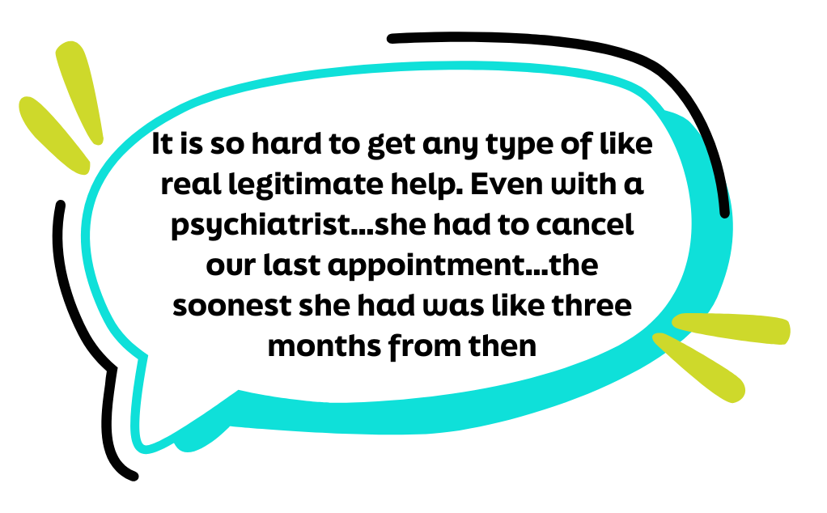
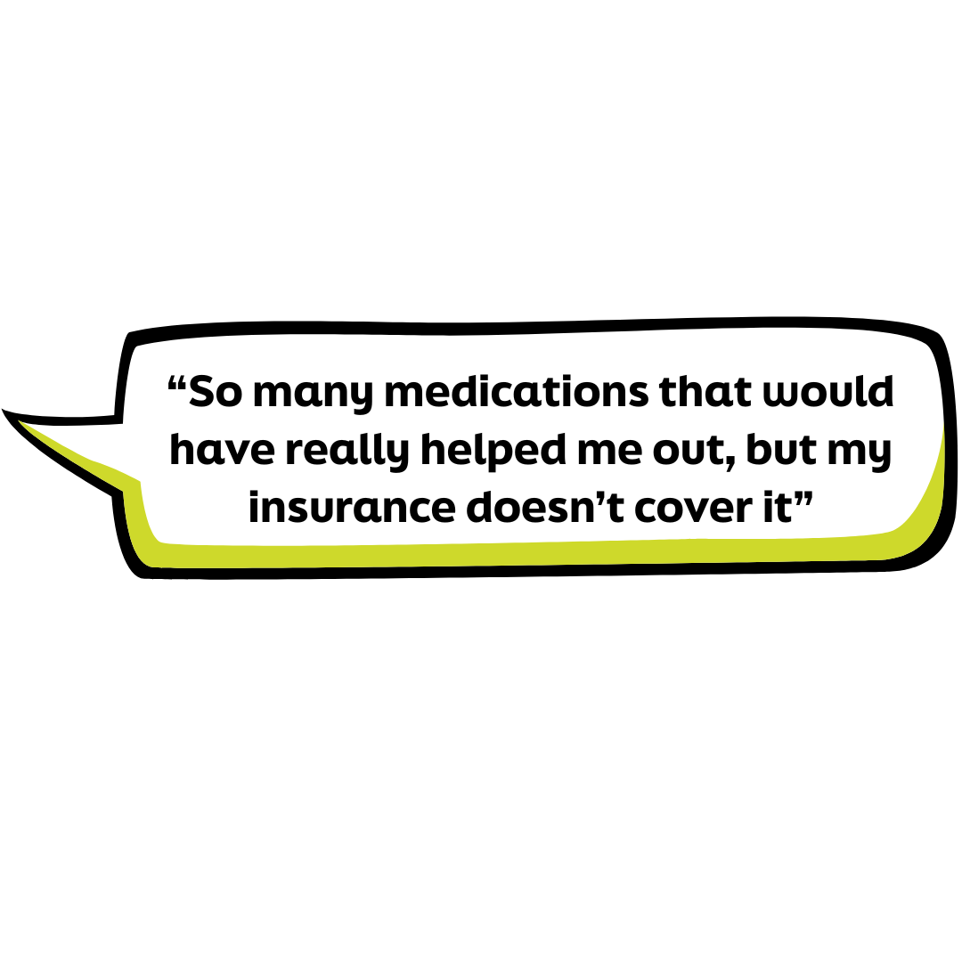
How Youth Perceive Barriers

Slide 28
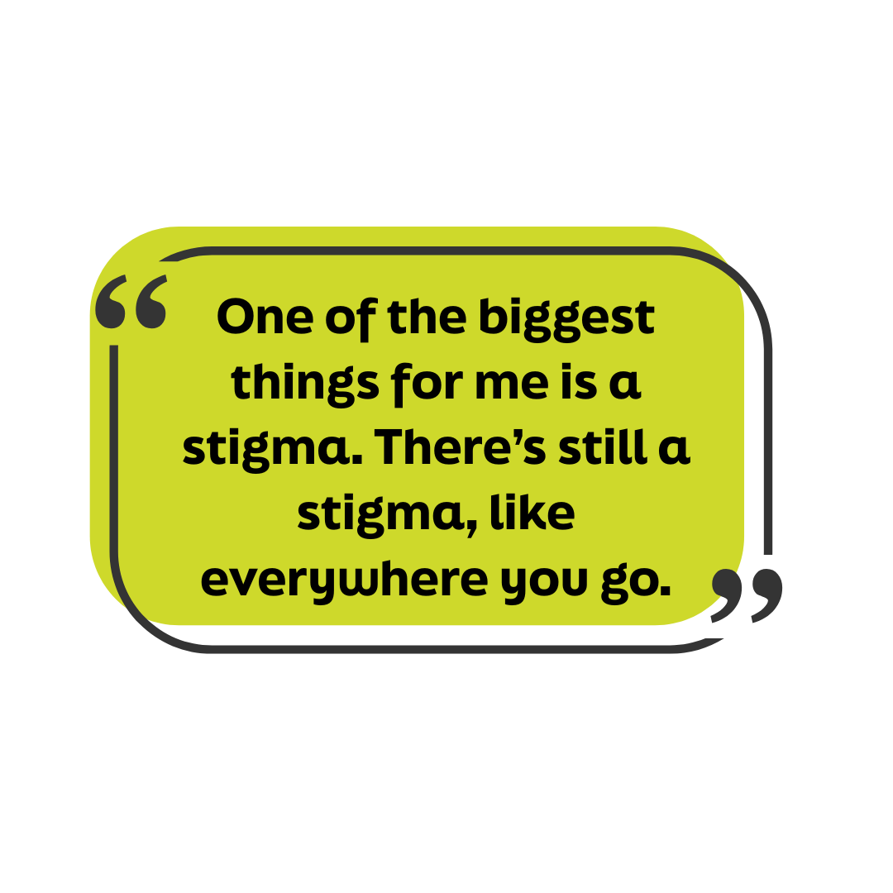
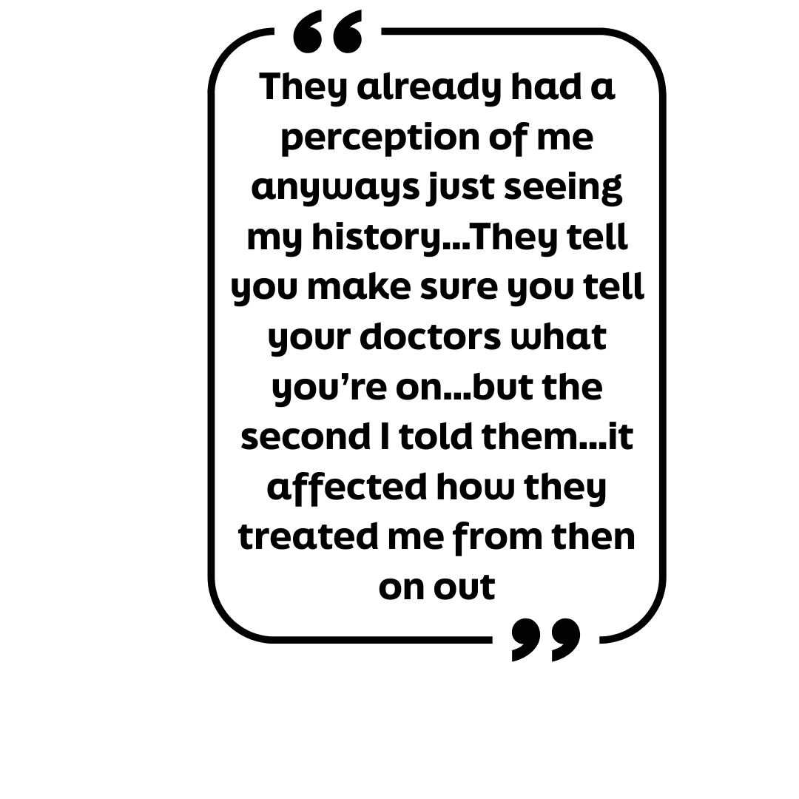
Experiencing Stigma

Slide 29

Developmental & Cultural Considerations
Confirm capacity to consent ¹³
  Use Den Hartogh's four factors
Consider the support system
Address social determinants of health
Recognize differentiated normalization ³
Acknowledge impact of the drug war on communities
³ Friedman et al., 2022
¹³ Shircliff et al., 2024
Notes:
Consent involves providing information about benefits, risks, and alternative treatment to a youth (Shircliff et al., 2024)
One study found that parent related barriers accounted for 1/3 of youth who did not successfully connect to mental health treatment
Laws have changed around age of consent, varying by state as the field recognizes barriers youth face
It's critical to be able to evaluate if a youth has the ability to consent and is choosing to do so by their own choice
Consider Den Hartogh's four factors to assess ability to consent (Rowan as cited by Shircliff et al., 2024)
Youth's recognition of outcomes for enrolling in treatment
Level of importance of treatment to the youth
How autonomy would be violated by blocking individual consent to treatment
Decision making ability as defined by state law
Outcomes are most effective when the support system is involved (Shircliff et al., 2024)
Understand the youth's definition of support system rather than making assumptions
Understand the social determinants of health that impact the youth being supported and consider how these may be barriers to successful harm reduction care
Along with the previous point, recognize what the drug culture is within the youth's sphere
Always consider how the drug war and it's messaging have impacted the way youth and their support system view substance use and treatment
Treatment could be seen as punitive

Slide 30
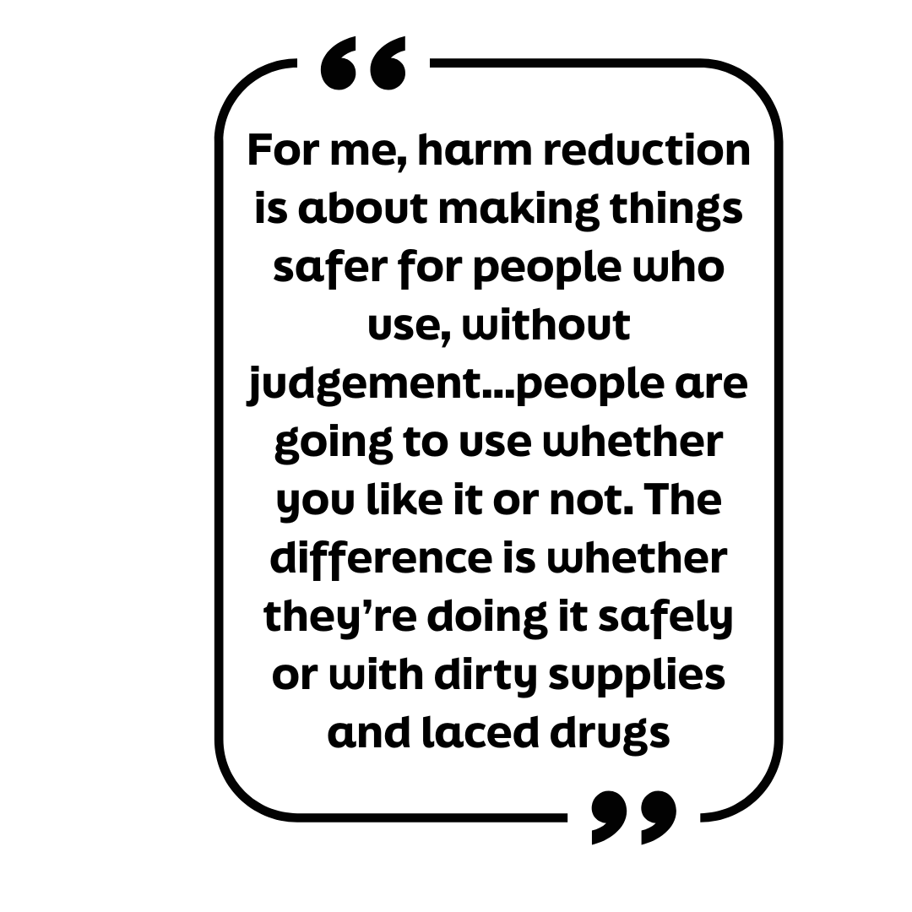
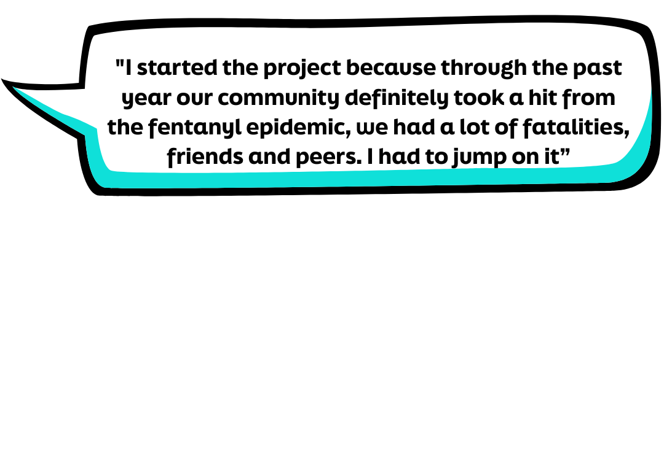
"Nothing About Us, without Us"
Teens prefer harm reduction services to occur at school ¹⁸
Naloxone and Community messaging projects
¹⁸ Witt et al., 2024
Notes:
Natalie petitioned her school board as a sophomore to stock Narcan in bathrooms at school, no questions asked.
"We get a lot of Narcan donated, I personally keep the bathrooms restocked and keep up flyers"
"In the past 2 years, there have been less overdoses, a lot less people using in general"

Slide 31
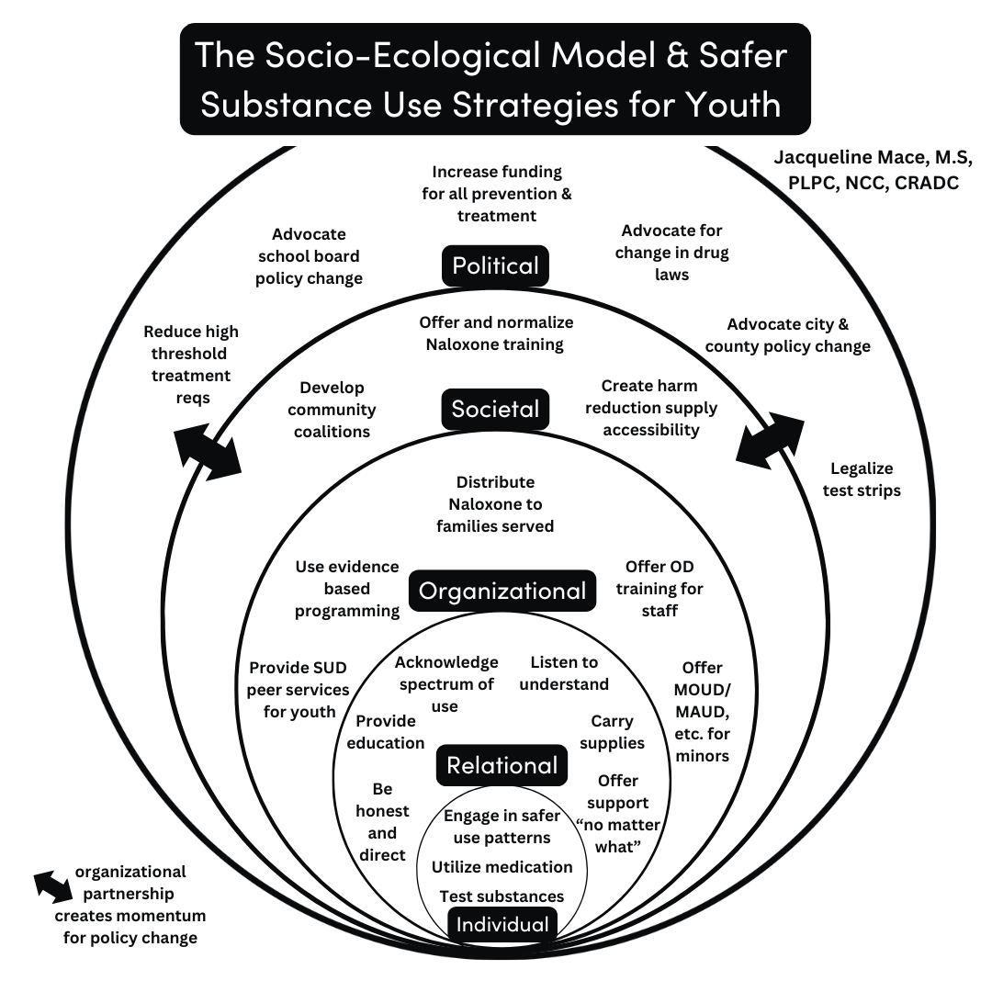
Jacqueline Mace, M.S, LPC, NCC, CRADC
Notes:
There is harm reduction to be done at every level.
Interplay between organizational, societal and political levels of engagement.
When organizations work together, they are able to address societal changes. That provides momentum and backing for larger shifts in policy.
Individuals and organizations CAN NOT engage in harm reduction without partnering with other like-minded organizations. That is how we answer the call for ethical change.
Tanz, et al (2021) highlight the need for :
" Community-based coalitions, in collaboration with public health entities, can work with schools, physicians, youth-serving organizations, faith-based institutions, and the media to emphasize these messages, support naloxone training and access, and address stigma". If your organization is not engaging in the work at a community level, it's time to rethink the work and either find a local coalition to join, or start one.

Slide 32
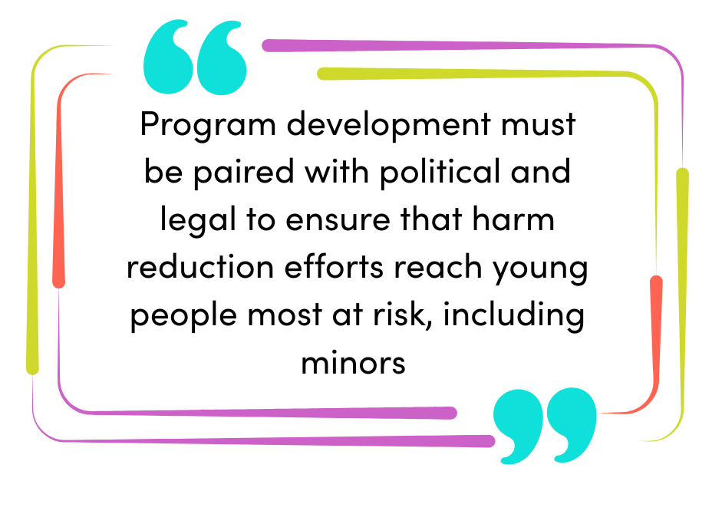
Ethical Considerations
Know local laws (https://www.teenhealthlaw.org/)
Consult 42 CFR Part 2 ¹³
When ethics and law conflict, consult and document
Youth, especially YWUD, input is critical, not optional
⁹
9 Kimmel et al., 2021, p. 7
¹³ Shircliff et al., 2024
Notes:
Know your local laws
Utilize your liability insurance and your peers when in doubt about the application of a law
Understand Title 42 of the Code of Federal Regulations, Part 2 which provides guidance for protection of substance use treatment information in addition to HIPAA laws (Shircliff et al., 2024)
Explore your personal boundaries, your bias, what situations would result in discomfort so you can be aware of your reactions in real time
Ethics and law WILL conflict. Have a reliable list of peers who understand the nuances of treatment and youth confidentiality
Treat youth involvement as ethically mandatory, rather than ethically aspirational
Get political! Within the bounds of your position and legal limitations

Slide 33
Confidentiality & the Youth Provider
Provide informed consent early (at first contact) and often
Be direct and specific with youth about your legal and ethical duty
When ethical dilemma arises, consult with other professionals
Utilize professional code of ethics and ethical decision-making models
Consider whether the harm from not disclosing outweighs the possible harm of disclosure
When ethical and legal guidelines require disclosure-allow to occur on youth's terms
Offer to disclose together, allow youth to lead if comfortable, role play to practice

Slide 34

Cash is a 16-year-old, Latinx male who has been using fentanyl daily for about 6 months. He reports being introduced by a friend thinking he was using Xanax. He later learned the pills were pressed with fentanyl. He recently progressed to crushing and snorting the pills. Cash reports little support at home where he lives with his father and 8-year-old sister. He states he does not want his dad to know about his use. He is worried his use will result in failing school and ruin his chance to attend nursing school. He reports he's tried to stop before but is terrified of getting sick. He is interested in trying MOUD.
What considerations might come up in treating this youth based on what we have discussed today?
Putting it into Practice – Case Study

Slide 35
Final Thoughts
Youth substance use is a normal part of development, so we need harm reduction strategies that prioritize safety, meet youth where they’re at, respect their autonomy
While overall youth drug use is decreasing, overdose deaths are rising, especially among marginalized youth
Barriers to harm reduction include stigma, focus on abstinence, legal and ethical challenges, limited access to resources
Harm reduction for teens includes many of the same tools used for adults, such as education, naloxone, fentanyl/test strips, medications for substance use disorder, safer use behaviors
Effective & ethical intervention must consider teen brain development, cultural background, systemic inequity, youth involvement in shaping harm reduction practices
Notes:
While youth drug use has decreased and continues to decrease, experimentation with substances has become more deadly for youth. Youth are at high risk of fatal overdose and while overdose deaths are preventable, in many cases, individuals are not prepared to act.
Recent research conclude necessity of adolescent harm reduction education, improved access to naloxone, and MH and SUD services (Friedman et al., 2022; Witt et al., 2024)

Slide 36

Resources
Talking with Teens
  The National Council- Getting Candid Project
  Safety First: Real Drug Education for Teens
Harm Reduction/Safer Strategies
  dancesafe.org
  harmreduction.org
  partysaferwithjess.com
Ethics
  TeenHealthLaw.org
  Forester-Miller and Davis’ Ethical Decision Making Model

Slide 37
References
¹ CHOC. (2023, August 29). What parents should know about over-the-counter naloxone (Narcan) nasal spray. CHOC - Children’s Health Hub. https://health.choc.org/what-parents-should-know-about-over-the-counter-naloxone-narcan-nasal-spray/
² Cima, R. (2022, March 20). Dare: The anti-drug program that never actually worked. Priceonomics. https:/priceonomics.com/dare-the-anti-drug-program-that-never-actually/
³ Friedman, J., Godvin, M., Shover, C. L., Gone, J. P., Hansen, H., & Schriger, D. L. (2022). Trends in Drug Overdose Deaths Among US Adolescents, January 2010 to June 2021. JAMA, 327(14), 1398–1400. https://doi.org/10.1001/jama.2022.2847
⁴ Hansen, W. B., Beamon, E. R., Saldana, S., Kelly, S., & Wyrick, D. L. (2023). D.A.R.E./keepin' it REAL elementary curriculum: Substance use outcomes. PloS one, 18(4), e0284457. https://doi.org/10.1371/journal.pone.0284457

Slide 38
References
⁵ Hermans, S. P., Samiec, J., Golec, A., Trimble, C., Teater, J., & Hall, O. T. (2023). Years of Life Lost to Unintentional Drug Overdose Rapidly Rising in the Adolescent Population, 2016-2020. The Journal of adolescent health : official publication of the Society for Adolescent Medicine, 72(3), 397–403. https://doi.org/10.1016/j.jadohealth.2022.07.004
⁶ Heward, B. J., Yule, A. M., & Jackson, P. R. (2024). How should harm reduction strategies differ for adolescents and adults? AMA journal of ethics, 26(7). https://doi.org/10.1001/amajethics.2024.534
⁷ Hill, L. G., Zagorski , C. M., & Loera, L. J. (2022). Increasingly powerful opioid antagonists are not necessary. International Journal of Drug Policy, 99. https://doi.org/10.1016/j.drugpo.2021.103457.
⁸ Jenkins, E. K., Slemon, A., & Haines-Saah, R. J. (2017). Developing harm reduction in the context of youth substance use: insights from a multi-site qualitative analysis of young people's harm minimization strategies. Harm reduction journal, 14(1), 53. https://doi.org/10.1186/s12954-017-0180-z
⁹ Kimmel, S. D., Gaeta, J. M., Hadland, S. E., Hallett, E., & Marshall, B. D. L. (2021). Principles of harm reduction for young people who use drugs. Pediatrics, 147(Suppl 2), S240–S248. https://doi.org/10.1542/peds.2020-023523G

Slide 39
References
¹⁰ Lum, A., Damianidou, D., Bailey, K. et al. (2023). SMART recovery for youth: a small, exploratory qualitative study examining the potential of a mutual-aid, peer support addictive behaviour change program for young people. Addict Science Clinical Practice 18, 30 (2023). https://doi.org/10.1186/s13722-023-00379-w
¹¹ Miech, R. A., Johnston, L. D., Patrick, M. E., O’Malley, P. M. (2024). Monitoring the future national survey results on drug use, 1975–2024: Overview and detailed results for secondary school students (PDF). Monitoring the Future Monograph Series.
¹² National Harm Reduction Coalition. (2025, March 17). https://harmreduction.org/
¹³ Shircliff, K. R., Cummings, C., & Borgogna, N. C. (2024). Ethical Considerations in Substance Use Treatment for Youth: Assessing Clinical Practices and Policy Frameworks for Potential Harm. Research on child and adolescent psychopathology, 10.1007/s10802-024-01274-x. Advance online publication. https://doi.org/10.1007/s10802-024-01274-x
¹⁴ Sloyer, W., Stark, A., Woods-Razaa, J., Halliday, T., Peterson, F., & Pietruszewski, P. (2023). Results from national assessment data: Insights into effective substance use prevention messaging for youth. National Council for Mental Wellbeing. Retrieved from: https://www.hhs.nd.gov/sites/www/files/documents/BH/Prevention/Getting%20Candid%20Findings%20Report.pdf

Slide 40
References
¹⁵ Society for Adolescent Health and Medicine. (2021). Medication for adolescents and young adults with opioid use disorder. Journal of Adolescent Health, 68(3), 632–636. https://doi.org/10.1016/j.jadohealth.2020.12.129
¹⁶ Tanz, L. J., Dinwiddie, A. T., Mattson , C. L., O’Donnell, J., Davis, N. L. (2022). Drug overdose deaths among persons aged 10–19 years — United States, July 2019–December 2021. Morbidity and Mortality Weekly Report 71(50), 1576–1582. DOI: http://dx.doi.org/10.15585/mmwr.mm7150a2
¹⁷ West, S. L., & O'Neal, K. K. (2004). Project D.A.R.E. outcome effectiveness revisited. American journal of public health, 94(6), 1027–1029. https://doi.org/10.2105/ajph.94.6.1027
¹⁸ Witt, L. B., Greenberg, J., & Cantone, R. E. (2024). Harm reduction and substance use in adolescents. Primary care, 51(4), 629–643. https://doi.org/10.1016/j.pop.2024.05.005
¹⁹ World Health Organization. (n.d.). Adolescent health. World Health Organization. https://www.who.int/health- topics/adolescent-health/#tab=tab_1

Slide 41
Let's Keep the Conversation Going
Thank you for attending! For questions, comments or a copy of the slides, please reach out. I'd love to connect with you!
Jacqueline Mace
jmace@elliementalhealth.com

